Slide 1
Advocacy 101
How to not be terrified, overwhelmed or befuddled

Slide 2
Introductions….
WHO ARE YOU
WHY ARE YOU HERE TODAY
WHAT IS ONE THING YOU REALLY LOVE AND WHY?

Slide 3
What is advocacy
Advocacy is defined as any action that speaks in favor of, recommends, argues for a cause, supports or defends, or pleads on behalf of others.
Advocacy usually means getting support from another person to help you express your views and wishes. And to help you stand up for your rights. Someone who helps you in this way is called your advocate.
The aim of advocacy is to create change.
Advocacy is the act of promoting an idea with varying degrees of wanting to influence an outcome
Notes:
What do you hear in these definitions of advocacy? How is it different than what you think of advocacy as? How is it the same?

Slide 4
Why does the church advocate?
“As members of the ELCA, we believe that we are freed in Christ to serve and love our neighbor. God uses our hands, through our direct service work and our voices, through our advocacy efforts, to restore and reconcile our world.” –ELCA Advocacy
An effort to create long term change while providing short term solutions
Jesus wasn’t silent!!!!
Communion of the saints (UBUNTU!)
https://www.elca.org/our-work/publicly-engaged-church/advocacy
https://www.youtube.com/watch?v=F5bXlUXVixg

Slide 5
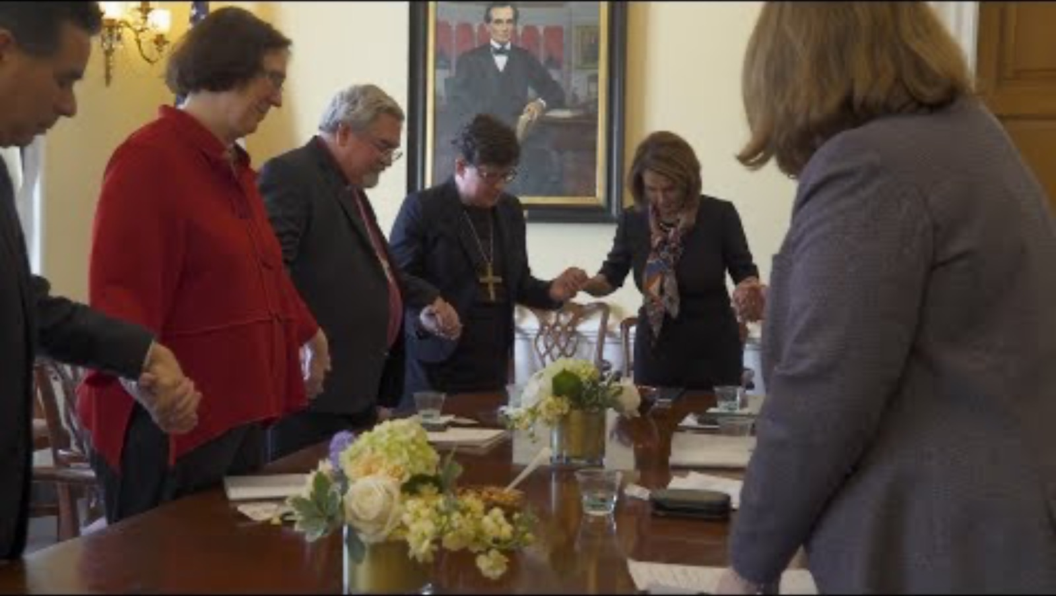

Slide 6
BUT….advocacy doesn’t work in a bubble
Accompaniment, walking together, do more good than harm
What do YOU need? How can I support you? (sometimes listening is advocacy!!!)
Showing up is advocacy (Al Taqwa fundraiser)
Advocate vs. savior. https://www.involvepeople.org/advocacy-vs-saviorism/
My story, your story, God’s story=OUR STORY (circles of accompaniment and inclusion)

Slide 7
Effective advocacy
We can’t be all things to all people. (make this your mantra!)
You advocate best about what is personal to you.-what’s your WHY
Not in it alone-network, network, network
Educate yourself-the more you know, the more effective you can be-and know that the education changes!!!
It’s a marathon, not a sprint (don’t set your goals on one thing)
Notes:
Immigration and palestne are personal to me-
People get paid to advocate so wrok with them
Pick your topic for today

Slide 8
Don’t
Apologize for your advocacy ”I’m sorry but…”
Speak in anger (be genuine but calm)
Proclaim why you are right and they are wrong (keep it conversational)
Give someone literature and handouts

Slide 9
Do
Practice until you are comfortable (tell your television what you think)
Have a buddy to check in with (this is hard stuff, sometimes even harder than talking to a legislator)
Keep it personal, share stories, build relationship (what’s your why)
Offer to continue conversation at another time
Know your facts
Find the right time for conversations

Slide 10
SHARE YOUR STORY
Stories are powerful bridge builders between people. Your stories matter, whether from your own life, your faith community, your school, your friends or even people you value but may not know well. This is the foundation of your advocacy work. You will use this to flesh out your message.
An elevator speech SHORT― the time it takes to ride an elevator with someone ― that draws that person into further conversation or connection. When you advocate you often don’t have lots of time.
ME (who am I, why does this matter to me), YOU (what do I want you to do?) WE (how can we work together?)

Slide 11
Create your message
ME
As a ________________ (parent, young adult, senior citizen, person with college debt), I am concerned about __________________(anti-trans legislation, immigrant and refguee rights, Palestinians) because __________________
YOU
As your ___________(friend, co worker, neighbor, constituent), I am asking you to __________( pray, learn more, come to this workship with me) because ___________________
WE
I hope that we can ___________________ (learn more, ask questions, work on this) together because ___________________________

Slide 12
Letter writing 101
You can be wordy in a letter (expand and expound)
This is a place for facts and resouces BUT
You still need to make it personal-include a picture or a personal story
Power in numbers-make it a campaign “I’m writing letters to support….and I invite you to join me)
Creativity is allowed (paper plate campaign)
Use your resources, then personalize!
E-mail AND snail mail
US office and state office (duplicate is fine)

Slide 13
WHERE DO I SHARE MY STORY??
THE ADVOCACY CHAIN
The issue I’d like to advocate for: ________________________________________________
THE target person who needs to hear about it
someone who has power to act: e.g the president of the church, the president of the USA, the mayor, the president of the HOA
Who does the target person listen to? (Secondary influencers)
This could be specific names, it could be special interest groups, it could be customers or stakeholders or constituents-list as MANY as you can!)
Who do the secondary influencers listen to? (tertiary influencers)
Who do the tertiary influencers listen to?
Repeat as needed until you arrive at…..the top of the chain-your target

Slide 14
The advocacy map
From your chart you can build a map or a web
Keeps you on target so you don’t spin your wheels
Cohesive plan-are you reaching all the way to the top?? If not, what’s missing?
Include the 5 W’s in your map/web
ACCOUNTABILITY-find a friend to share your map with

Slide 15
Don’t Lose Medicaid!!!!-Gretchens Advocacy Map for June
What | When | Where/what | Why | Who
Rally | June 1 | Lincoln capital | Large group | State legislators
Letter to the editor | June 15 | Lincoln Journal Star | Encourage others to join the fight | Other constituents
Calls to us senators | Every Monday and Wednesday in June over lunch | My office-use the 5 calls app | They need to hear my voice over and over again | US Senators
Sign up for advocacy groups | One group each week on Tuesdays (e.g preserve Medicaid.com) | At night, on my couch-do my research | Build the network | Lobbyists, US legislators, the President
Connect with an advocacy group to ask what I can do | June 24 | Start with Linda Timmons | Build the network | Lobbists and legislators

Slide 16
How to write a letter
https://www.riaclu.org/en/publications/advocacy-101-how-write-your-legislator
Writing an Email to Stakeholders/Legislators
✓ Some organizations have setup action alerts to make it simple for you to send an email to decision-makers who set policy and make laws.
✓ When you receive an action alert, personalize the message with one or two sentences and send it.
✓ If you have a personal story about tied to the issue, share it in your email.
✓ When legislators receive hundreds of personalized messages about a certain issue, they’re more likely to notice and take action

Slide 17
More tips
Be sure to let the decision-maker know where you live (city, state) and why you feel so strongly about the issue.
✓ Encourage the decision-maker to respond and let you know their position on the issue.
✓ It’s best to send letters to members of Congress to the local district office rather than to Washington, D.C., where mail is processed for safety and delivery can be delayed. ✓ Keep your organization partners up to date on how your communication efforts are going.

Slide 18
Writing for impact (expand your message)
Identify yourself as a constituent and person of faith. My name is Pastor Jane Doe, and I serve First Lutheran of Anytown, OH.
Identify the issue you care about. I write to you today because there are too many hungry kids in Anytown. (ME)
Express a common and shared value. It is immoral that so many hard-working families are struggling with hunger in our district. (WE)
Use a story to make it real. Last week, I learned that one of our families is watering down their childʼs milk to make it last longer due to not having enough money to make ends meet. (ME)
Use statistics sparingly. This family is not alone, more than 1 in 5 children in Ohio will experience hunger this year.
Always include what you want them to do. Please support the proposed expansion of cash assistance in HB 12345. This will help many hard working families to overcome barriers that are out of their control. (YOU)
NOTE THE ORDER CHANGE: ME, WE, YOU INSTEAD OF ME, YOU, WE

Slide 19
Who and when
When: often-before a bill enters committee, while in committee, on the floor
Who: your legislator, committee chair
https://www.govtrack.us/congress/bills/
https://www.congress.gov/bill/118th-congress/house-bill/9649/all-actions?overview=closed#tabs

Slide 20
Advocacy alerts (easy ways to do letters)
https://give.elca.org/page/56774/action/1?_ga=2.57520943.407686024.1741379658-732355457.1730835834
https://go.bread.org/page/80018/action/1?ea.tracking.id=tophat&_gl=1*1nqcr4p*_gcl_au*MTc4OTk3MTQ3Ni4xNzM4MzY5Mjg0
https://act.hrc.org/page/18408/data/1?locale=en-US

Slide 21
Practice…..(flesh out your message more!)
Dear _____
I am __________ (who are you, including location!)
I am writing today because I care about __________(identify the issue AND the corresponding bill).
This matters to _________ (common audience e.g. Nebraskans) because ________
It is personally important to me because _____________________
Here are some important things to consider (Insert facts here)
And so I urge/ask/request (action verb) you to _______(vote yes, vote no, sponsor) ______(name of bill or action requested)
Thank you and call for follow up

Slide 22
Social media
Don’t just share stuff, make sure it has a message or an ask
Memes create drama, not action
Research before you share (especially if it’s something you are passionate about)
Where did the message come from? And who is sharing it?
Keep it personal
Set your boundaries before you post, but allow for discussion
Use what is shared by those you are advocating for and with (accompaniment-e.g. LFS)-be a network partner to grow the message

Slide 23
Social media continues
Use hashtags as appropriate
Know others social media and use (legislators, local, public media)
Keep your message consistent and don’t clog it up (16 shares a day gets you blocked!)
PLAY NICE!
https://www.facebook.com/PeteRickettsNE
https://www.facebook.com/ELCAammparo
Notes:
Transgender mice

Slide 24
Phone calLs
Not as scary as you might think. Really, they aren’t.
Give yourself a script, but don’t recite like a robot
Be specific (this is the difference between a letter and a phone call!)
Call often, vary message slightly
Passionate but polite
Short and sweet (often leaving a message for a person checking a box)
BE CLEAR IN YOUR ASK

Slide 25
PHONE CALLS
Call DC, call local offices, call the white house switch board
It’s ok to leave a voicemail but ask for a callback!!!
Persistent and consistent!!!
Always thank the person on the phone
It’s ok if you stutter, stumble or mumble. You are human, this is real.
Use your resources, but make it personal

Slide 26
Hook, Line and sinker….
Hook: Hello my name is and I’m one of your constituents residing in ________
Line: I’m calling today because _____________(this is your why-make it compelling you only have 1 minute max to “reel them in”
Sinker: And so I ask you to _______________ (direct ask!)
Close with a thank you and be sure they have your contact info

Slide 27
Scripts and phone numbers
https://5calls.org/

Slide 28
Practice time…..One more way to adapt your message
Hook: I am
Line: why should you care
Sinker: Asking you to __________(VERY SPECIFIC!!!)
Your connection
Repeat the sinker!!!!!!

Slide 29
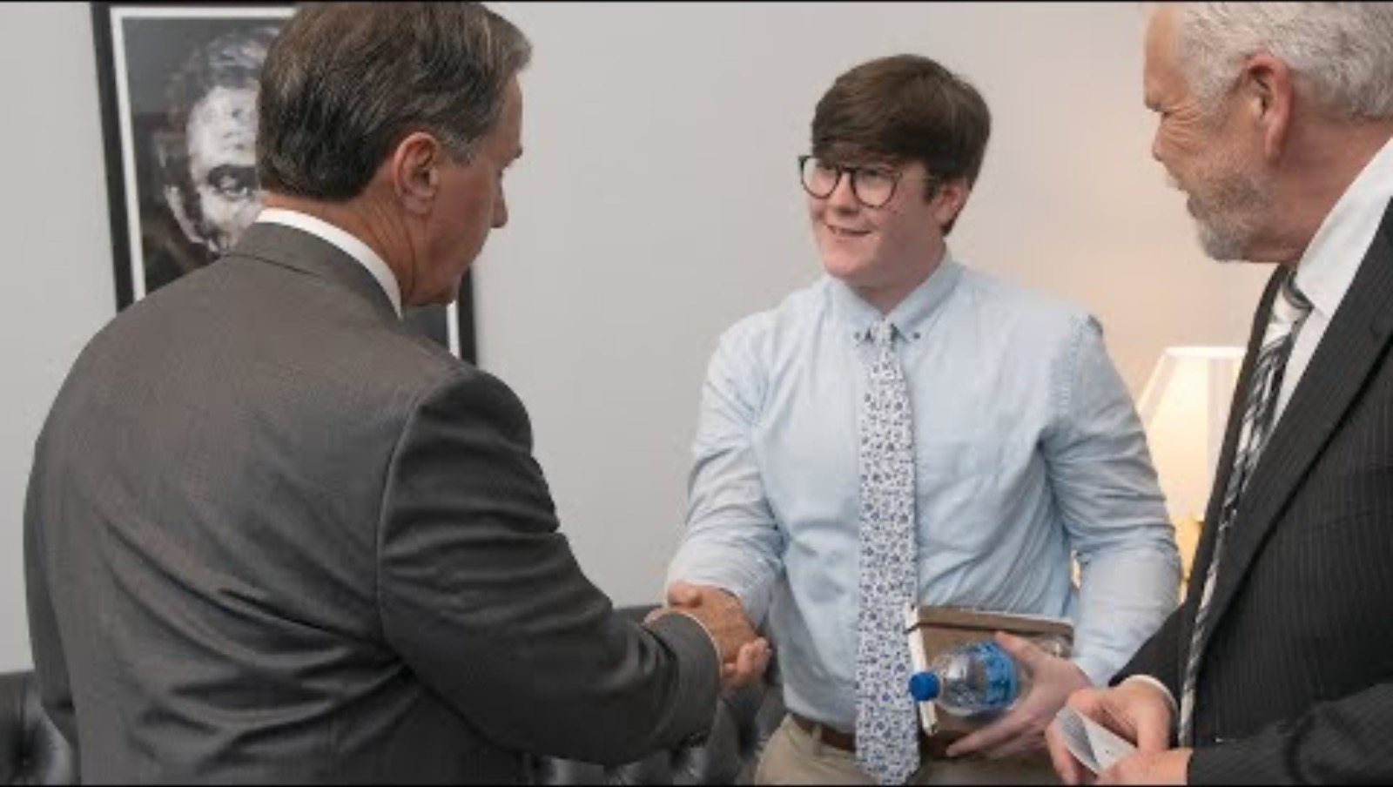
In Person advocacy

Slide 30
Where to start
Reach out to agencies who are already doing it (Much harder to make this connection on your own!)
Many have the facts, but need the personal story and that’s where YOU come in
Virtual zoom advocacy works too
Power in numbers
Always be respectful
Middle level staffers are GOLD! (they get you up that chain)

Slide 31
You don’t have to do it alone
Town Halls
Lutheran Advocacy Days
Ask your local office when your legislator will be meeting with people
In Nebraska, you can also submit a comment to be read: https://nebraskalegislature.gov/bills/view_bill.php?DocumentID=58857

Slide 32
Gretchen’s go-to resources
5 calls
Ne Appleseed
Civic Nebraska
Bread For the World
ELCA Advocacy
LAMPA: https://www.lutheranadvocacypa.org/get-involved/
LOPPW: https://www.loppw.org/resources/advocacy/

Slide 33
What can’t I do??? Professional boundaries
Social statements are your guide
It’s OK to advocate as YOU, just know the difference and be clear about who you are representing. (When do you use your title?)
Only advocate on behalf of your employee/congregation if it’s clear you are all on the same page and it fits within the mission/vision and values of the org
Be clear about what you do on your own time and what is done “on the clock” (might even keep a log)
Personal e-mail, personal phone, personal resources for personal advocating

Slide 34
Political, not partisan
When ***acting on behelf of the church****
  Advocate for issues not people
  Non partisan discussions and educational events are ok
  Conversations centered around ”hot topics” are ok. (Know your social statement or invite the Bishop!)
  Get out the vote, civic engagement events are ok
  Not OK: Asking a candidate to pledge support for a religious denomination’s position on an issue, publicizing a candidate’s position on an issue, or publicizing a candidate’s independent decision to support or oppose the denomination’s position.
  Claiming your faith in your advocacy is OK (as a person of faith, I believe) as long as it matches up with the social statements.
  Not OK: posting or sharing partisan or political propaganda

Slide 35
Build relationships
What will encourage conversation in your congregation and what will make people shut down?
Just because I can, doesn’t mean I should. (e.g. a yard sign at my own house)
https://elcamediaresources.blob.core.windows.net/cdn/wp-content/uploads/Being_A_Public_Church.pdf (page 5-6)
Remember, we all have different opinions and that’s good!

Slide 36
For support when the going gets tough…
Join an advocacy group (or groups) of like minded individuals (50501, blue dot, etc)
Have an accountability buddy (NOT from your community or church, someone you can talk to outside the situation)
Don’t do advocacy in isolation (have a letter writing party)
Reach out to the synod office
The Everyday Advocate by Ross Murry
Nadia Bolz Weber: What’s mine to hold?

Slide 37
THANK YOU!!!!
Never doubt that a small group of thoughtful committed individuals can change the world. In fact, it's the only thing that ever has.” (Margaret Mead)

