Slide 1
Imagining Creative Ideas for Use in Worship
Sarah Effken Purcell
Nebraska Synod Council Member
Grace Lutheran Church, Cook, Nebraska
Notes:
Welcome! I’m …..
My husband and I participated in the Nebraska Synod Vision trip to Tanzania in 2024. While driving through Tanzania, we had several conversations with Pastor Priscilla and Pastor Sandra about creative additions to the worship service.
This presentation will include: 1) some of those ideas, 2) plus creative ideas my pastor has utilized, 3) as well as other pastors within the Nebraska Synod.
The handout lists 18 creative ideas to enhance your worship experience. If you are interested in the prayers, blessings, service and/or complete information, please email me at the email address listed at the top of your handout. The pastors who have shared their ideas are listed also on the front page of the handout. On the back, you have a space to write notes, plus a star pattern.

Slide 2
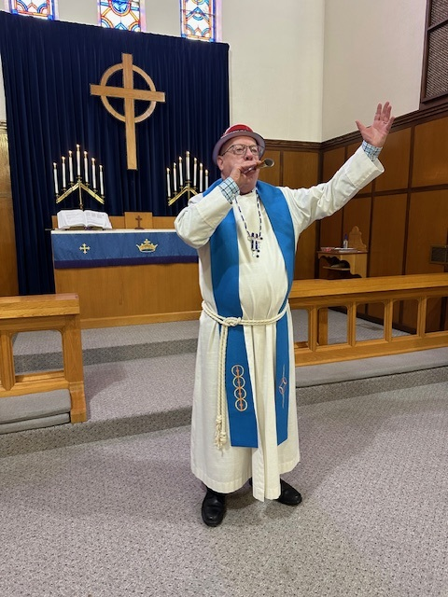
Happy New Year!
Celebrate the beginning of the church New Year – the first Sunday in Advent!
Party horns for the children
Makes a great children’s message
Notes:
This is a fun way to begin the new church year!
Party horns – give to the kids

Slide 3
Chalking the Door
Notes:
In Epiphany, chalking the door is a way to mark our church and/or our home with sacred signs and symbols as we ask God’s blessings upon those who live, work, or visit throughout the coming year.
The 3 Wise Men, Caspar (C), Mal-cheer (M), and Bal-tha-zar (B) followed the star to Bethlehem and the Christ child two thousand (20) and twenty-five years (25) ago. Those are signs of the cross in between, not plus signs!
A liturgy and prayers are available if you email me.

Slide 4
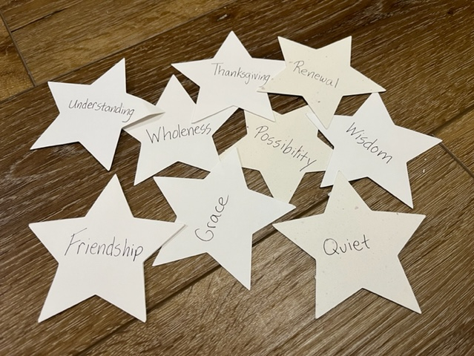
Epiphany Star Words
Our turn to be led by a star
Paper cutout with a word written on the star
Distribution? Our middle-school age children handed them out after church - they were face down in an offering plate
Guiding word for the year
Keep, trade, or pick another word
Notes:
7” star pattern on the side with your notes
Could purchase post-it notes in the shape of stars!
Email me for a list of epiphany star words!

Slide 5
Baseball Opening Season
Be a member of team Jesus Christ
Sew “JC” on a baseball shirt
You play for the name on the front of the jersey, not the name on the back
“Being on Jesus’ team” could be reflected in the sermon theme
Notes:
In the spring – end of March

Slide 6
Seed, Soil, and Water Blessings
Notes:
This is one of my favorite Sundays – the sun shines through the stained-glass windows on the seed, soil, and water, which are blessed by pastor during the Children’s message. This is also called Rogation Sunday.
My favorite part however is the prayer, so let’s stand, face North, and do a part of the prayer!
Email me for hymn suggestions, the litany, and prayers

Slide 7
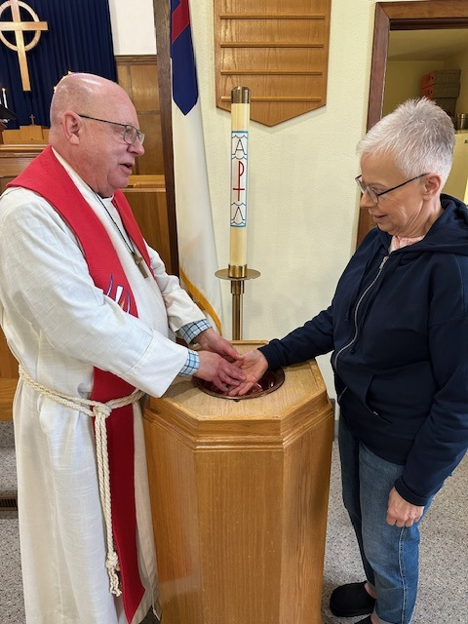
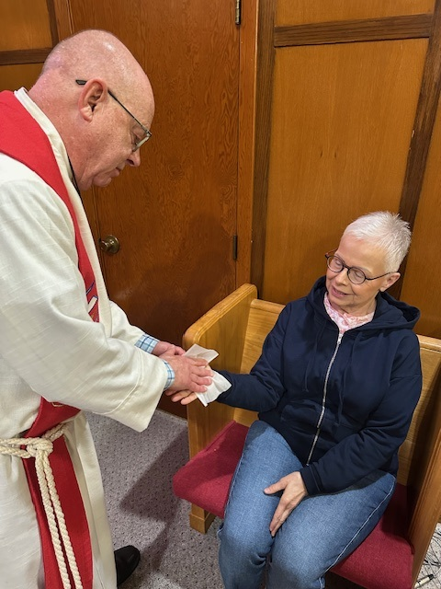
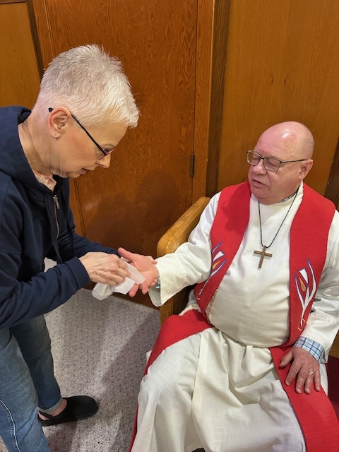
Maundy Thursday
Notes:
A foot washing is a sign of Jesus’ radical love for you. Some folks find it uncomfortable to have their feet washed, so hand washing can be done instead.
Hand washing, is a sign of God’s blessing for your service.
You can also use sanitation wipes to wipe the hands of another person, and then that person can return the act of humility. Each person has a wipe.

Slide 8
Holy Humor Sunday
Most Christians would agree that joy and laughter are important.
However, many people grow up worshiping in sanctuaries where laughter is frowned upon.
Joy and laughter can lead us to healing.
God’s grace can also come to us in the form of humor that helps us make it through another day.
Notes:
Holy Humor Sunday is traditionally the Sunday after Easter.
An entire Holy Humor Sunday service in bulletin form is available by email.

Slide 9
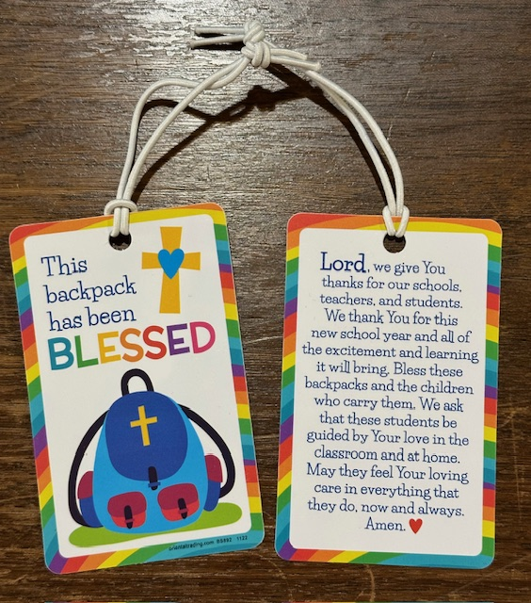
Blessing the Backpacks
Start the school year off with a Blessing of the Backpacks Sunday.
Great for blessing backpacks of students of all ages and teachers
Notes:
Available by email are two different blessings is available.

Slide 10
Community Partnerships
Our congregation asked for DQ free sundae coupons to go along with Blessing the Backpacks and our church sign
Any more ideas for partnerships?
Notes:
Give out coupons!

Slide 11
Highlighting Confirmation Student’s Bibles
The Sunday after the new confirmation students receive their new Bible from the church, ask them to return next Sunday with their new Bible.
Ask your church members to highlight their favorite verse(s) in each confirmation student’s Bible.
Remember to bring highlighters!
Notes:
Forewarn your congregation, and perhaps ask them to have several verses in mind, just in case someone else has already selected your verse.

Slide 12
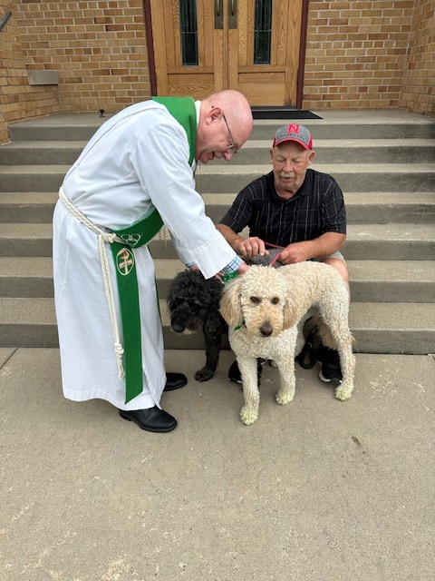
Blessing the Animals
Notes:
Francis of Assisi is associated with protection of animals. It’s customary for the Blessing of the Animals ceremony to happen on or around his feast day, which is October 4th.
Picture on the left is at my local church, while the picture on the right is at the UNL Lutheran Student Center. If a pet doesn’t feel comfortable in a large group, a picture can be brought instead. Pets are blessed, with a blessing can be given to all animals.
Treats for the animals could be given, as well as treats for the humans – hot dogs and cat whisker cookies!

Slide 13
All Hallow’s Eve Service
Notes:
Of course, this is a respectful service that can be done at a graveyard. It might be more appropriate to conduct outside your church building
1 Samuel 28: 3-25 is read with parts played by Saul, a woman, Samuel, a servant, and a narrator. These are the verses where Saul consults a medium who calls up Samuel.
Ezekiel 37:1-14 is also read with parts by Ezekiel and the Lord. These are the verses on “those dry bones.” The entire service is available by email.

Slide 14
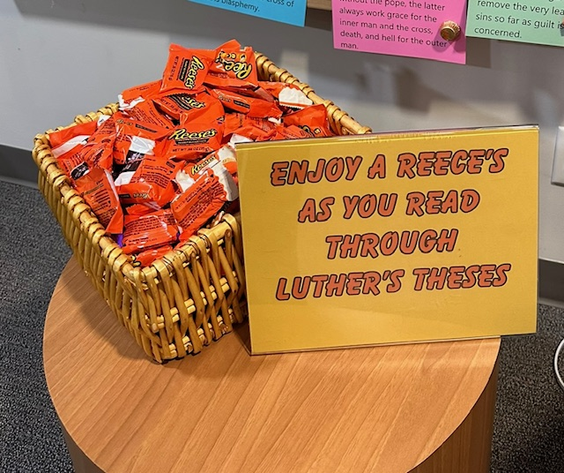
Reformation Sunday Festival
Notes:
Check out the posters on the wall!
Ask Taylor Swift or Martin Luther questions.

Slide 15
Taizé Service of Prayer
A Taizé pilgrimage is a Christian pilgrimage, particularly for young people to the Taizé Community in Burgundy, France
Individuals from diverse backgrounds and denominations come to worship, pray, work, and engage in spiritual reflection together
Noted for short songs that allow for meditation, many found in the Evangelical Lutheran Worship hymnal.
Notes:
Short songs, repeated again and again, give it a meditative character. Using just a few words they express a basic reality of faith, quickly grasped by the mind. As the words are sung over many times, this reality gradually penetrates the whole being. Meditative singing thus becomes a way of listening to God.
Silence makes us ready for a new meeting with God. In silence, God’s word can reach the hidden corners of our hearts. In silence, it proves to be “sharper than any two-edged sword, piercing until it divides soul from spirit.” Hebrews 4:12

Slide 16
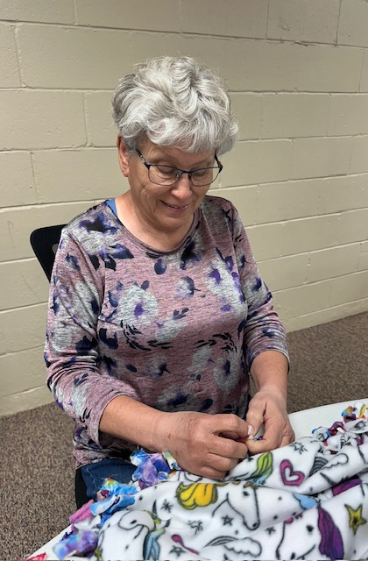
Prayer Stations
Prayers in the Sand – Ezekial 2:9-19
Around the World – Romans 8:22-23
Reflections – Psalm 139
Tie Blankets – Mark 10:45
Taking Your Prayers to the Cross – Matthew 11:28-30
Notes:
Need to ease people into prayer stations. Find people to help you make it happen.

Slide 17
An Offering Idea
Discovering new ways for members to give
There are many ways to give generously in addition to giving monetarily

Slide 18
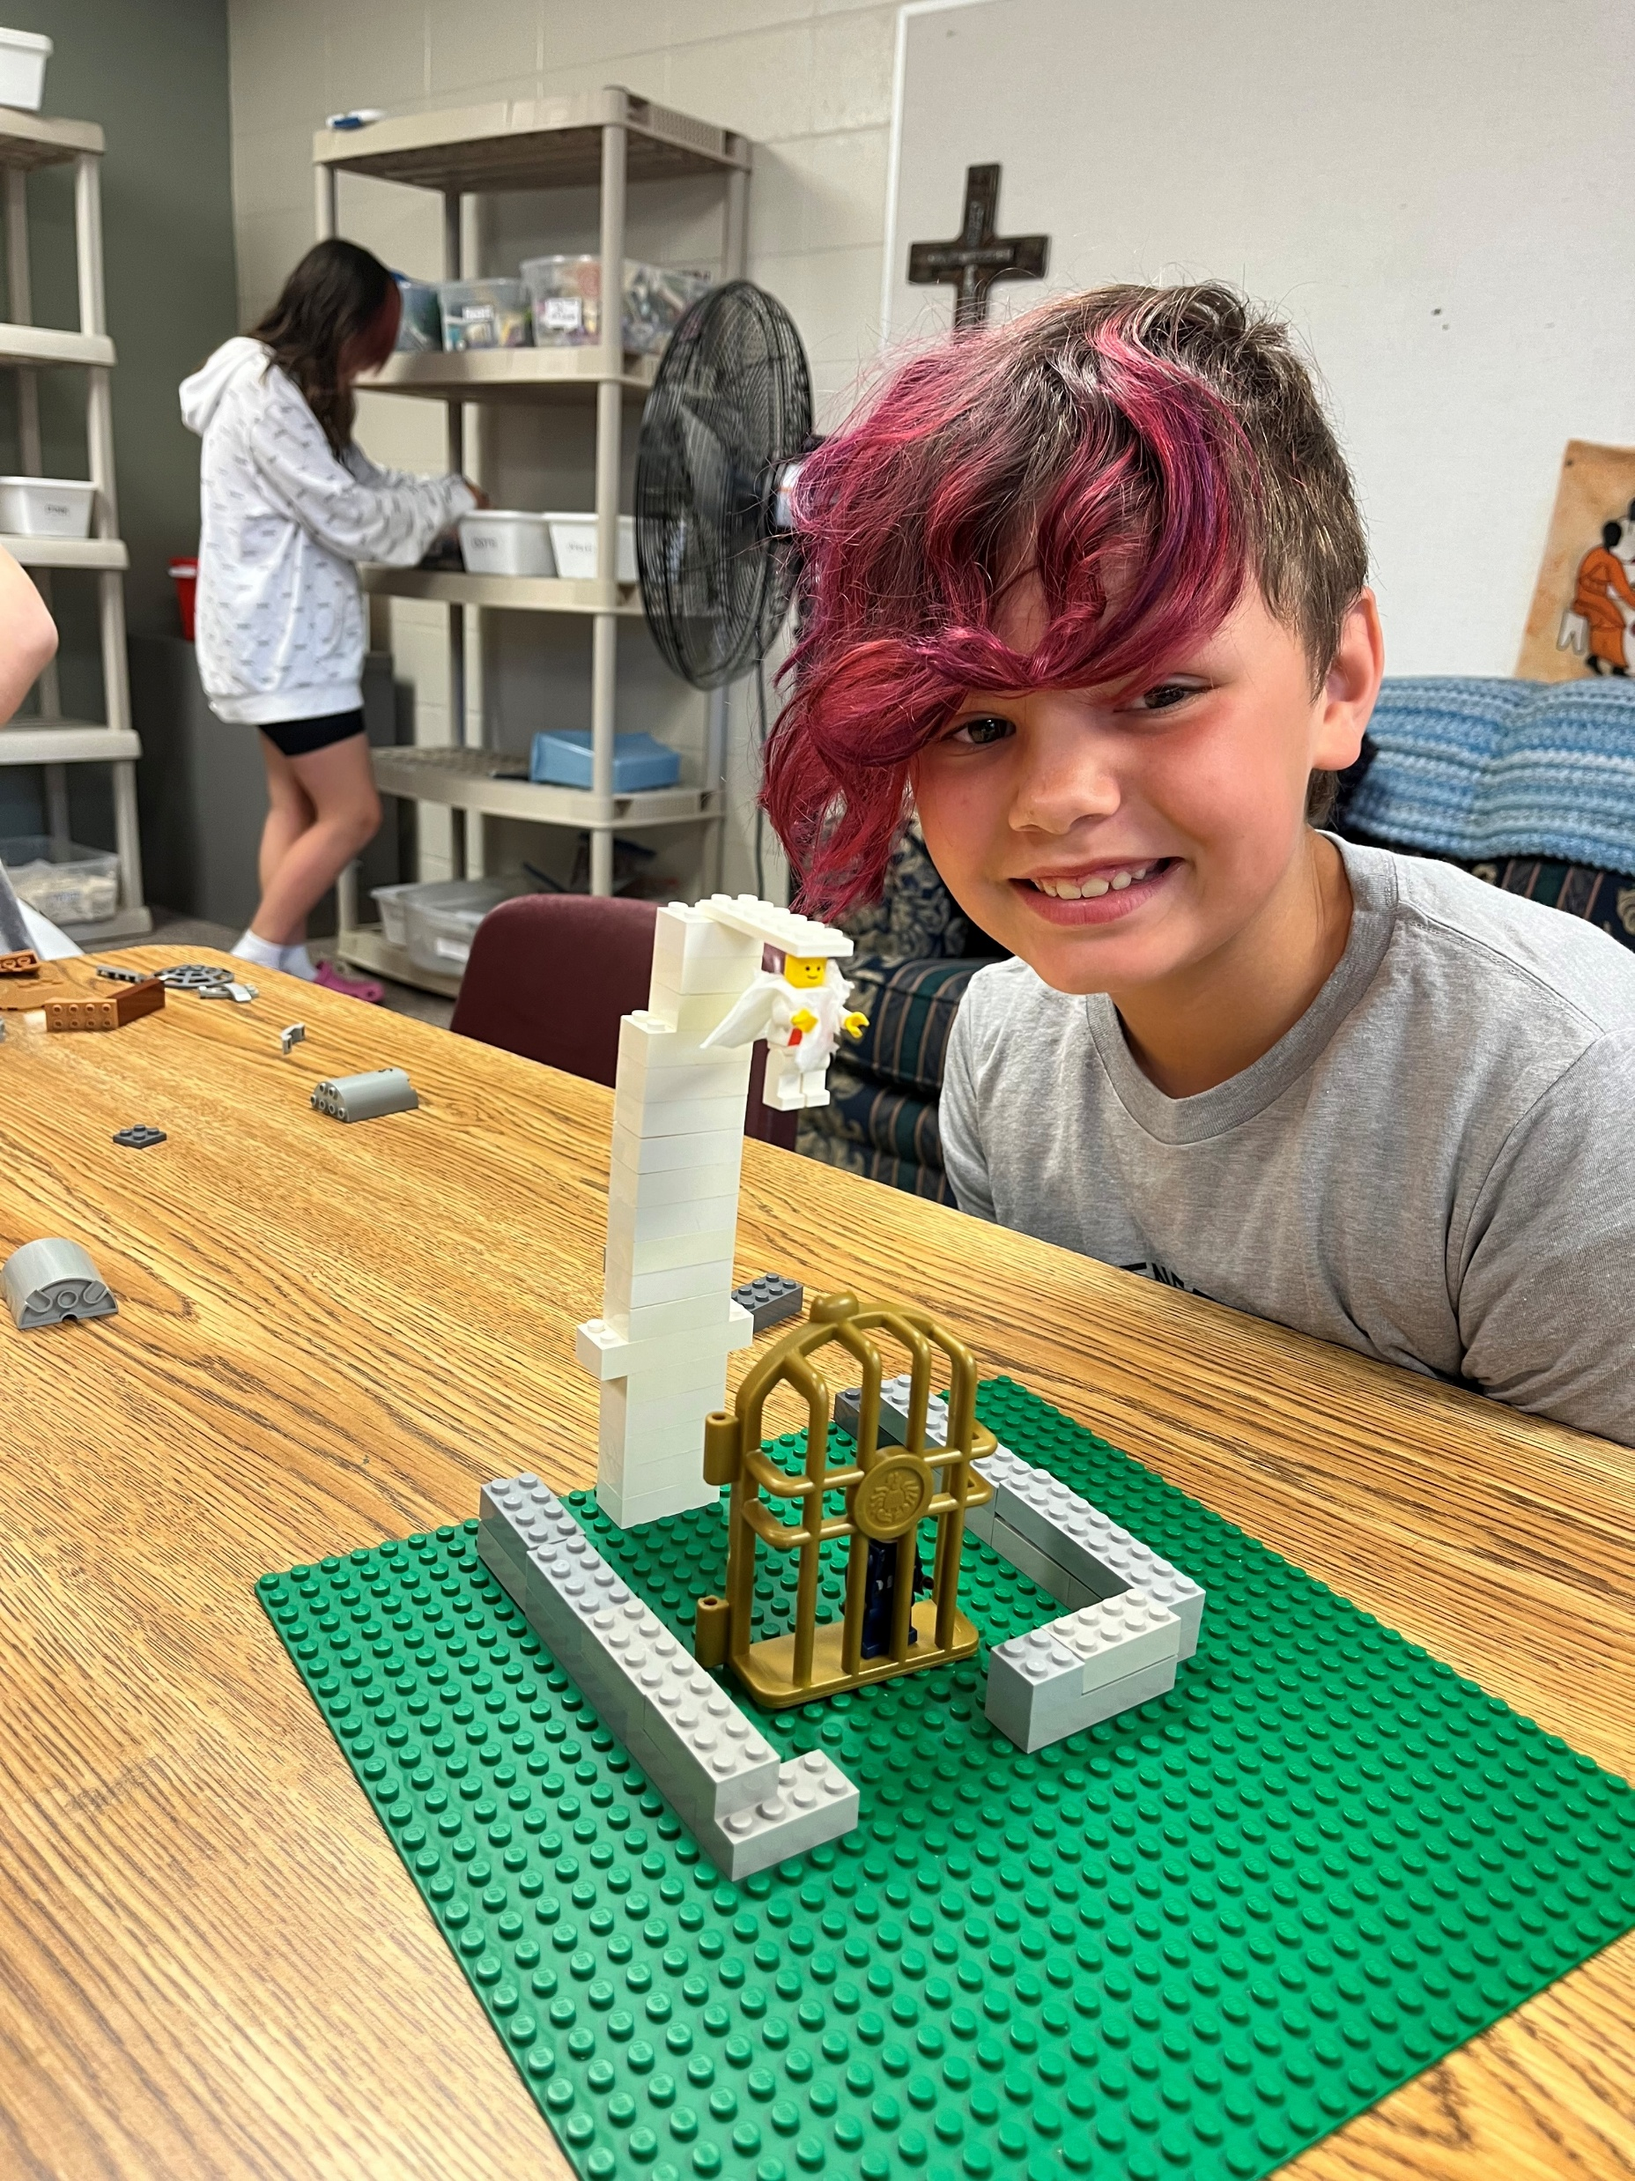
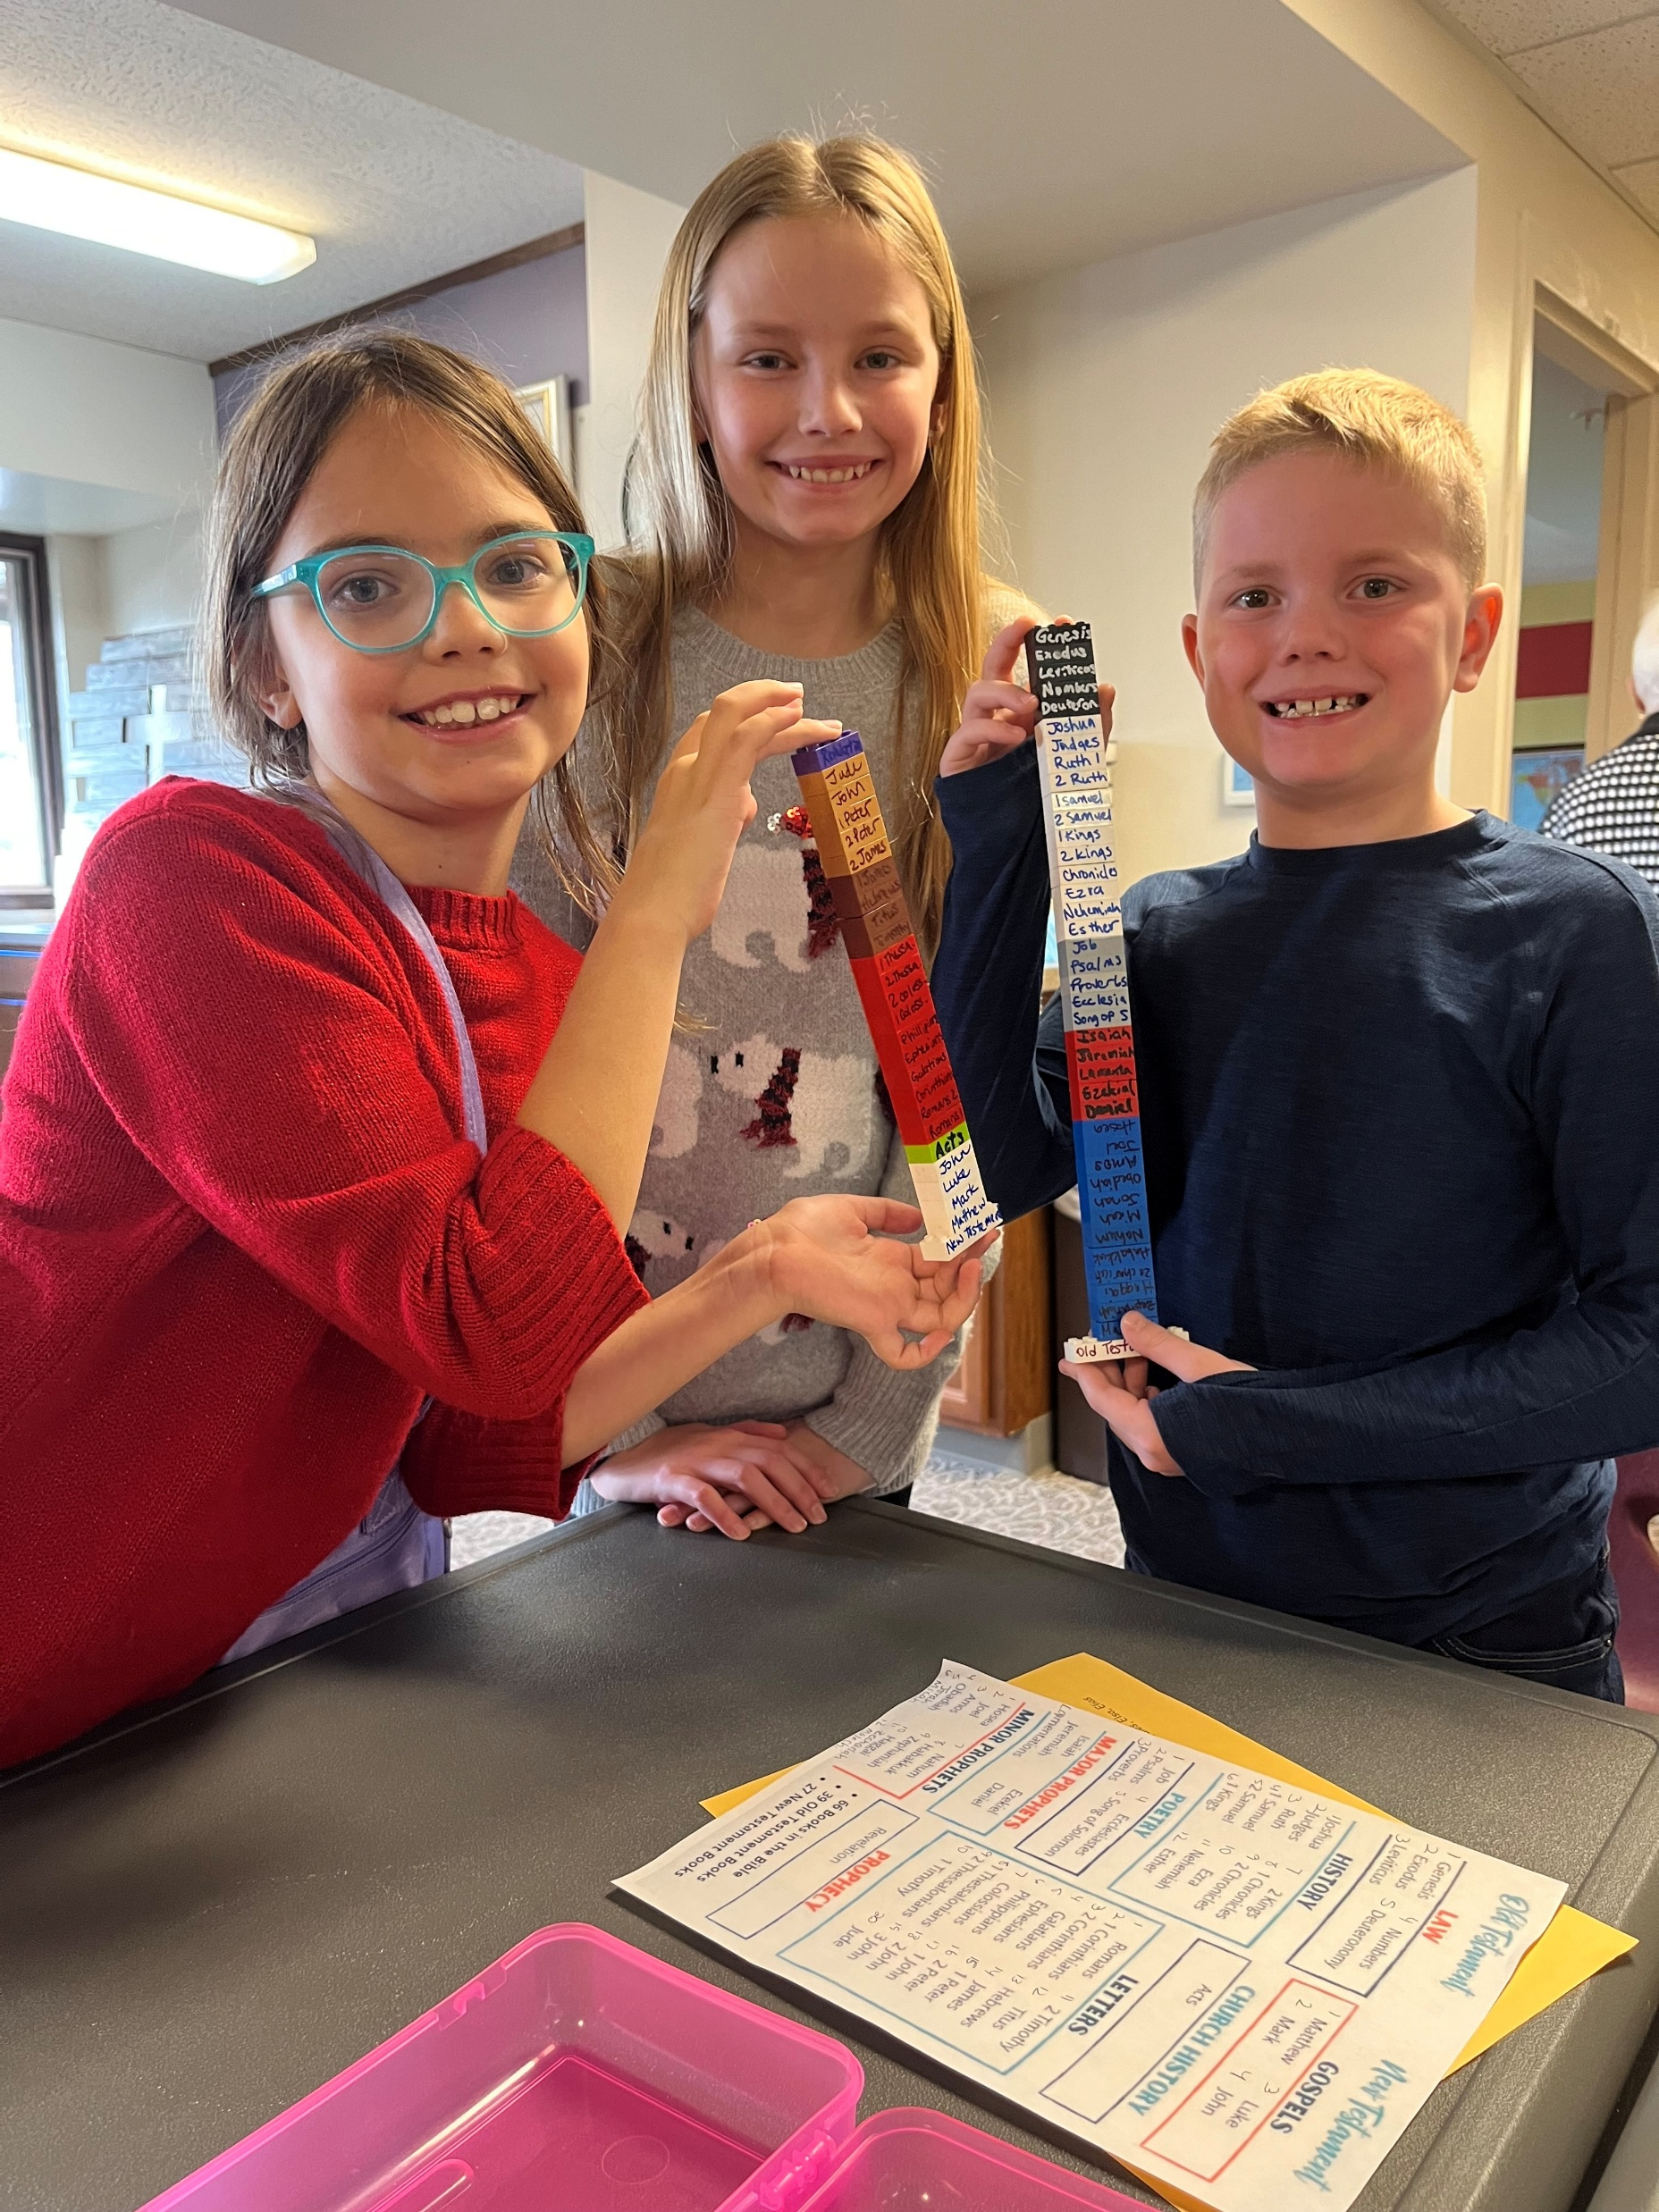
Legos in Worship

Slide 19
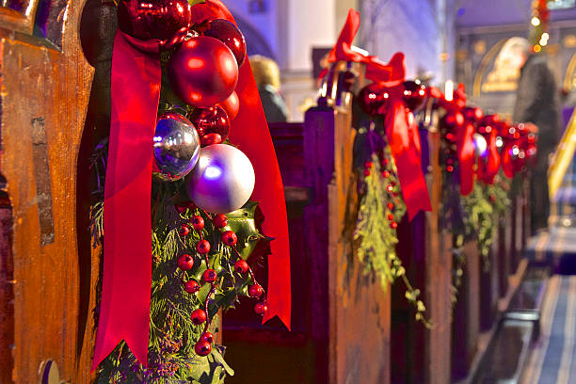
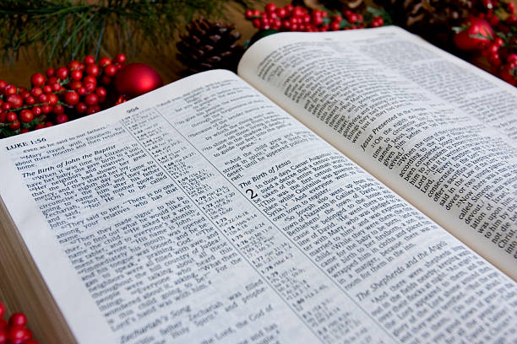
Carols and Lessons Sunday
Notes:
Sunday after Christmas – a complete service with 8 carols and lessons is available by request.
The lessons can be read by members of the congregation. This is a great service for the Sunday after Christmas, if your pastor is taking a vacation day.

Slide 20
Let’s take a few minutes to share your creative worship experiences…..
Notes:
Everyone needs a little Jesus!

Slide 21
Comments or Questions? Thank You!
Sarah Effken Purcell
sarah.effken.purcell@gmail.com
Nebraska Synod Council Member
Grace Lutheran Church, Cook, Nebraska
Notes:
You can google and find many different ideas to enhance your worship service. Please make sure the ideas you find are rooted in theology.
Evaluation – one side one item you liked from the presentation
Other side – one change you would make

