Slide 1
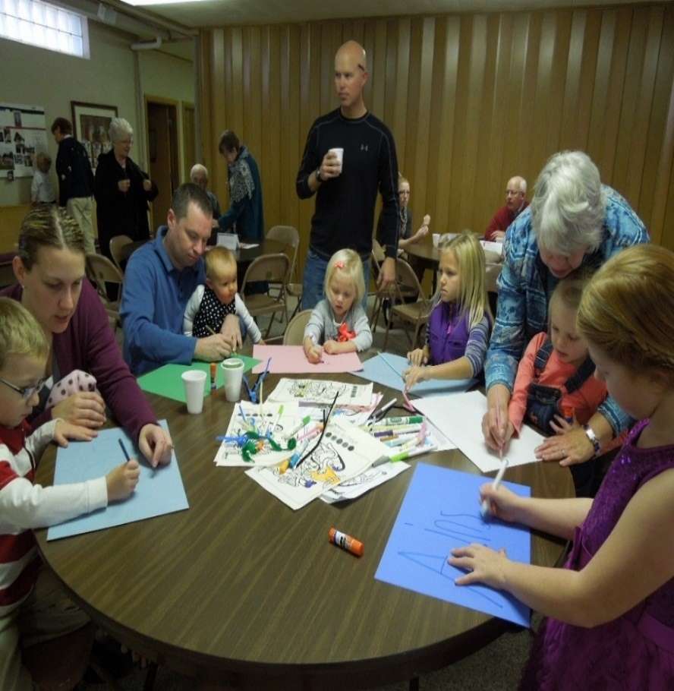
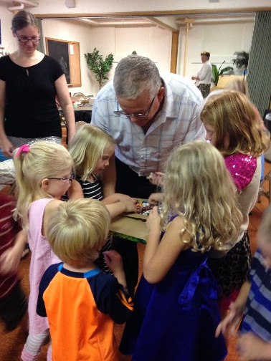
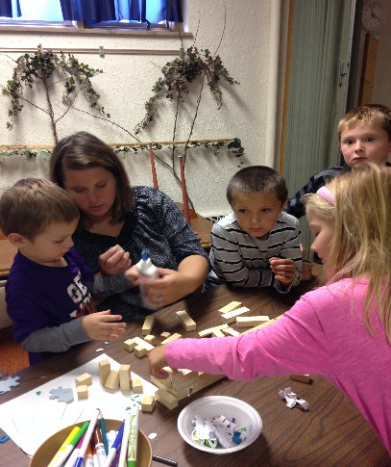
Cross+Generational Ministry Deacon Kristin Johnson
Connecting the Church Generationally

Slide 2
SHARE
Your highs and lows of this past 24 hrs with at least 2 people you did not come with today.

Slide 3
You will receive power when the Holy Spirit comes on you,
and you will be my witnesses, in Jerusalem, in all Judea and Samaria, and to all the ends of the earth.
Acts 1:8
Notes:
A. Bible Time
Choose one or more of the following to unveil the theme verse:
READ the verse together aloud. Invite guests to chant it back and forth responsively or whisper it with you. This will begin the process of sinking the Scriptures into their minds.
TEACH the sign language live, with the Video DVD Sign Language Tutorial, or with Christy Smith at www.faithink.com, FINKlink WS01.
SIGN the verse three times while reading it as a group.
FACE a partner and try to sign the verse silently while “mouthing” the words.
ASSIGNED LEADER:

Slide 4
TALK
When you think about the Holy Spirit, what comes to mind?

Slide 5
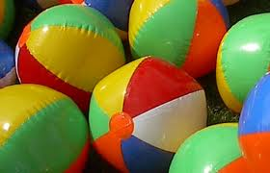
TALK
Beach Ball
Prayers
RED Section
ORANGE Section
BLUE Section
YELLOW Section
WHITE Section
GREEN Section

Slide 6
L: Let us pray.
Dear God, you came to your people with great power on the day of Pentecost.
P: You will receive power when the Holy Spirit comes on you.
Notes:
Opening Prayer Slide 1 (Click to advance)

Slide 7
L: The disciples were gripped by your Holy Spirit and the church was born! After that, they went out and told everyone they met about Jesus.
P: You will receive power when the Holy Spirit comes on you.
Notes:
Opening Prayer Slide 2 (Click to advance)

Slide 8
L: We need your power, too! We need to have courage and strength to be your witnesses.
P: You will receive power when the Holy Spirit comes on you.
Notes:
Opening Prayer Slide 3 (Click to advance)

Slide 9
L: Fill us with that same power and presence. Then send us as bold witnesses to bring love, joy, hope, healing and peace to this hurting and confused world.
P: In the name and power of the Risen Christ! Amen.
Notes:
Opening Prayer Slide 4 (Click to advance)

Slide 10
You are a beloved Child of God
Notes:
P. Blessing
INVITE each person to bless six others before they leave.
TRACE the sign of the cross on your neighbor’s forehead or open palm, state their name, and use the words on this slide as the blessing.
ENCOURAGE guests to bring this theme home and share the FAITH 5 every night this week. Games, songs and American Sign Language for today’s verse can be found at www.faithink.com, FINKlink WS01. This lesson is also found in the Bible Song journal.
ASSIGNED LEADER:
Idea: Shell Blessing
Place a baptismal font or a clear basin of water up front. You will need one seashell for each small group. Invite one person from each group up front for a blessing. A leader dips a seashell in the basin, then traces a cross on the person’s forehead with water from the shell, using the words from this week’s blessing. The blessed person then returns to their small group using the shell and water to bless each member.

Slide 12
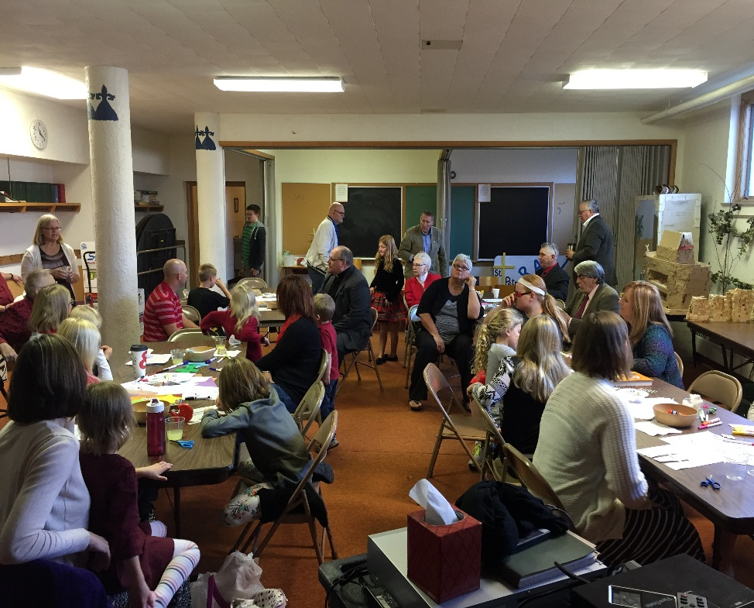
What is Cross+Generational Ministry?
Intentional emphasis on encouraging interaction and ministry with and between people of all generations.

Slide 13
What is(n’t) Cross+Generational Ministry?
It is not: It is:
A program or curriculum A way of doing ministry/New Mindset
A new phase of or name for children’s ministry A shift away from “silos” in ministry
Related only to faith formation A holistic way of reclaiming the model of early church
Teaching knowledge Changing hearts and building faith
Once a week Everywhere, all the time

Slide 14
Why Cross+Gen?
1. It is an expression and vision of the Kingdom of God that is both already here now and not yet fully realized. It is a reclaiming of the unified family that often no longer exists in today’s society.
“ ...for in Christ Jesus you are all children of God through faith. As many of you as were baptized into Christ have clothed yourselves with Christ. There is no longer Jew or Greek, there is no longer slave or free, there is no longer male and female; for all of you are one in Christ Jesus.”- Galatians 3:26-28
A faith community is often the ONLY institution in our society that has the opportunity to consistently gather all 8 generations into one space and time.

Slide 15
Why Cross+Gen?
2. It provides an opportunity for adults to relearn the traits of creativity and wonder exemplified by the “magical thinking” of children, and to be reminded of the creative nature of God.
“ Every child is an artist. The problem is how to remain an artist once we grow up.”- Pablo Picasso
Generally, what works for kids works for adults! Adults can hear and learn the Word of God through interactive, engaging, story-centric, and experiential methods.
Too many of our kids today do not have enough caring adults in their lives. And our adults do not have enough kids in their lives.

Slide 16
Why Cross+Gen?
3. It empowers the family (and the church family) to take faith formation into the home.
We can no longer assume that parents grew up in the church and know the Biblical stories.
It helps adults and children to engage in the story together, to learn and wonder alongside one another.
We can teach the value of questioning. “I don’t know” is sometimes the best answer. We learn how to question together.
“Like in the story of Wizard of Oz—we are simply better when we journey together, than apart.”

Slide 17
What did Cross+Generational Ministry look like at St. Petri?
FAITH5
GIFT (Growing In Faith Together)
VBS
Confirmation
Worship

Slide 18
Share: Your Highs and Lows
Read: A Bible Verse or Story
Talk: Discuss It
Pray: Together
Bless: One Another
Notes:
Ble

Slide 19
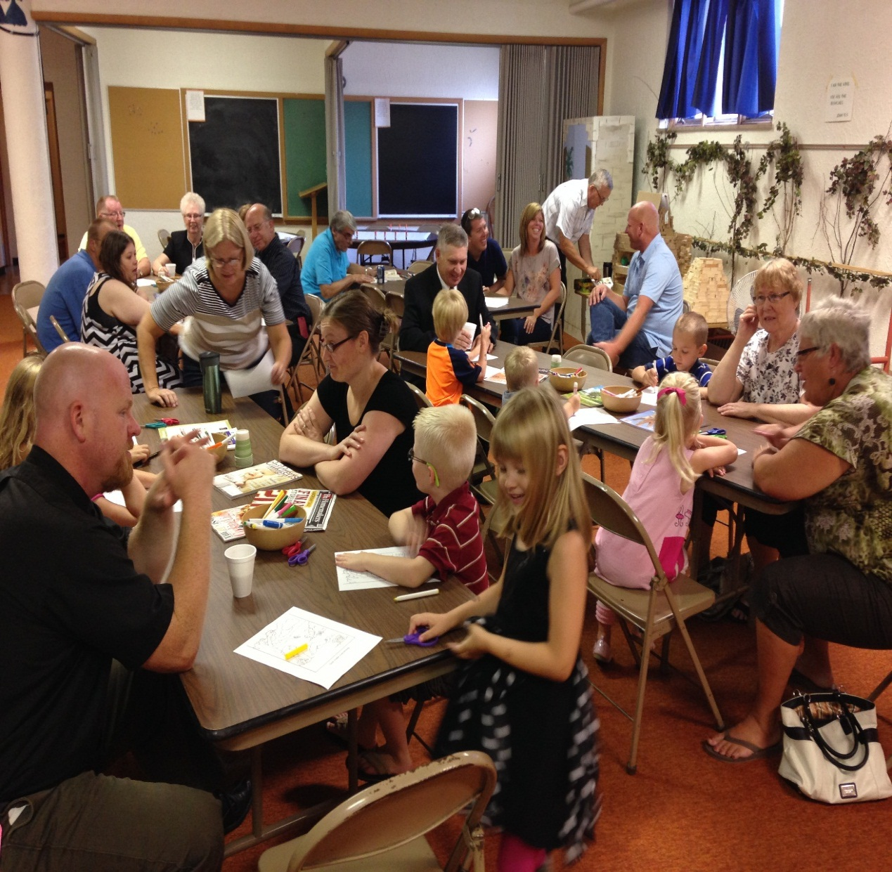
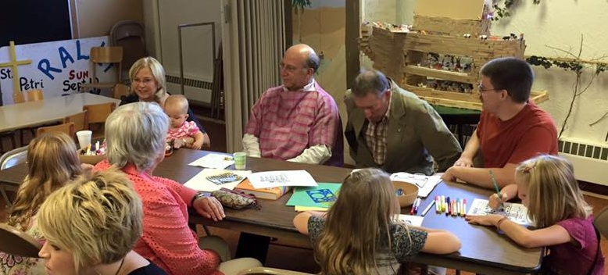
GIFT: Growing In Faith Together
SHARE
Highs and Lows

Slide 20
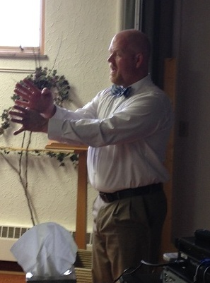
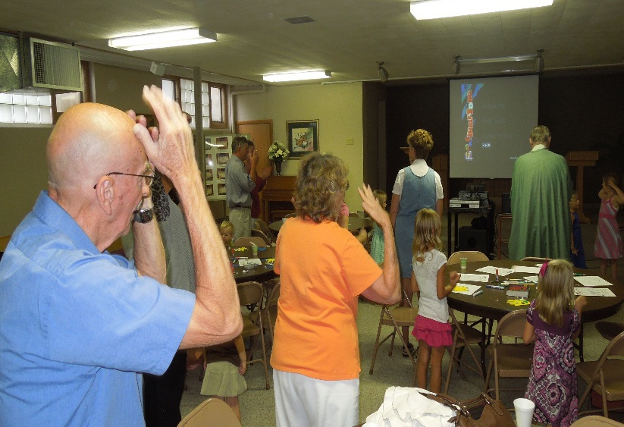
GIFT: Growing In Faith Together
READ
Scripture

Slide 21
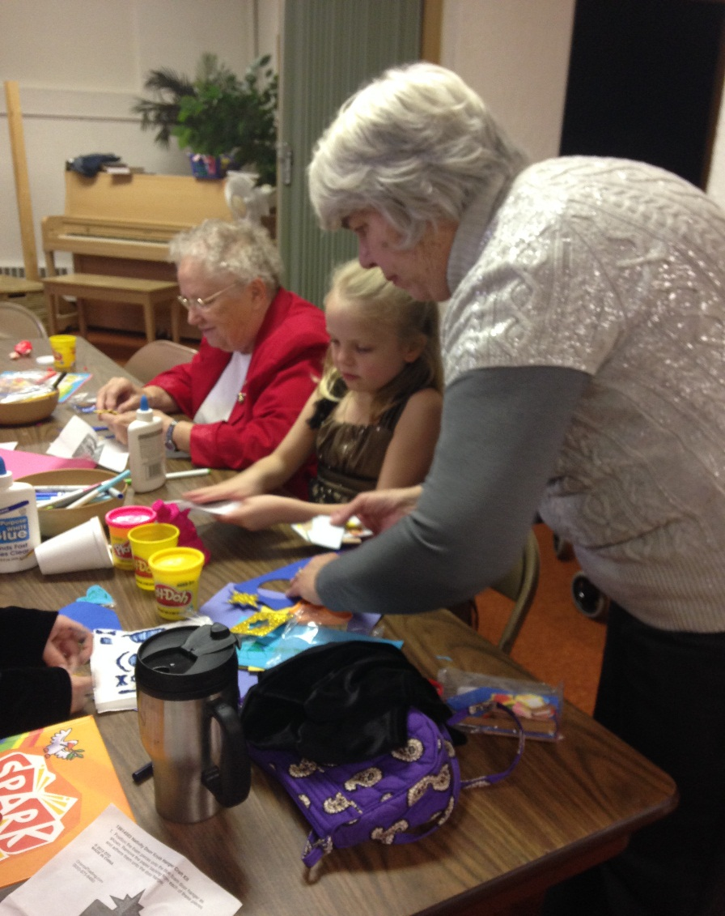
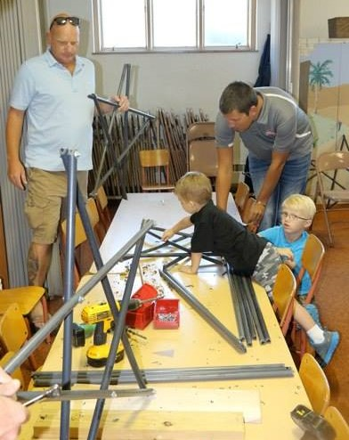
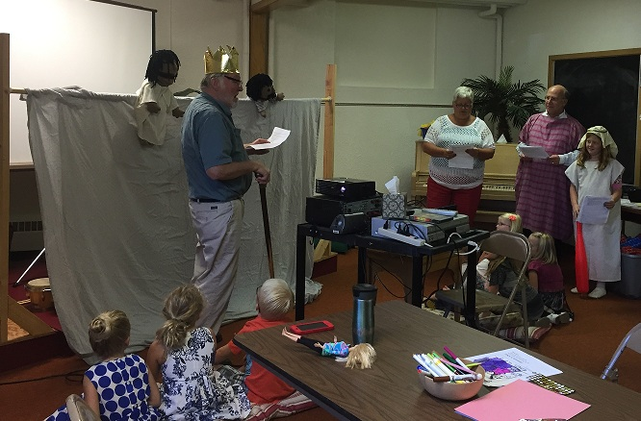
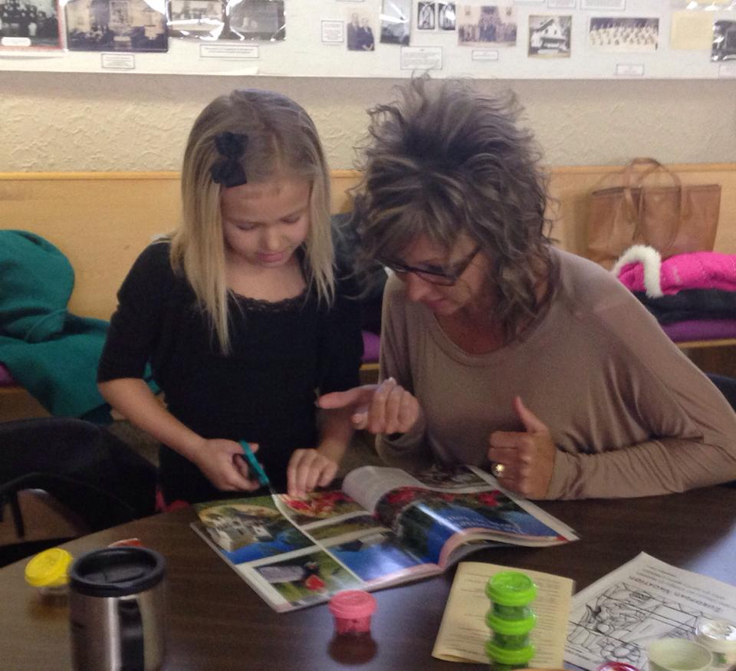
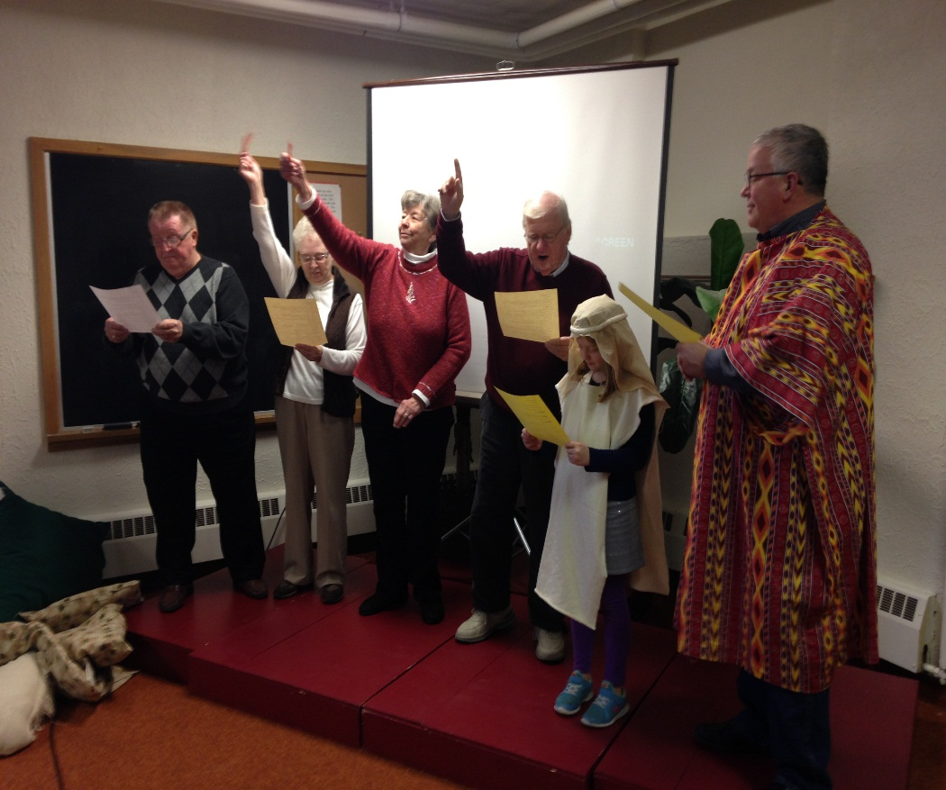
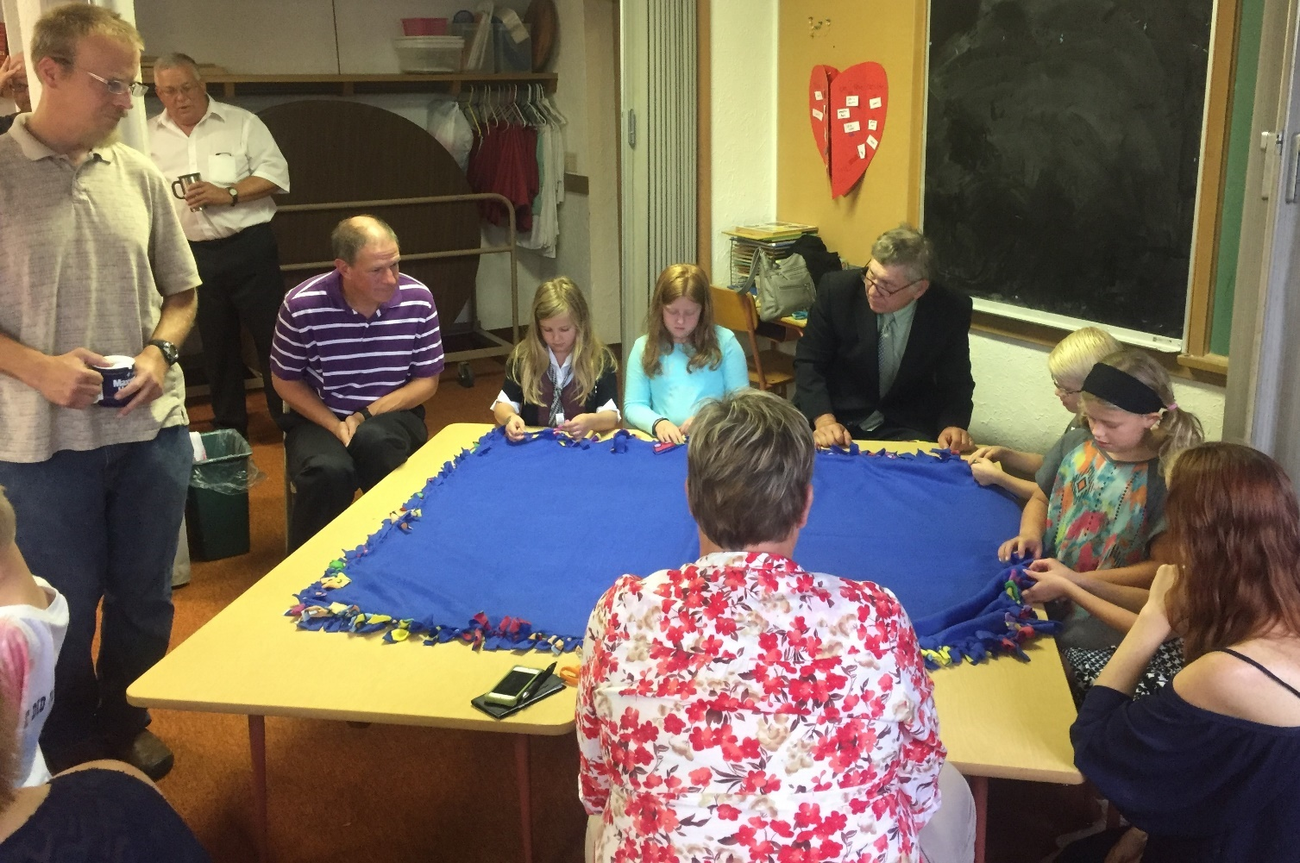
GIFT: Growing In Faith Together
TALK about the Biblical story

Slide 22
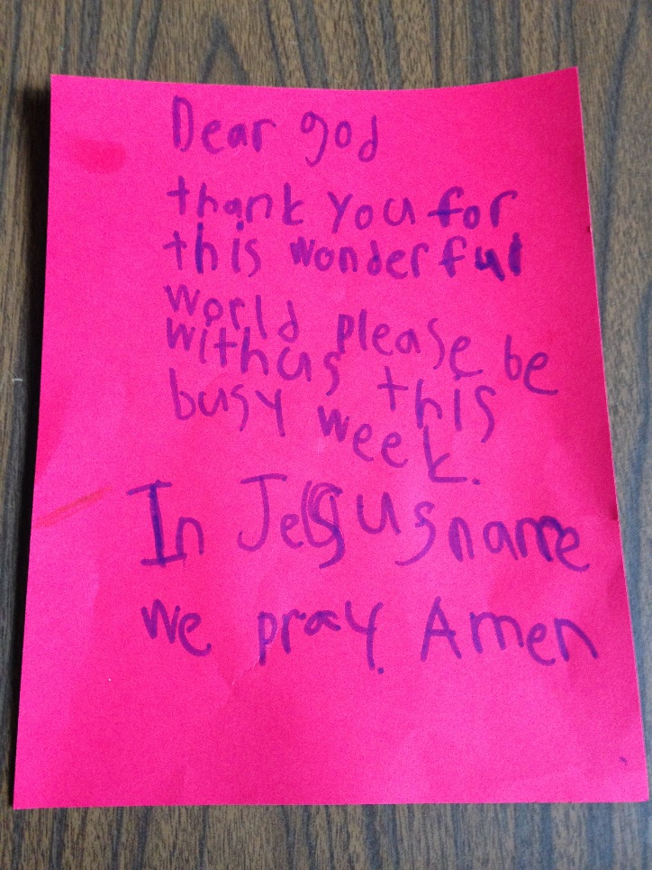
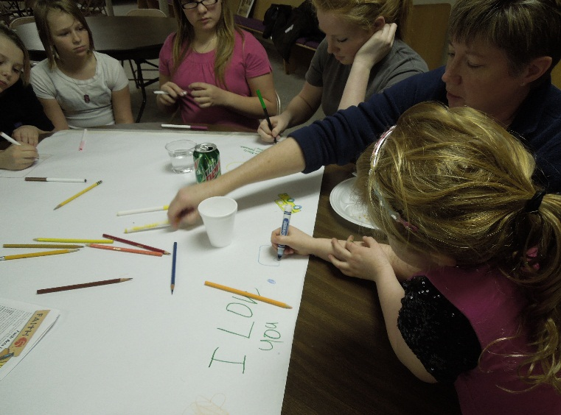
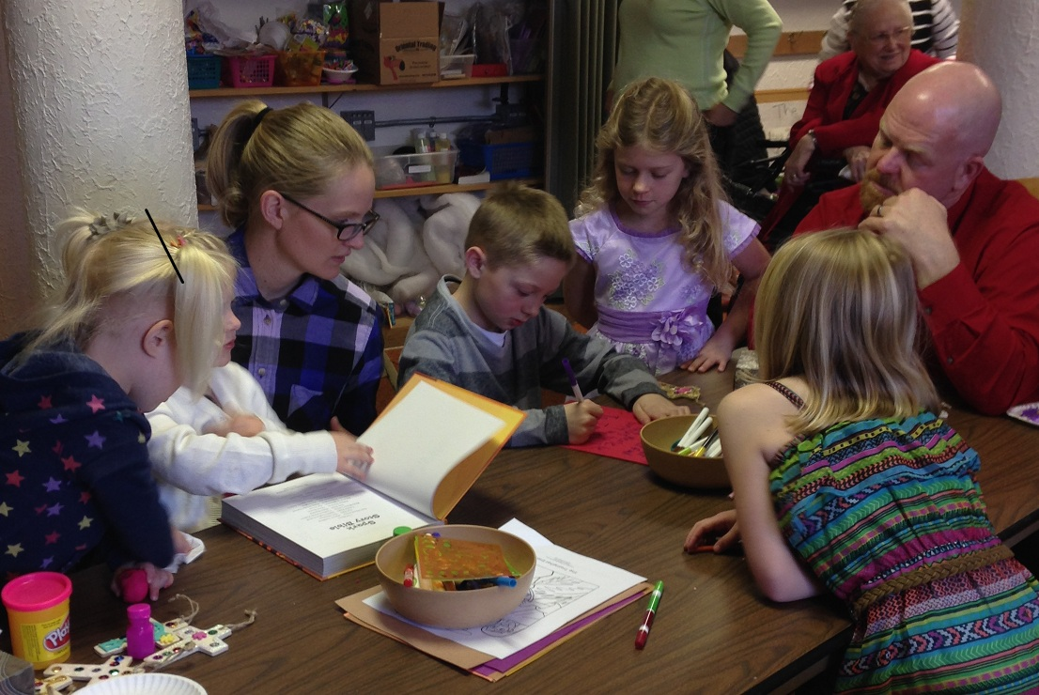
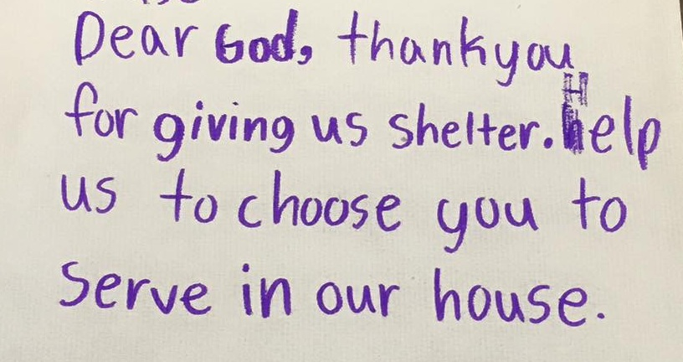
GIFT: Growing In Faith Together
PRAY

Slide 23
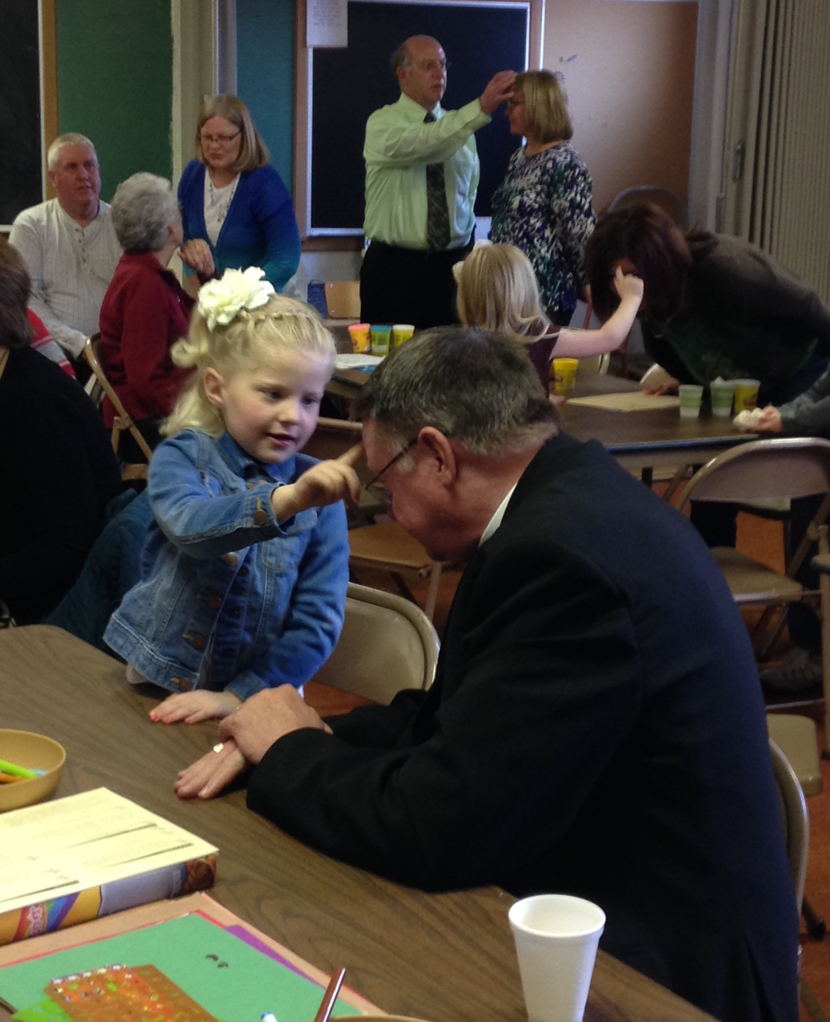
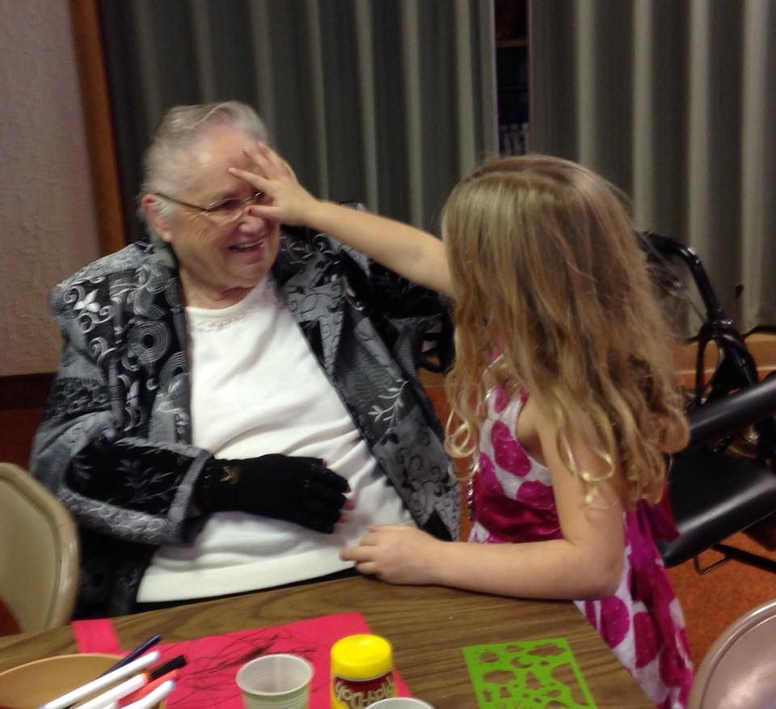
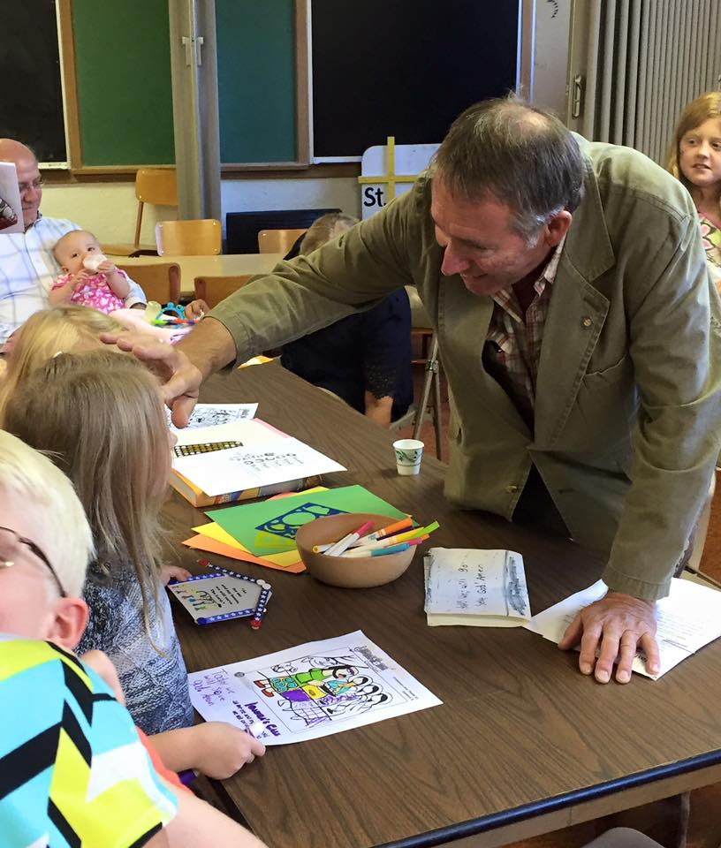
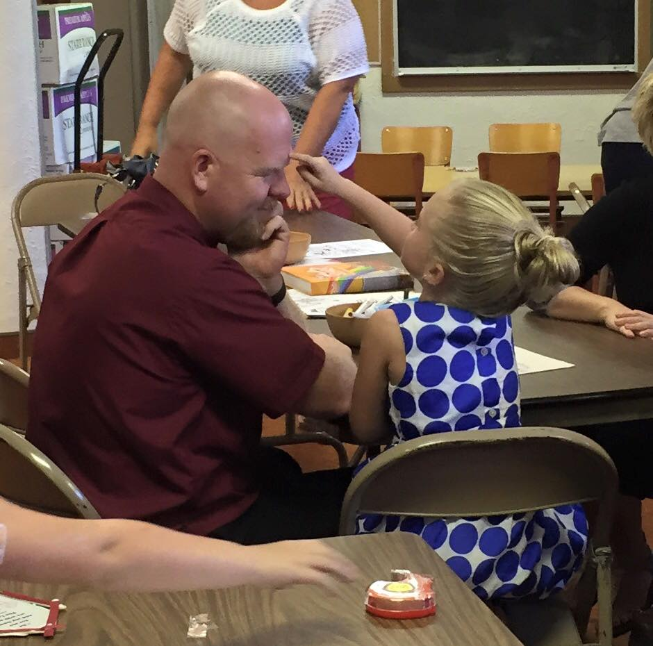
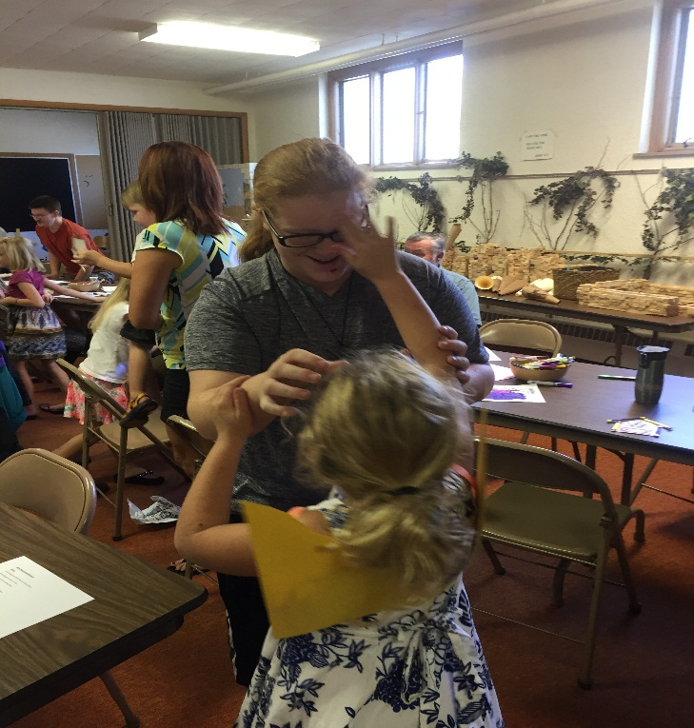
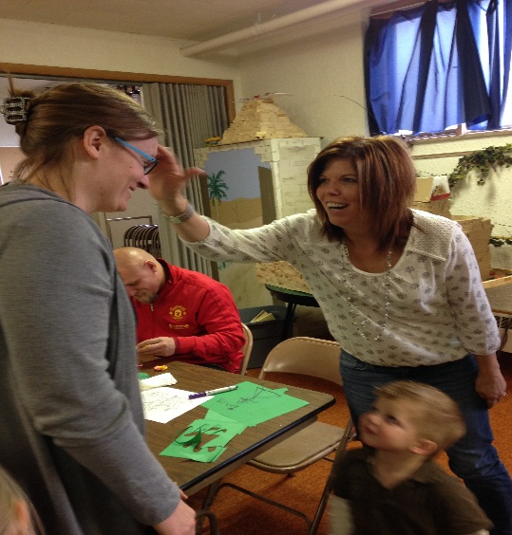
GIFT: Growing In Faith Together
BLESS

Slide 24
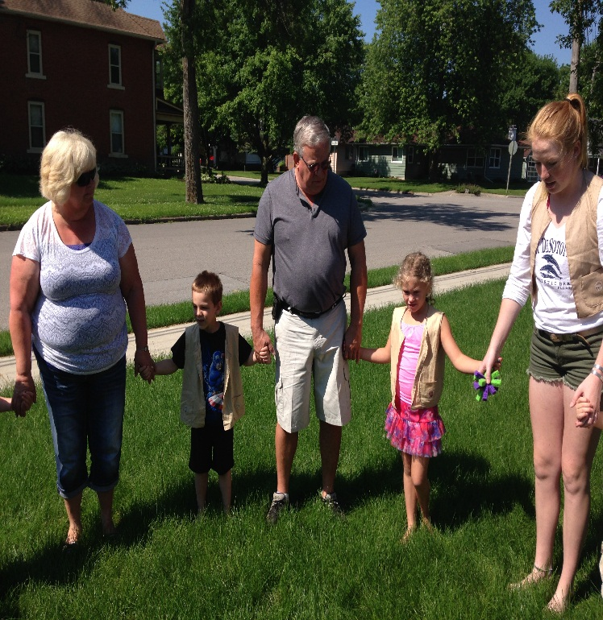
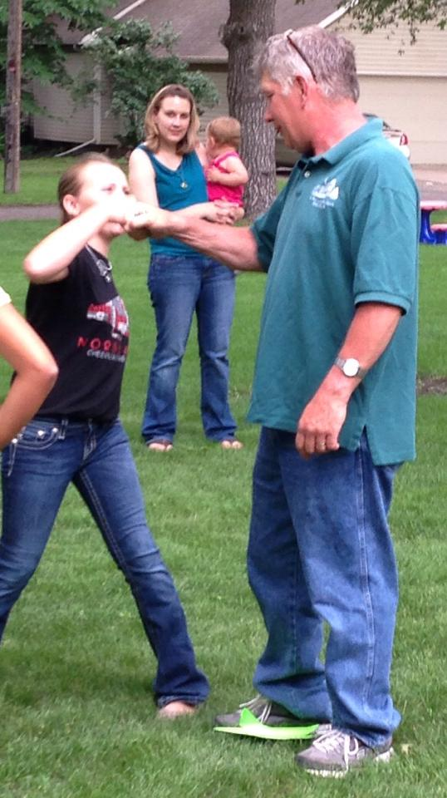
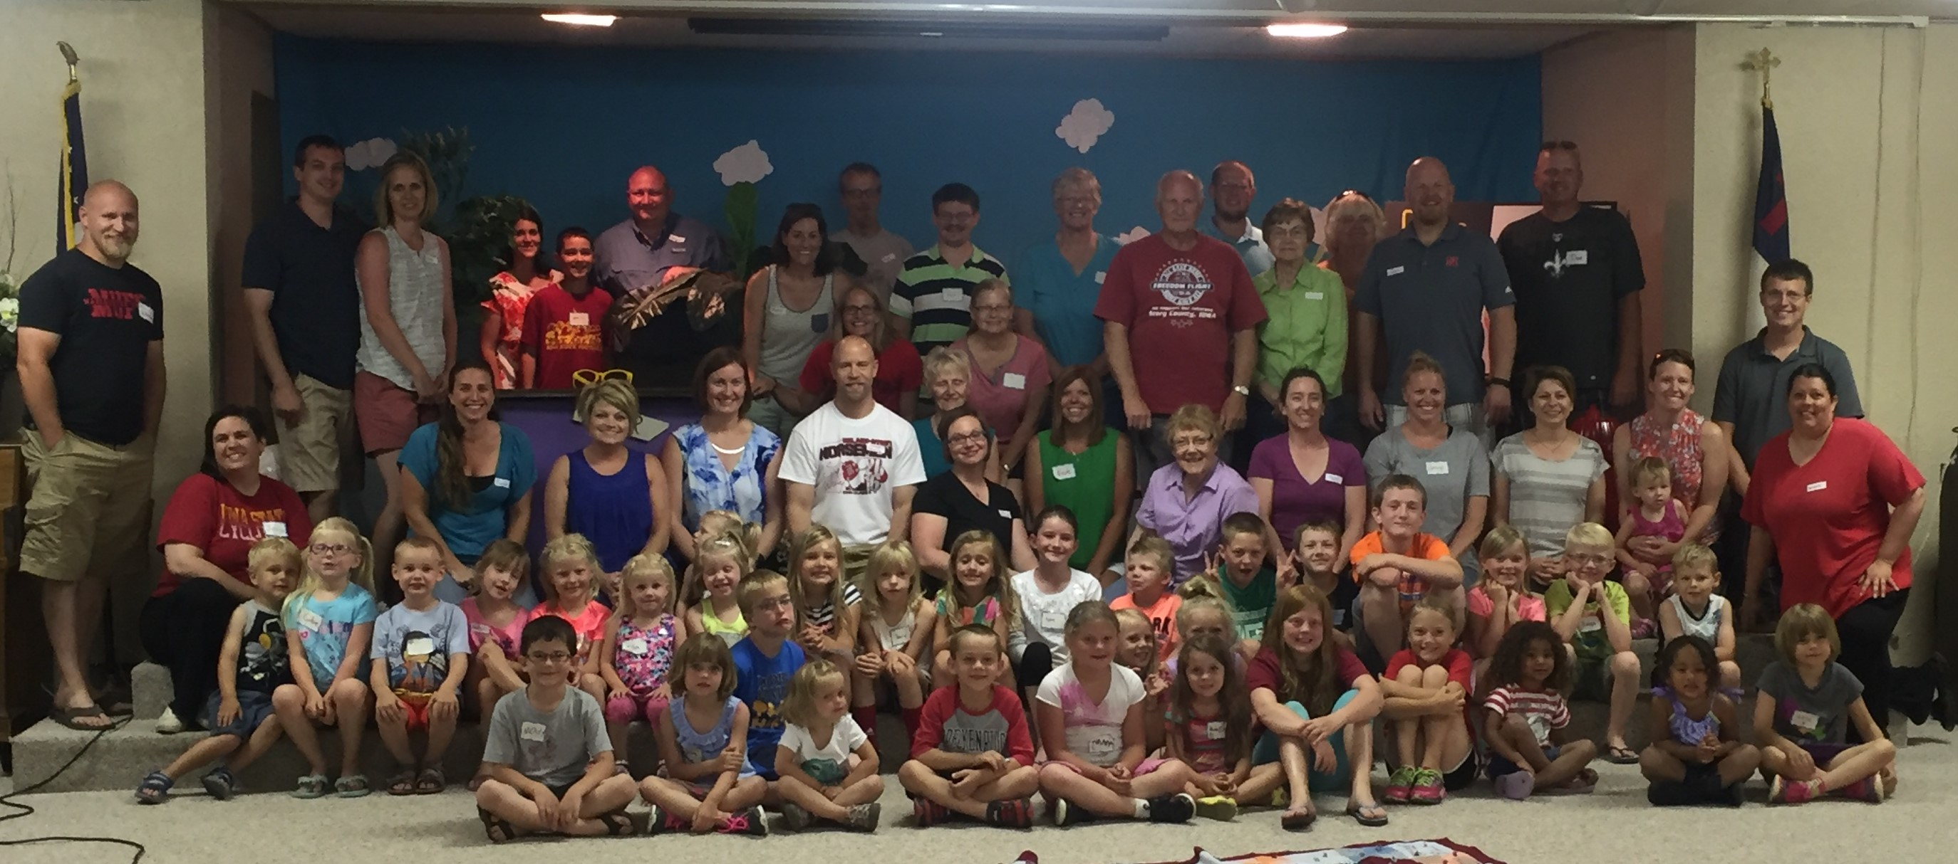
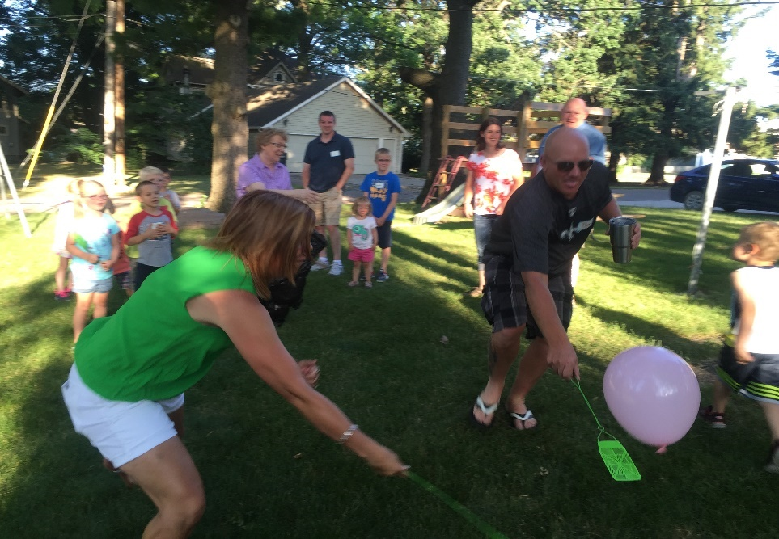
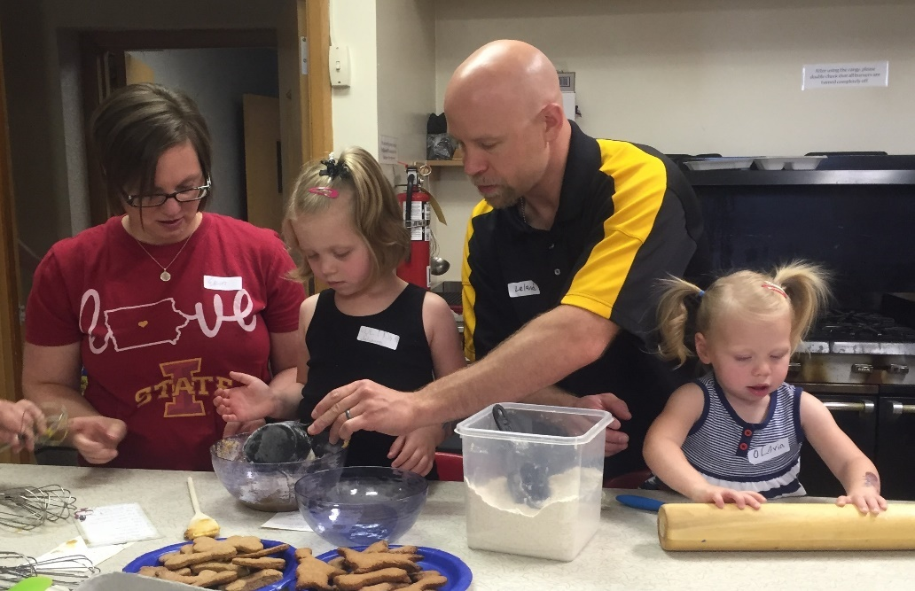
Cross+Gen VBS

Slide 25
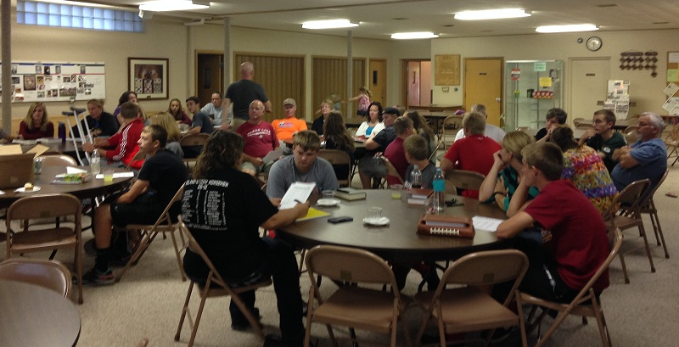
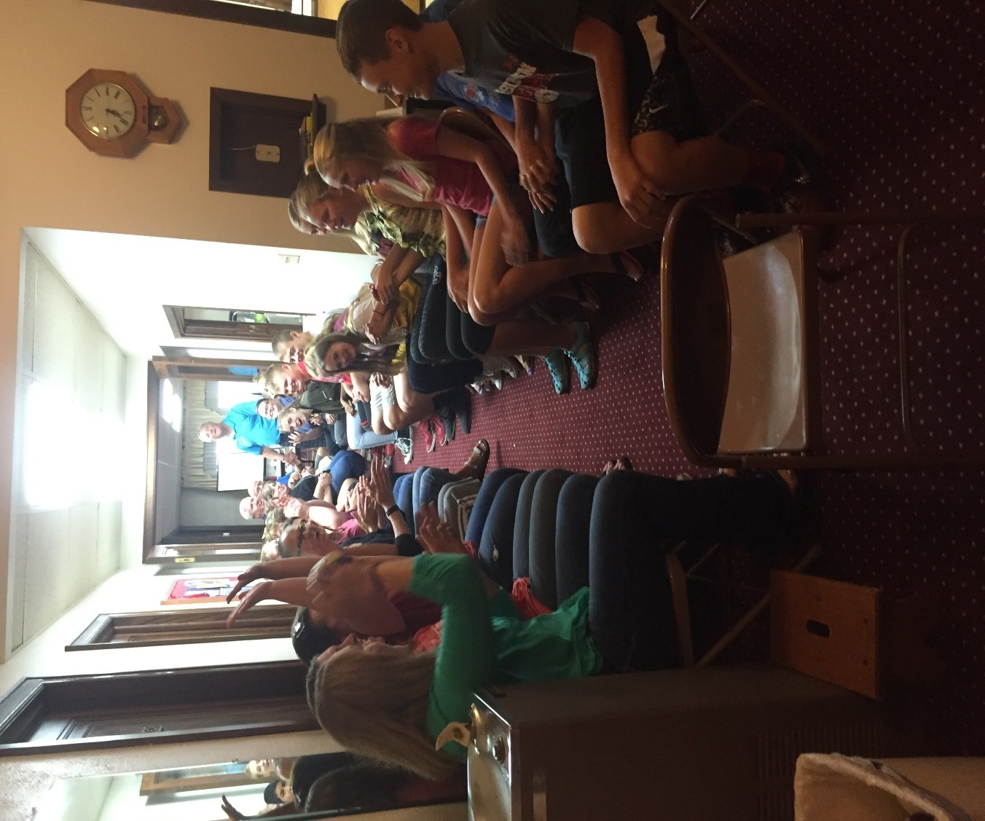
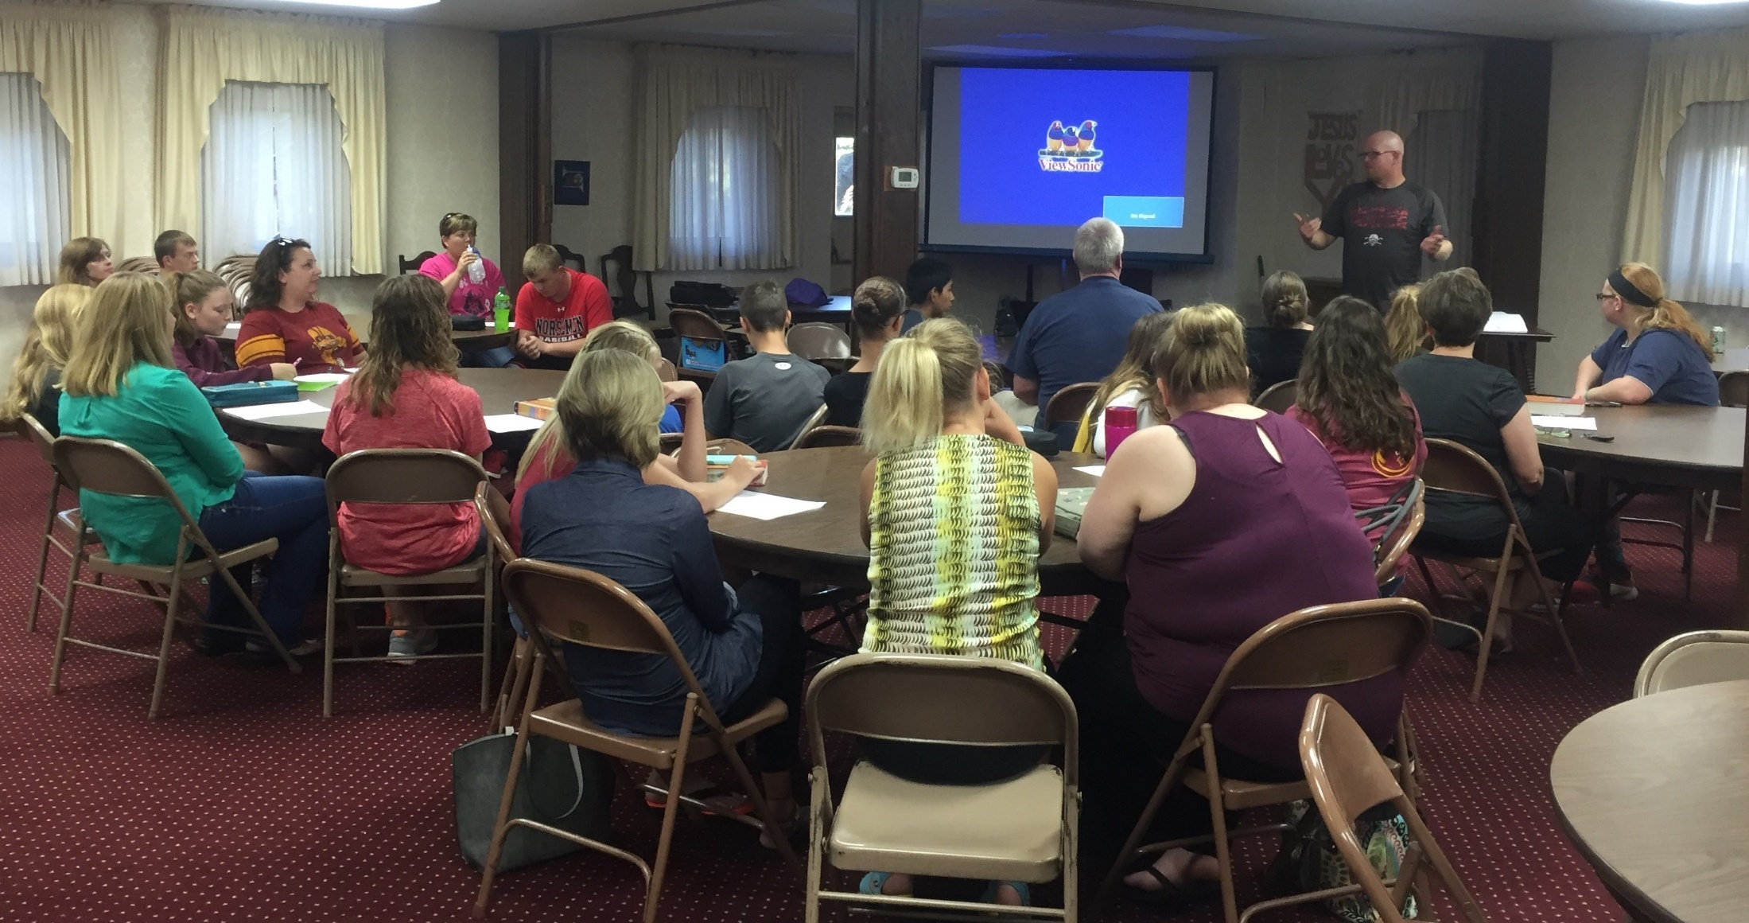
Cross+Gen Confirmation

Slide 26
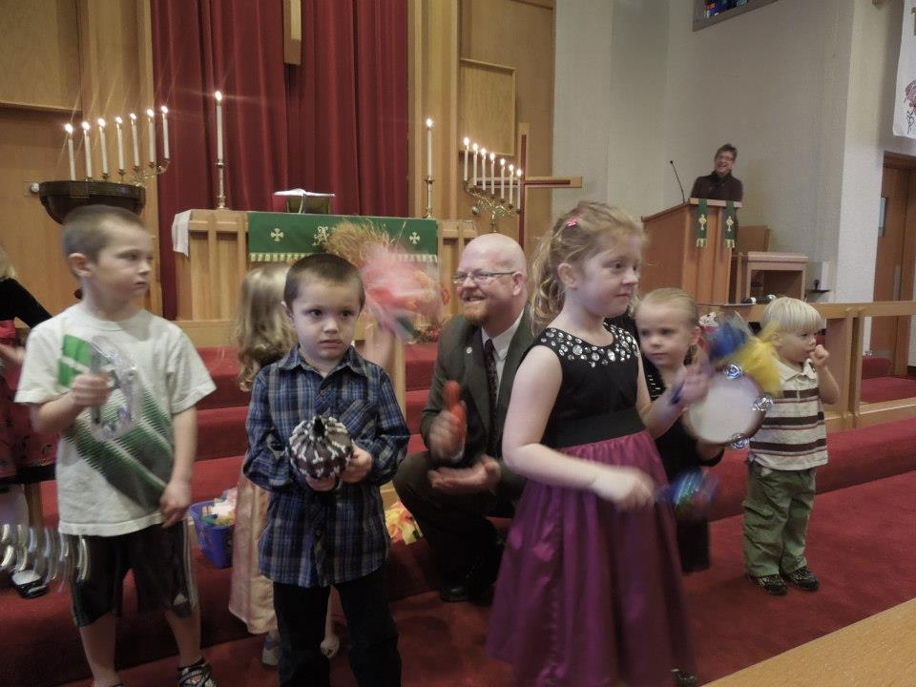
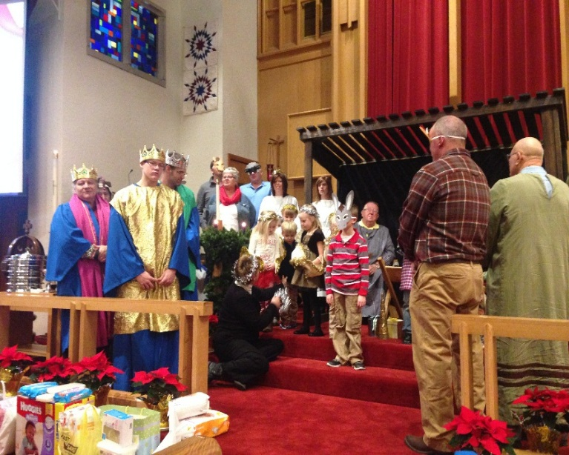
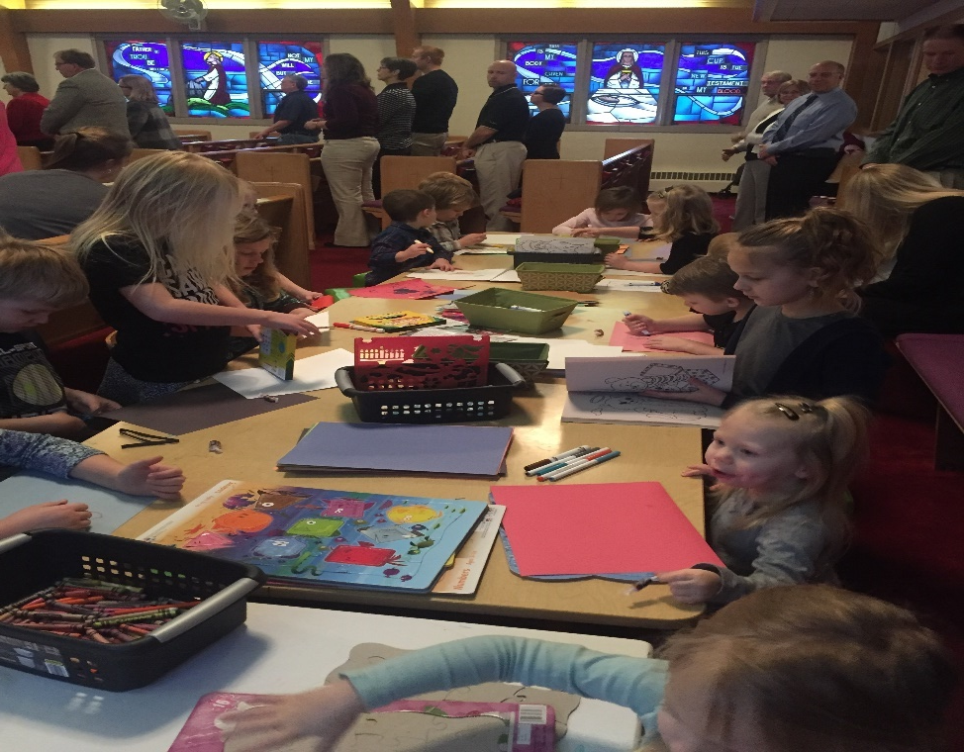
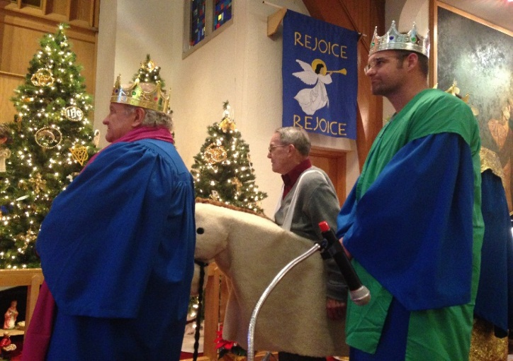
Cross+Gen Worship
Cross+GenService
Joyful Noise and Creation Station

Slide 27
5 Steps To Changing A Culture:
Validate
Cast a New Vision
Challenge
Encourage
Rinse and Repeat

Slide 28
Putting It Together
Where in your congregation are 3 or more generations together? How can this experience improve?
Where are 3 or more generations NOT together, but they can or might be? What would have to change?
Dream big- where can you imagine a new Cross+Generational experience?

Slide 29
Resources
Nebraska Synod’s website – Under Faith In Action tab, go to Faith Formation. Follow links to Cross+Generational Ministry
Faith5.org website
Facebook:
Nebraska Synod Cross+Generational Ministry
2. Birthing Cross+Gen Community

