Slide 1

A few interesting facts about
Immigration…

Slide 2
Immigration Process- MTV Decoded with Francesca Ramsey
https://www.youtube.com/watch?v=ZLrYMTc585I

Slide 3


Slide 4
Asylum…
You have to be physically present in the United States to apply for Asylum.
You have to meet the legal definition of “refugee.”
You are required to provide evidence to support you have been persecuted or have “well-founded” fear for future persecution.

Slide 5
Refugee=
A person who is unable or unwilling
to return to their home country and
Cannot obtain protection in that country due to
Past persecution or well-founded fear of being
Persecuted in the future.

Slide 7


Slide 8


Slide 9


Slide 10


Slide 11

https://www.youtube.com/watch?v=e0-RPp_mXx0

Slide 12


Slide 13


Slide 14


Slide 15


Slide 16


Slide 17
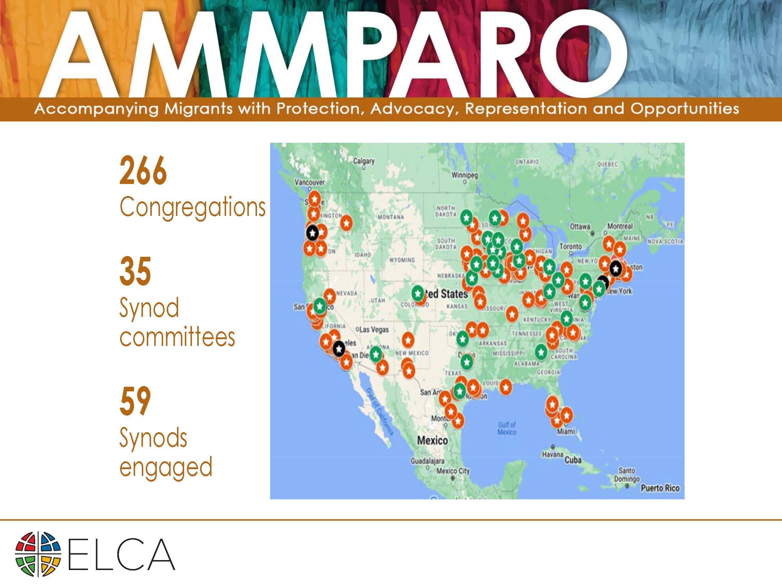

Slide 18
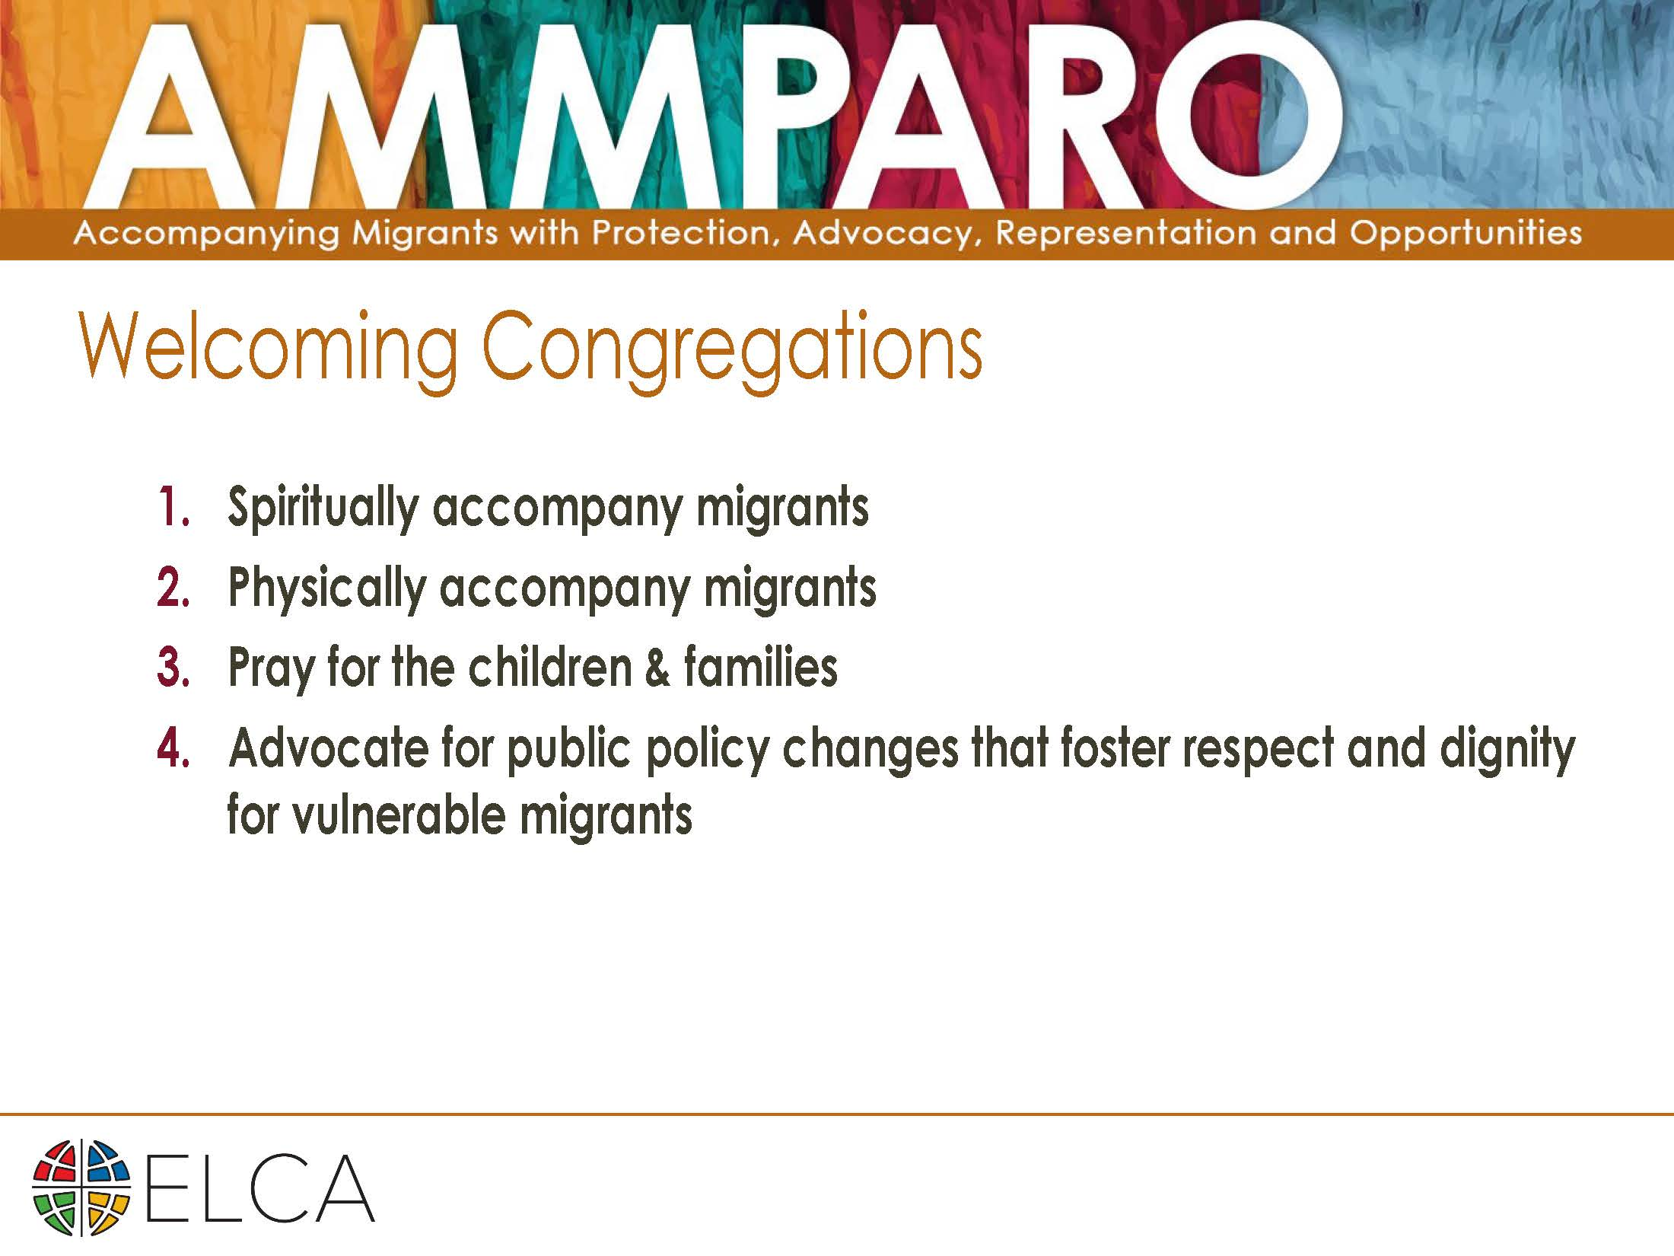

Slide 19
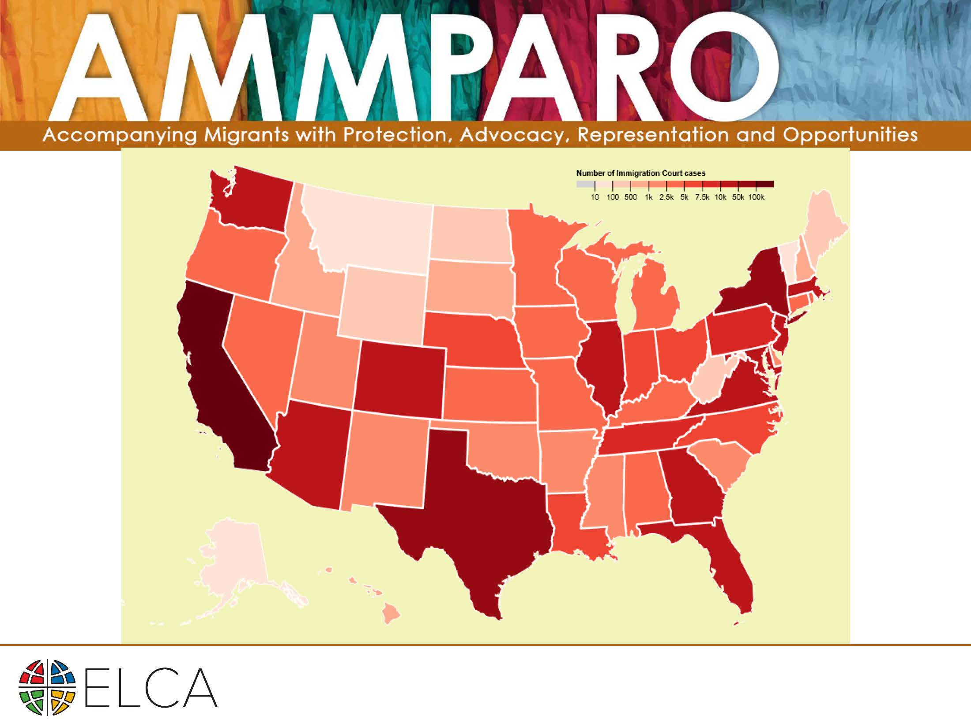

Slide 20


Slide 21


Slide 22


Slide 23
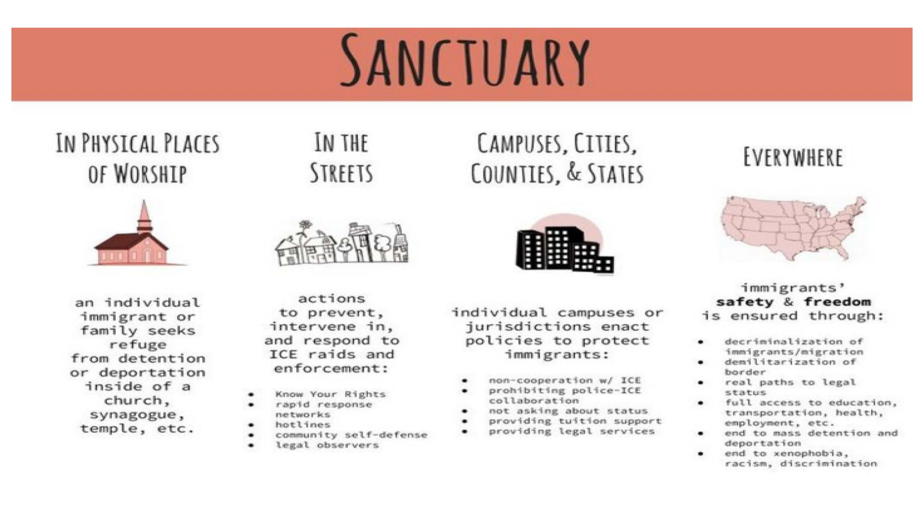

Slide 24
Sanctuary
https://www.youtube.com/watch?v=9gnCfJZhhO4

Slide 25
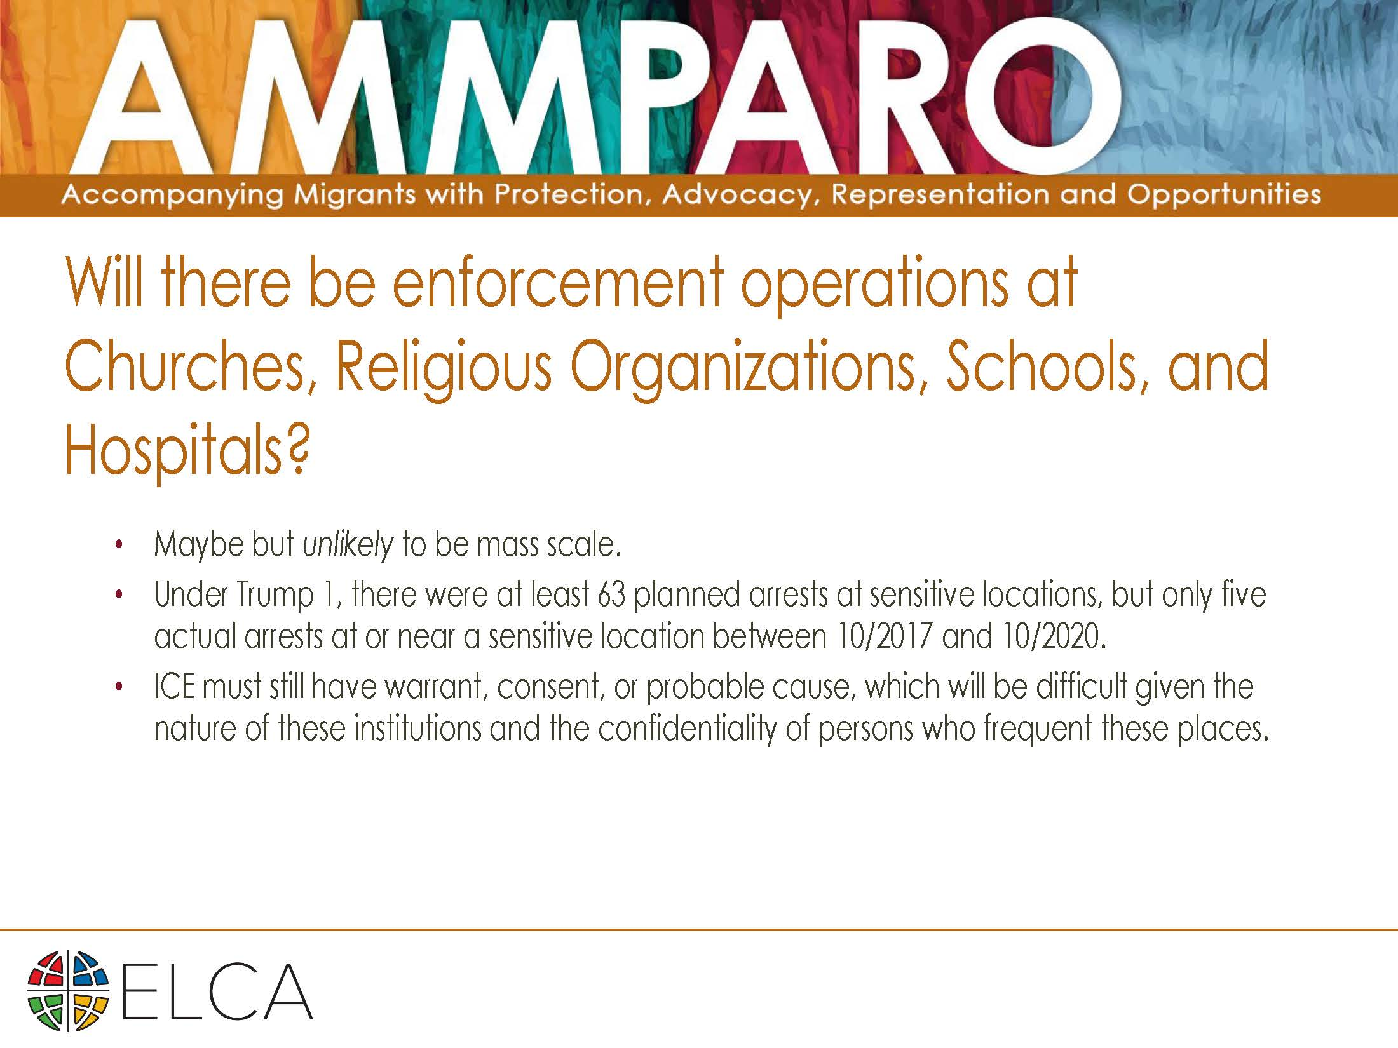

Slide 26
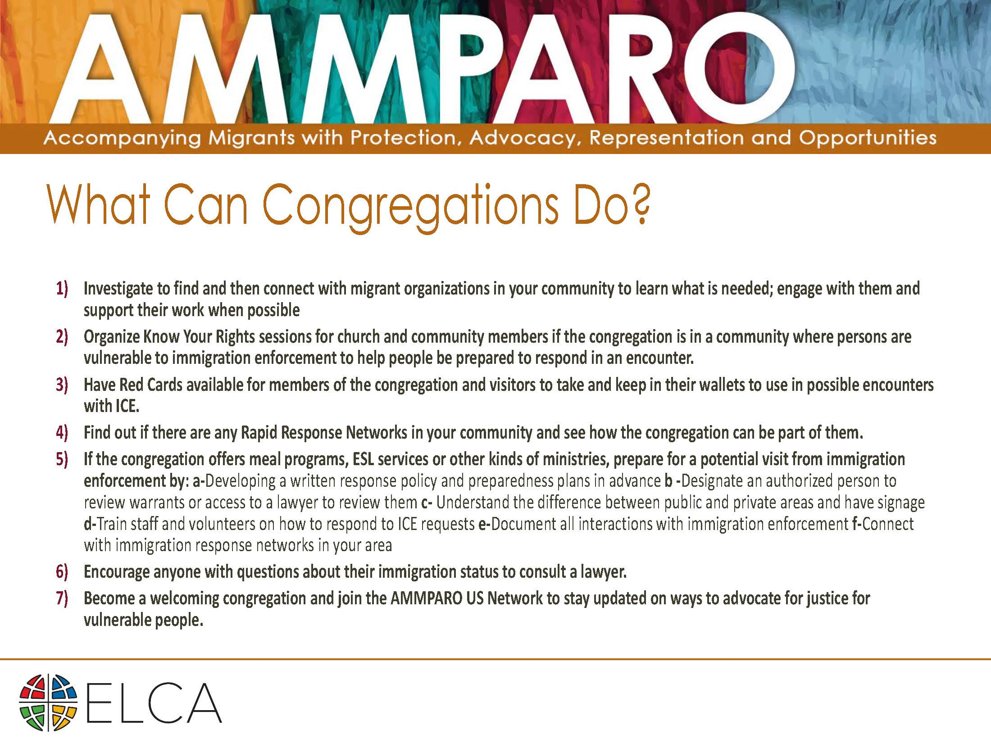

Slide 27


Slide 28
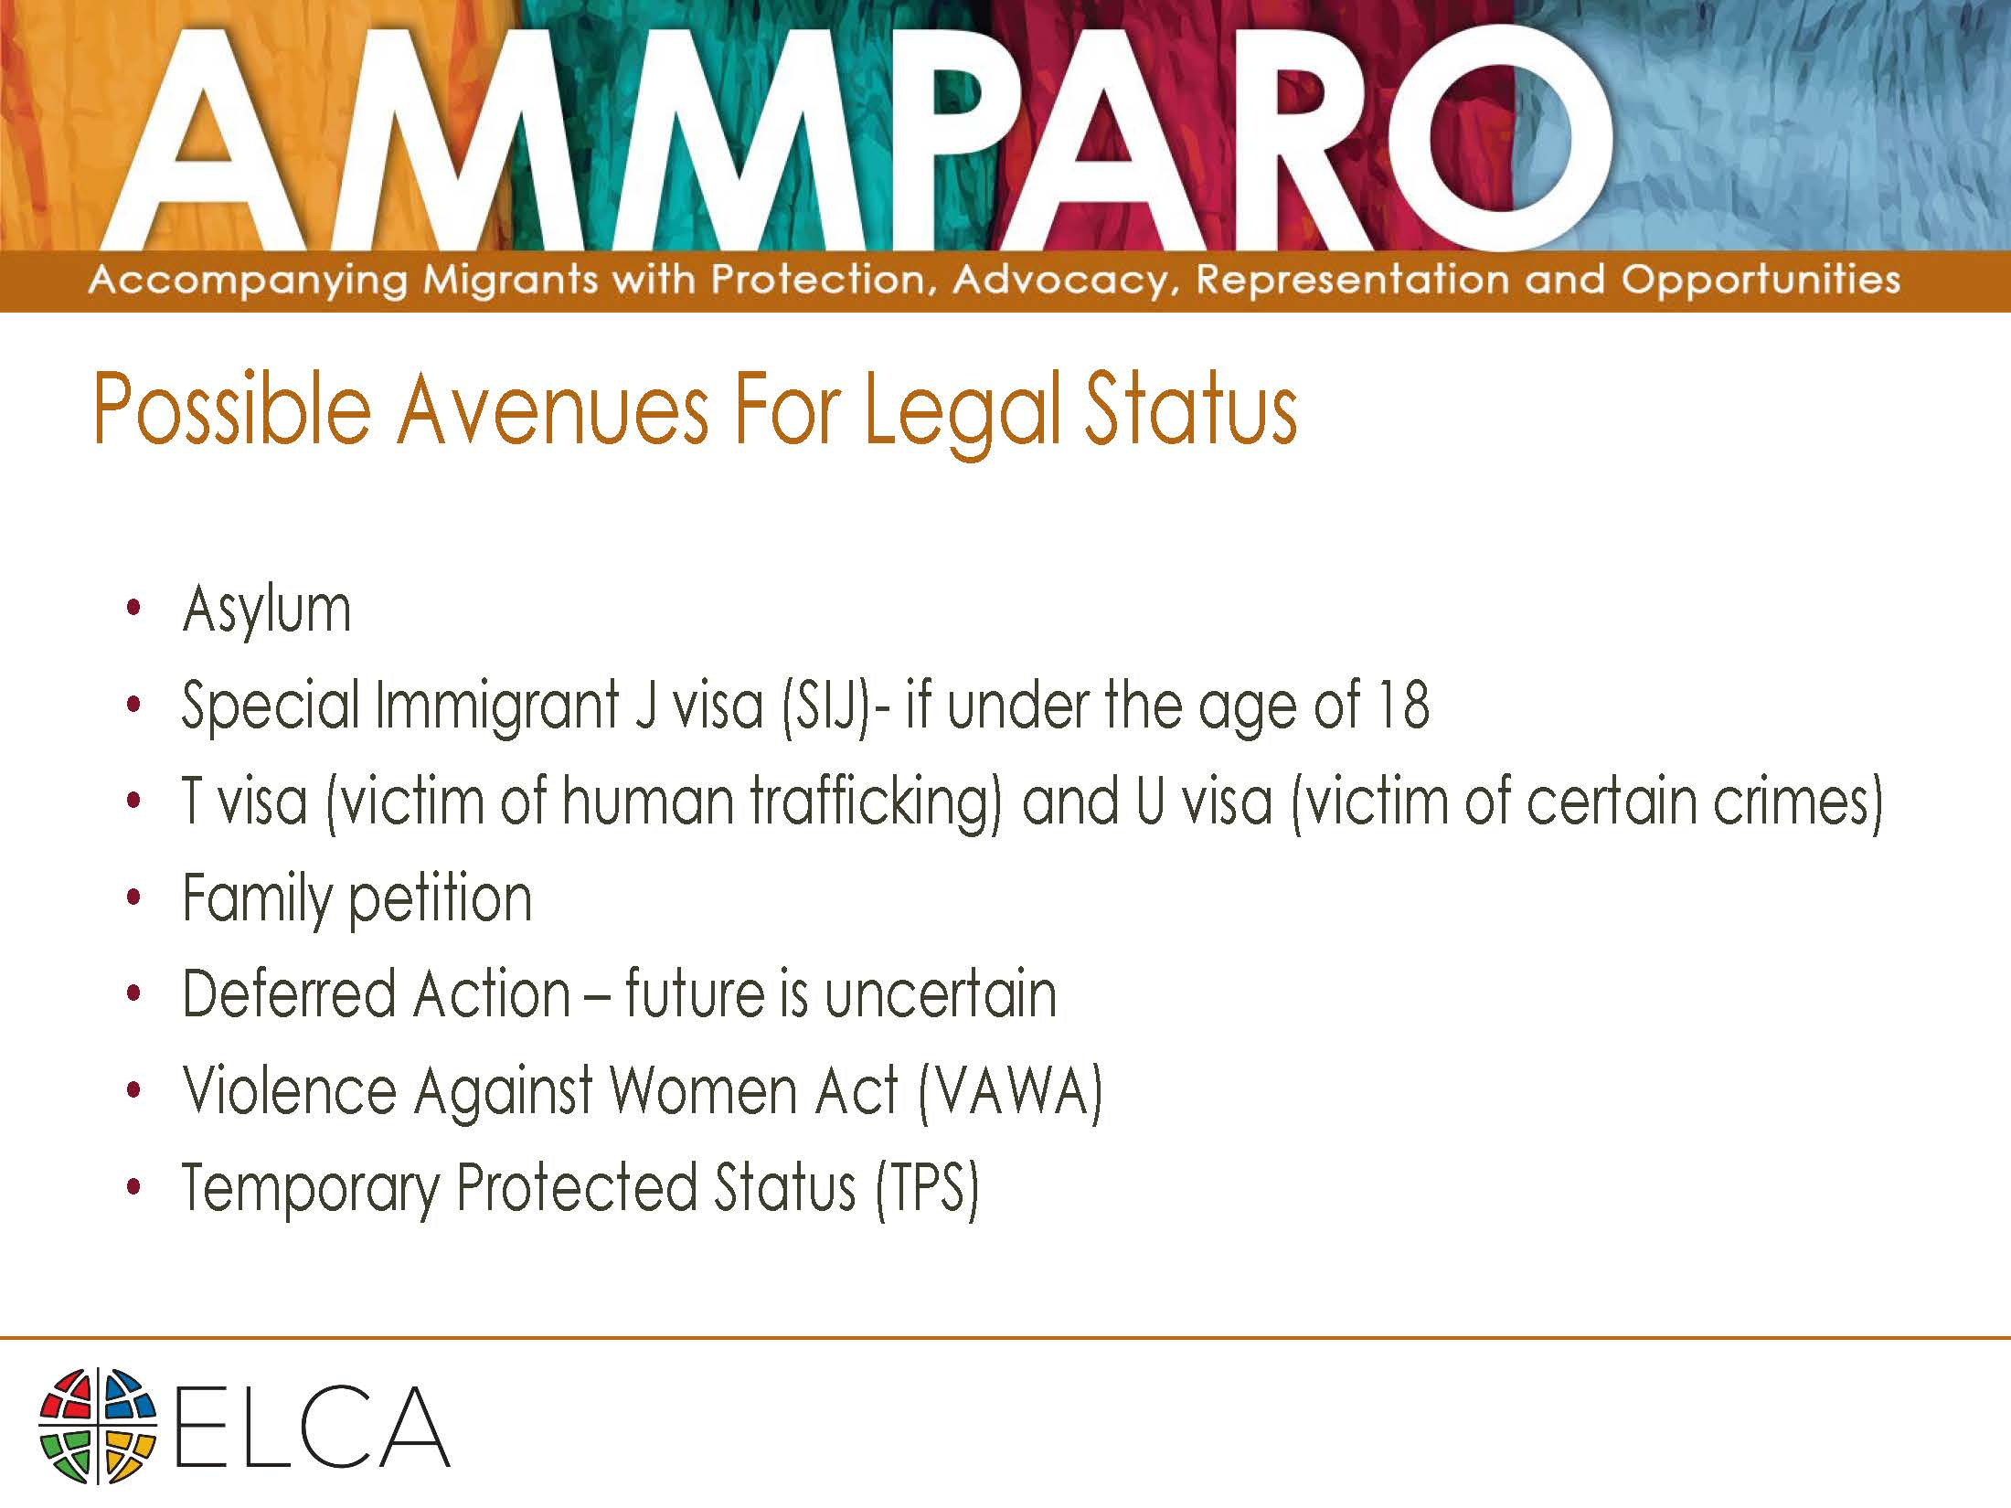

Slide 29


Slide 30


Slide 31


Slide 32


Slide 33


Slide 34


Slide 35


