Slide 1

Imagine...
IMAGINE!
Imagine?
Prelude I Have A Dream (Mary Lou Williams)
Mary Lou Williams (1910-1981) is one of the great pianists, composers, and arrangers of jazz. Williams wrote and arranged for such bandleaders as Duke Ellington and Benny Goodman, and she was friend, mentor, and teacher to Thelonious Monk, Charlie Parker, Miles Davis, Tadd Dameron, Dizzy Gillespie, and many others. Through the 1960s she wrote extensive liturgical and sacred music including Mary Lou’s Mass. “I Have A Dream” was written as a response to Martin Luther King Jr.’s assassination and is based on the text of his famous “I Have A Dream” speech.

Slide 2
Imagine...
IMAGINE!
Imagine?
For the Music of Creation
Notes:
Title slide during instrumental introduction

Slide 3
Imagine...
IMAGINE!
Imagine?
For the music of creation, for the song your Spirit sings,
For your sounds divine expression, burst of joy in living things:

Slide 4
Imagine...
IMAGINE!
Imagine?
God, our God, the world’s composer, hear us, echoes of your voice;
Music is your art, your glory, let the human heart rejoice!

Slide 5
Imagine...
IMAGINE!
Imagine?
Psalms and symphonies exalt you, drum and trumpet, string and reed,

Slide 6
Imagine...
IMAGINE!
Imagine?
Simple melodies acclaim you, tunes that rise from deepest need,

Slide 7
Imagine...
IMAGINE!
Imagine?
Hymns of longing and belonging, carols from a cheerful throat,

Slide 8
Imagine...
IMAGINE!
Imagine?
Lilt of lullaby and love song catching heaven in a note.

Slide 9
Imagine...
IMAGINE!
Imagine?
All the voices of the ages in transcendent chorus meet,

Slide 10
Imagine...
IMAGINE!
Imagine?
Worship lifting up the senses, hands that praise, and dancing feet;

Slide 11
Imagine...
IMAGINE!
Imagine?
Over discord and division music speaks your joy and peace,

Slide 12
Imagine...
IMAGINE!
Imagine?
Harmony of earth and heaven, song of God that cannot cease!

Slide 13
Imagine...
IMAGINE!
Imagine?
Greeting
The grace of our Lord Jesus Christ, the love of God, and the communion of the Holy Spirit be with you all. And also with you.

Slide 14
Imagine...
IMAGINE!
Imagine?
Kyrie
The Spirit Is Moving: A Jazz Liturgy of Renewal
by Jon Ailabouni
Notes:
Title slide during instrumental introduction – consider deleting

Slide 15
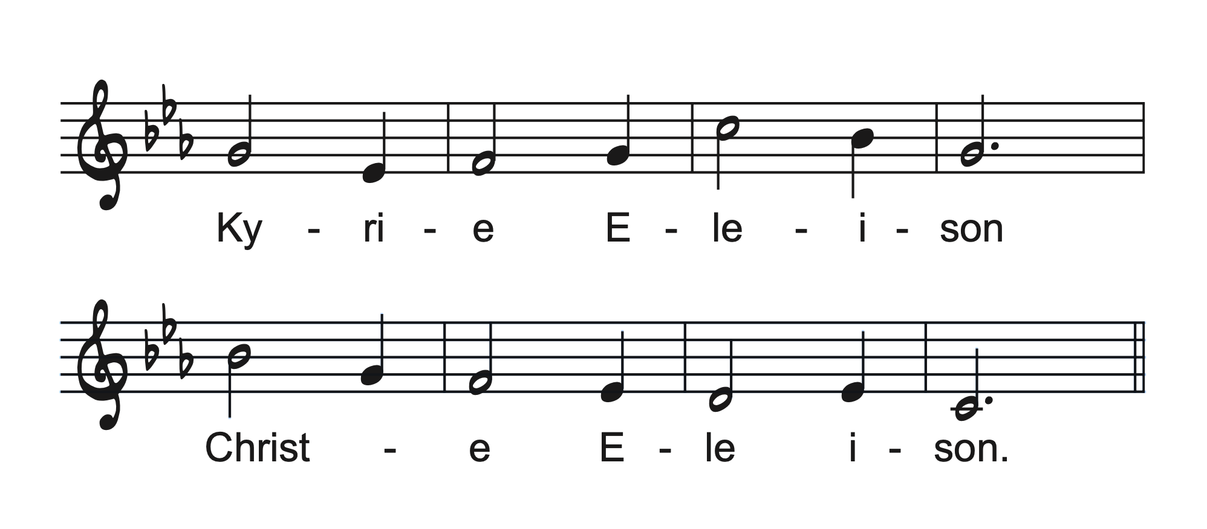
Imagine...
IMAGINE!
Imagine?

Slide 16
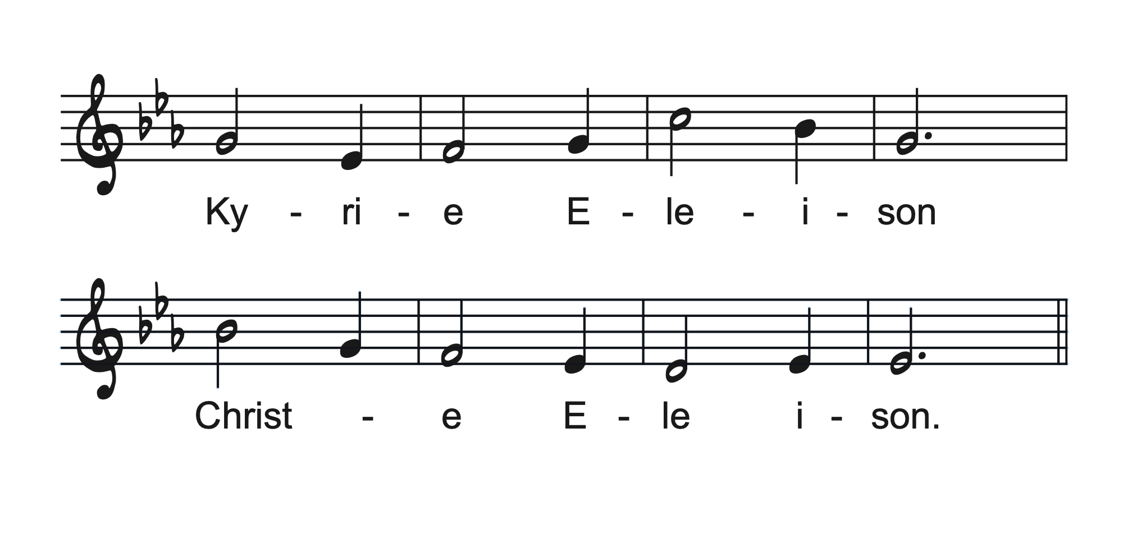
Imagine...
IMAGINE!
Imagine?

Slide 17
Imagine...
IMAGINE!
Imagine?

Slide 18
Imagine...
IMAGINE!
Imagine?

Slide 19
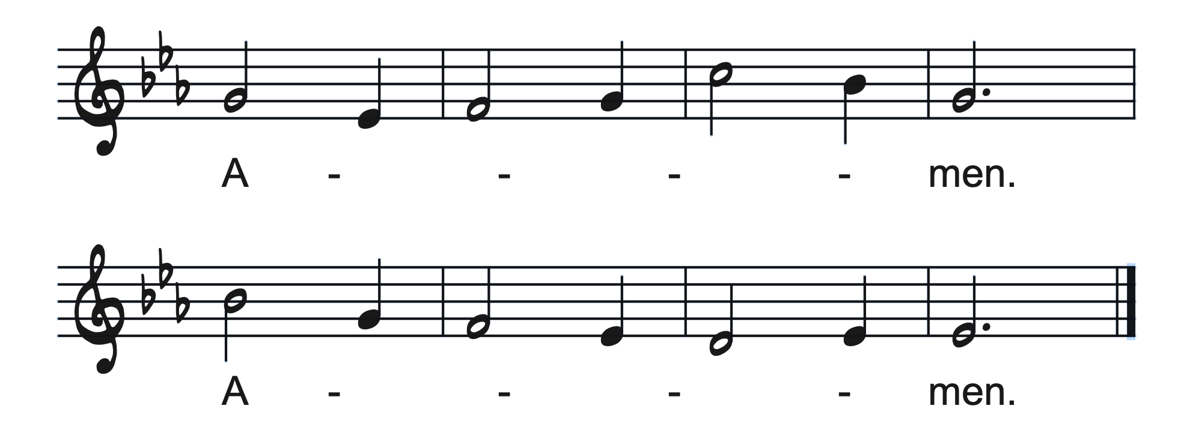
Imagine...
IMAGINE!
Imagine?

Slide 20
Imagine...
IMAGINE!
Imagine?
Glory To God
The Spirit Is Moving: A Jazz Liturgy of Renewal
by Jon Ailabouni
Notes:
Title slide during instrumental introduction – consider deleting

Slide 21
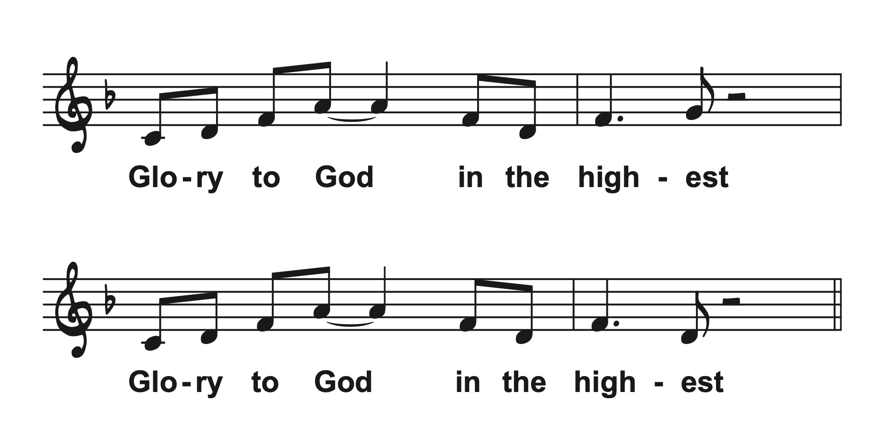
Imagine...
IMAGINE!
Imagine?

Slide 22
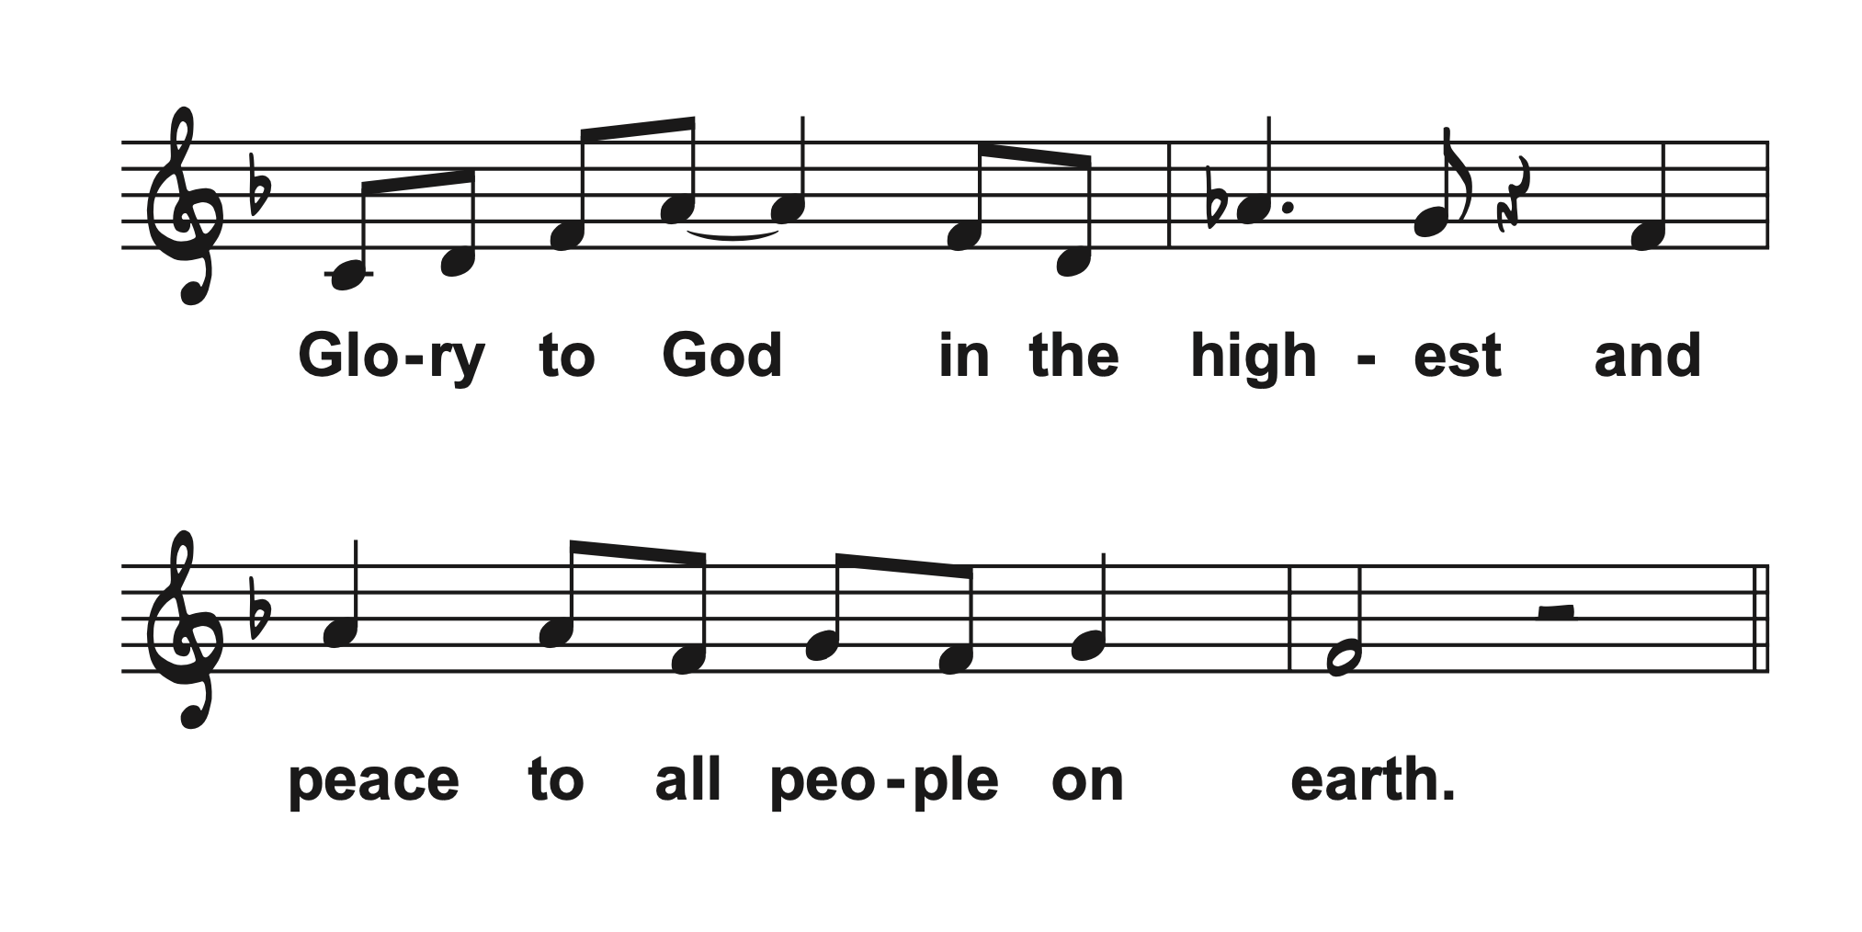
Imagine...
IMAGINE!
Imagine?

Slide 23
Imagine...
IMAGINE!
Imagine?

Slide 24
Imagine...
IMAGINE!
Imagine?

Slide 25
Imagine...
IMAGINE!
Imagine?
Cantor:
Glory to our God the Parent
Glory to God the Son
Glory to the Holy Spirit
Glory to the three in one

Slide 26
Imagine...
IMAGINE!
Imagine?

Slide 27
Imagine...
IMAGINE!
Imagine?

Slide 28

Notes:
Leave blank for instrumental

Slide 29
Imagine...
IMAGINE!
Imagine?

Slide 30
Imagine...
IMAGINE!
Imagine?

Slide 31
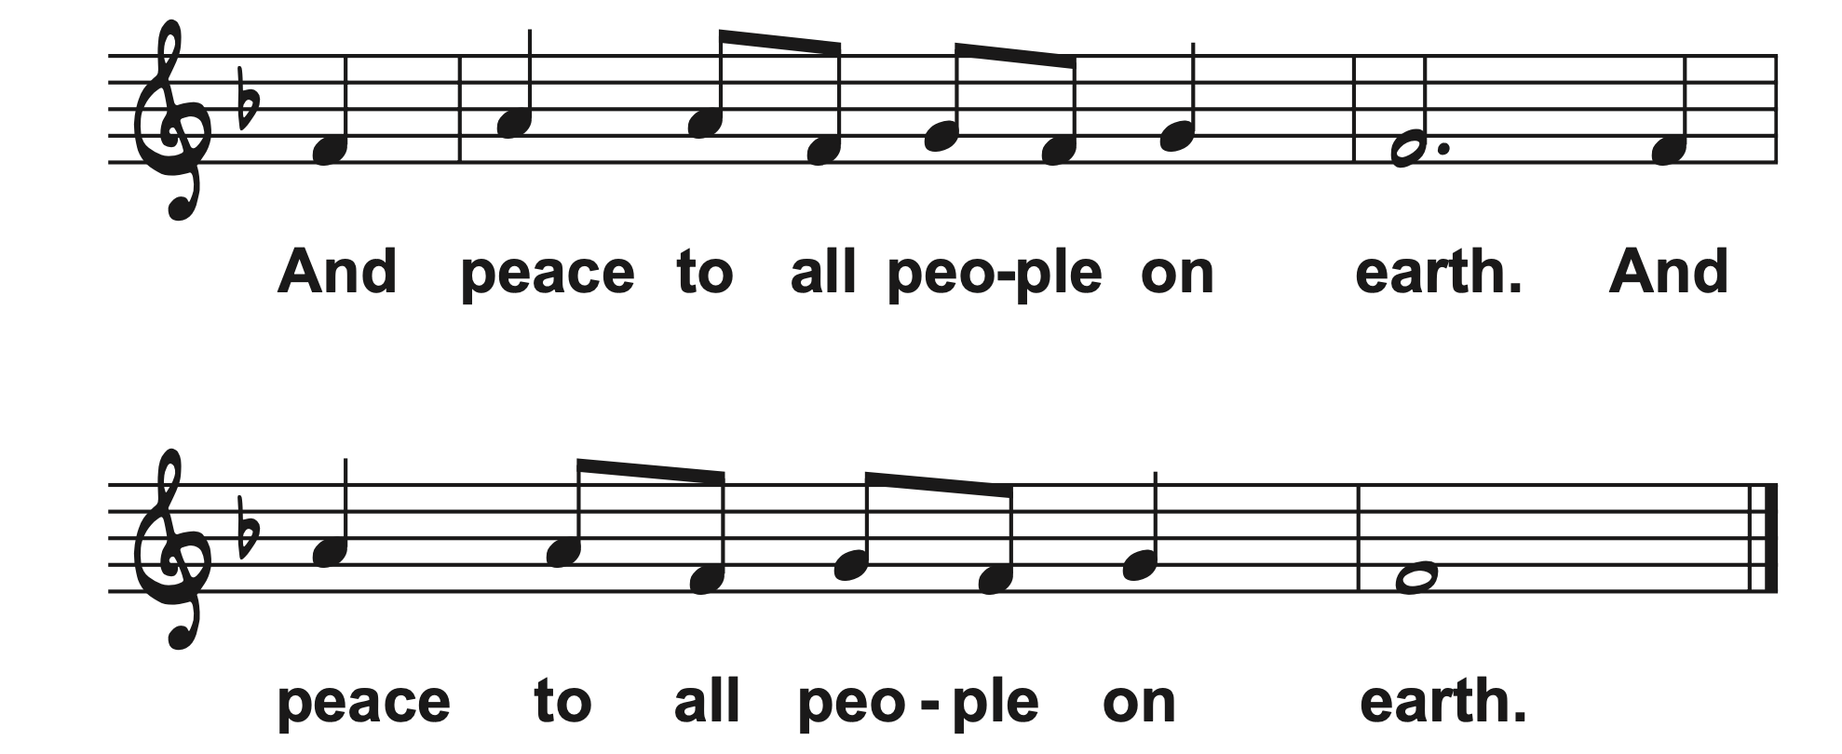
Imagine...
IMAGINE!
Imagine?

Slide 32
Imagine...
IMAGINE!
Imagine?
Prayer of the Day
Lifegiving God, we thank you, divine Seamstress for you never stop creating or imagining. From the dawn of time, to our mother’s womb, even in the age to come, your creativity is as endless as eternity. Today you are knitting us, your people, into one garment of many colors.

Slide 33
Imagine...
IMAGINE!
Imagine?
May we participate with God in creating a world where the unity for which Jesus prayed is knit within every action. A world where all are seen and welcomed as their authentic selves, included fully in the table of grace and mercy and sent out to continue Jesus’ work to proclaim God’s unifying love to a hurting, divided world. Amen.

Slide 34
Imagine...
IMAGINE!
Imagine?
First Reading–Acts 16:16-34
¹⁶ One day as we were going to the place of prayer, we met a female slave who had a spirit of divination and brought her owners a great deal of money by fortune-telling. ¹⁷ While she followed Paul and us, she would cry out, “These men are slaves of the Most High God, who proclaim to youthe way of salvation.” ¹⁸ She kept doing this for many

Slide 35
Imagine...
IMAGINE!
Imagine?
days. But Paul, very much annoyed, turned and said to the spirit, “I order you in the name of Jesus Christ to come out of her.” And it came out that very hour.
¹⁹ But when her owners saw that their hope of making money was gone, they seized Paul and Silas and dragged them into the marketplace before the authorities. ²⁰ When they had brought them before the magistrates, they said,

Slide 36
Imagine...
IMAGINE!
Imagine?
“These men, these Jews, are disturbing our city ²¹ and are advocating customs that are not lawful for us, being Romans, to adopt or observe.” ²² The crowd joined in attacking them, and the magistrates had them stripped of their clothing and ordered them to be beaten with rods.

Slide 37
Imagine...
IMAGINE!
Imagine?
²³ After they had given them a severe flogging, they threw them into prison and ordered the jailer to keep them securely. ²⁴ Following these instructions, he put them in the innermost cell and fastened their feet in the stocks.²⁵ About midnight Paul and Silas were praying and singing hymns to God, and the prisoners were listening to them.

Slide 38
Imagine...
IMAGINE!
Imagine?
²⁶ Suddenly there was an earthquake so violent that the foundations of the prison were shaken, and immediately all the doors were opened and everyone’s chains were unfastened. ²⁷ When the jailer woke up and saw the prison doors wide open, he drew his sword and was about to kill himself, since he supposed that the prisoners had escaped.

Slide 39
Imagine...
IMAGINE!
Imagine?
²⁸ But Paul shouted in a loud voice, “Do not harm yourself, for we are all here.” ²⁹ The jailer called for lights, and rushing in, he fell down trembling before Paul and Silas. ³⁰ Then he brought them outside and said, “Sirs, what must I do to be saved?” ³¹ They answered, “Believe in the Lord Jesus, and you will be saved, you and your household.”

Slide 40
Imagine...
IMAGINE!
Imagine?
³² They spoke the word of the Lord to him and to all who were in his house. ³³ At the same hour of the night he took them and washed their wounds; then he and his entire family were baptized without delay. ³⁴ He brought them up into the house and set food before them, and he and his entire household rejoiced that he had become a believer in God. Word of God, Word of Life,
Thanks be to God.

Slide 41
Imagine...
IMAGINE!
Imagine?
Psalmody
The Spirit Is Moving: A Jazz Liturgy of Renewal
by Jon Ailabouni
Notes:
Title slide during instrumental introduction – consider deleting

Slide 42
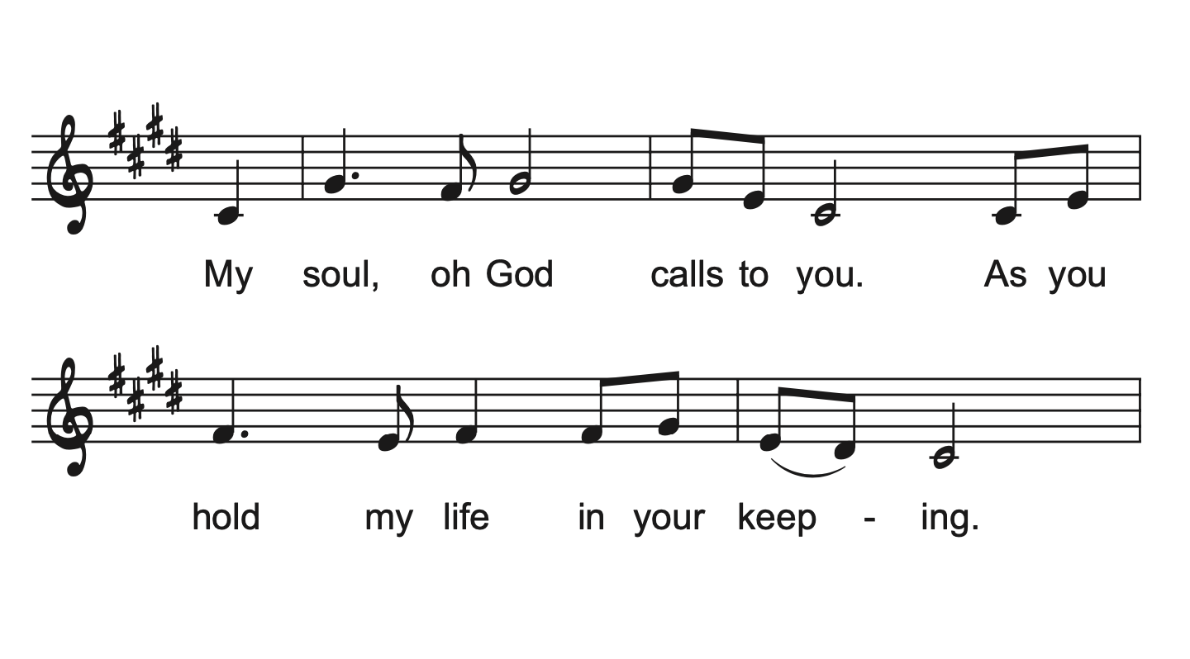
Cantor:

Slide 43
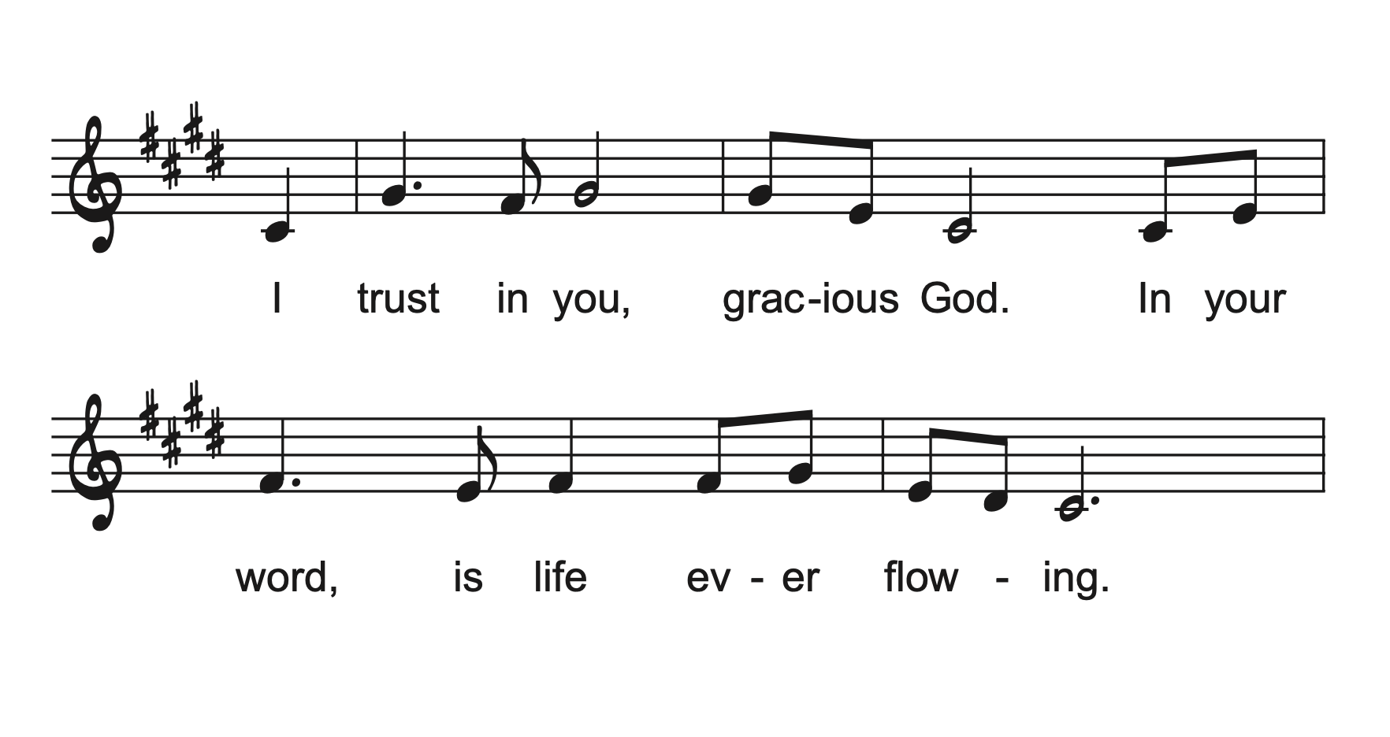

Slide 44
Congregation:

Slide 46
Imagine...
IMAGINE!
Imagine?
Psalm 97
The Lord reigns; let the | earth rejoice;
let the multitude of the | isles be glad.
Clouds and darkness sur- | round the Lord,
righteousness and justice are the foundations | of God’s throne.
Notes:
Is Psalm 97 for Saturday only?

Slide 47
Imagine...
IMAGINE!
Imagine?
Fire goes be- | fore the Lord,
burning up enemies on | every side.
Lightnings light | up the world;
the earth | sees and trembles.
Notes:
Is Psalm 97 for Saturday only?

Slide 48
Imagine...
IMAGINE!
Imagine?
The mountains | melt like wax
before the Lord of | all the earth.
The heavens declare your righteous- | ness, O Lord,
and all the peoples | see your glory.
Notes:
Is Psalm 97 for Saturday only?

Slide 49
Imagine...
IMAGINE!
Imagine?
Confounded be all who worship carved images and delight | in false gods!
Bow down before the Lord, | all you gods.
Zion hears and is glad, and the cities of Ju- | dah rejoice,
because of your judg- | ments, O Lord.
Notes:
Is Psalm 97 for Saturday only?

Slide 50
Imagine...
IMAGINE!
Imagine?
For you are the Lord, most high over | all the earth;
you are exalted far a- | bove all gods.
You who love the | Lord, hate evil!
God guards the lives of the saints and rescues them from the hand | of the wicked.
Notes:
Is Psalm 97 for Saturday only?

Slide 51
Imagine...
IMAGINE!
Imagine?
Light dawns | for the righteous,
and joy for the hon- | est of heart.
Rejoice in the | Lord, you righteous,
and give thanks to God’s | holy name.
Notes:
Is Psalm 97 for Saturday only?

Slide 52
Congregation:

Slide 54
Imagine...
IMAGINE!
Imagine?
Second Reading–Revelation 22:12-14, 16-17, 20-21
¹² “See, I am coming soon; my reward is with me, to repay according to everyone’s work. ¹³ I am the Alpha and the Omega, the First and the Last, the Beginning and the End.” ¹⁴ Blessed are those who wash their robes, so that they will have the right to the tree of life and may enter the city by the gates.

Slide 55
Imagine...
IMAGINE!
Imagine?
¹⁶ “It is I, Jesus, who sent my angel to you with this testimony for the churches. I am the root and the descendant of David, the bright morning star.” ¹⁷ The Spirit and the bride say, “Come.” And let everyone who hears say, “Come.” And let everyone who is thirsty come. Let anyone who wishes take the water of life as a gift.

Slide 56
Imagine...
IMAGINE!
Imagine?
²⁰ The one who testifies to these things says, “Surely I am coming soon.” Amen. Come, Lord Jesus! ²¹ The grace of the Lord Jesus be with all the saints. Amen.
Word of God, Word of Life,
Thanks be to God.

Slide 57
Imagine...
IMAGINE!
Imagine?
Gospel Acclamation
The Spirit Is Moving: A Jazz Liturgy of Renewal
By Jon Ailabouni
Notes:
Title slide during instrumental introduction – consider deleting

Slide 58
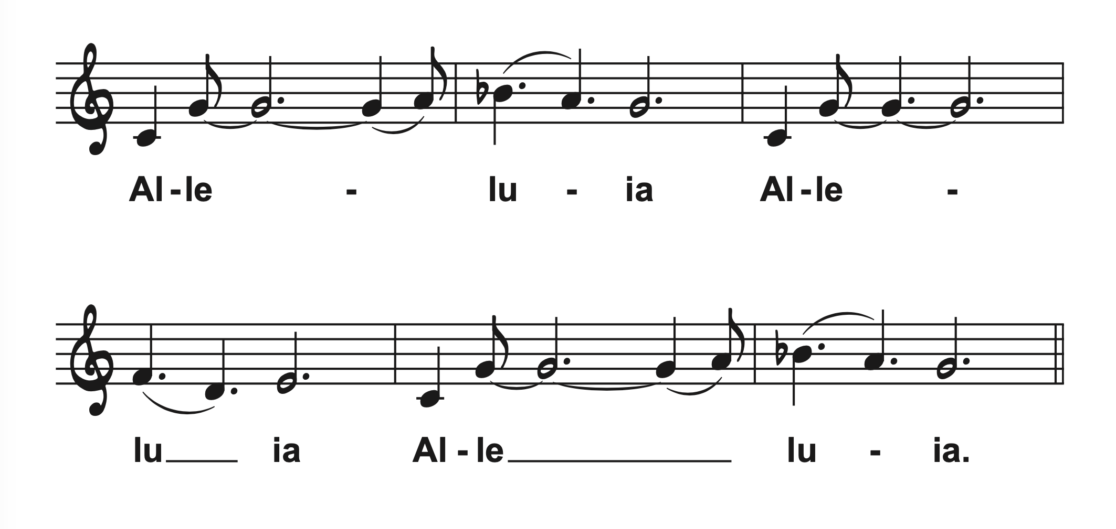
Imagine...
IMAGINE!
Imagine?
Cantor:

Slide 59
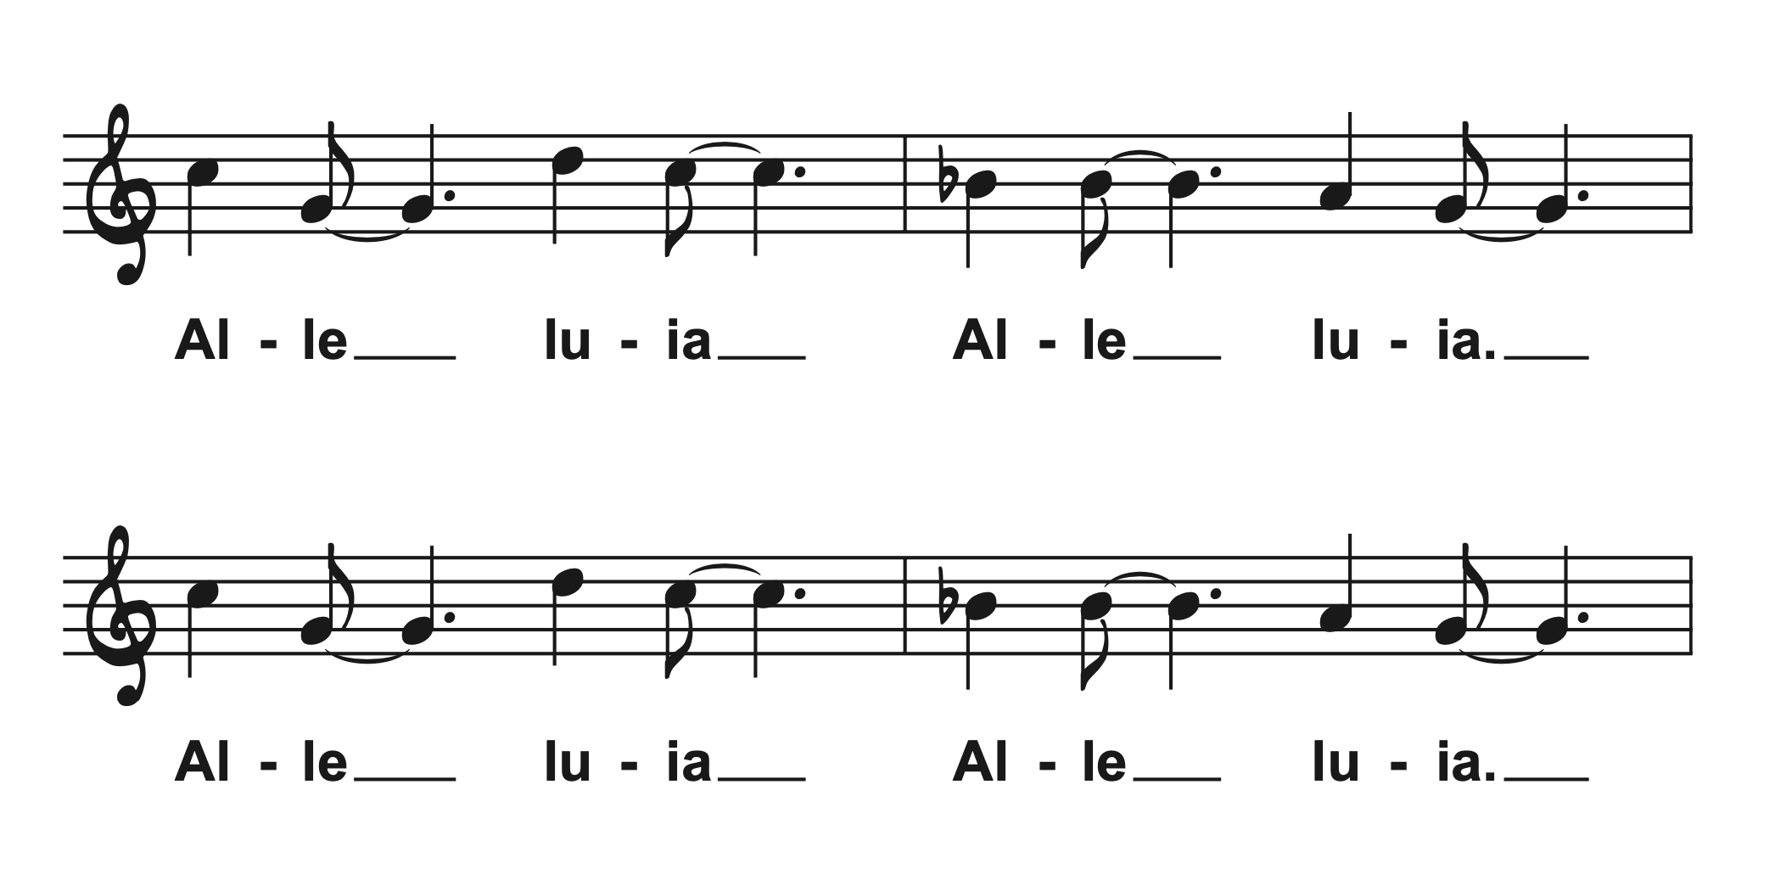
Imagine...
IMAGINE!
Imagine?

Slide 60
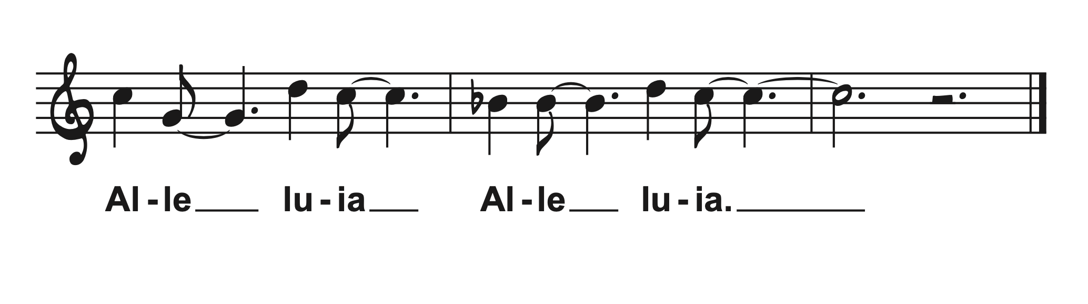
Imagine...
IMAGINE!
Imagine?

Slide 61
Imagine...
IMAGINE!
Imagine?
Congregation:

Slide 62
Imagine...
IMAGINE!
Imagine?

Slide 63
Imagine...
IMAGINE!
Imagine?

Slide 64
Imagine...
IMAGINE!
Imagine?
Gospel–John 17:20-26
The holy gospel according to John the 17th chapter.
Glory to you, O Lord.
²⁰ “I ask not only on behalf of these but also on behalf of those who believe in me through their word, ²¹ that they may all be one. As you, Father, are in me and I am in you,

Slide 65
Imagine...
IMAGINE!
Imagine?
may they also be in us, so that the world may believe that you have sent me. ²² The glory that you have given me I have given them, so that they may be one, as we are one, ²³ I in them and you in me, that they may become completely one, so that the world may know that you have sent me and have loved them even as you have loved me.

Slide 66
Imagine...
IMAGINE!
Imagine?
²⁴ Father, I desire that those also, whom you have given me, may be with me where I am, to see my glory, which you have given me because you loved me before the foundation of the world.
²⁵ “Righteous Father, the world does not know you, but I know you, and these know that you have sent me.

Slide 67
Imagine...
IMAGINE!
Imagine?
²⁶ I made your name known to them, and I will make it known, so that the love with which you have loved me may be in them and I in them.”
The Gospel of the Lord.
Praise to you, O Christ.

Slide 68
Imagine...
IMAGINE!
Imagine?
Sermon
“One Church, Better Together”
Bishop Scott Alan Johnson
Notes:
Leave blank – short drum solo before final verse

Slide 69
Imagine...
IMAGINE!
Imagine?
Somos Uno en Cristo (ELW 643)
Somos uno en Cristo, somos uno.
Somos uno, uno solo.
Somos uno en Cristo, somos uno.
Somos uno, uno solo.

Slide 70
Imagine...
IMAGINE!
Imagine?
Un solo Dios, un solo Señor,
Una sola fe, un solo amor.
Un solo bautismo, un solo Espíritu,
Y ese es el consolador.

Slide 71
Imagine...
IMAGINE!
Imagine?
We are all one in Christ, we are one body,
All one people out of many.
We are all one in Christ, we are one body,
All one people out of many.

Slide 72
Imagine...
IMAGINE!
Imagine?
There is one God, and only one Lord;
There is one faith, one holy love.
There is one baptism; there is one Spirit,
Who is God the comforter.

Slide 73
Imagine...
IMAGINE!
Imagine?
Somos uno en Cristo, somos uno.
Somos uno, uno solo.
Somos uno en Cristo, somos uno.
Somos uno, uno solo

Slide 74
Imagine...
IMAGINE!
Imagine?
Un solo Dios, un solo Señor,
Una sola fe, un solo amor.
Un solo bautismo, un solo Espíritu,
Y ese es el consolador.

Slide 75
Imagine...
IMAGINE!
Imagine?
Niceno- Constantinopolitan Creed
We believe in one God, the Father, the Almighty, maker of heaven and earth, of all that is, seen and unseen.

Slide 76
Imagine...
IMAGINE!
Imagine?
We believe in one Lord, Jesus Christ, the only Son of God, eternally begotten of the Father, God from God, Light from Light, true God from true God, begotten, not made, of one Being with the

Slide 77
Imagine...
IMAGINE!
Imagine?
Father; through him all things were made. For us and for our salvation he came down from heaven, was incarnate of the Holy Spirit and the virgin Mary and became truly human.

Slide 78
Imagine...
IMAGINE!
Imagine?
For our sake he was crucified under Pontius Pilate; he suffered death and was buried. On the third day he rose again in accordance with the scriptures; he ascended into heaven and is seated

Slide 79
Imagine...
IMAGINE!
Imagine?
at the right hand of the Father. He will come again in glory to judge the living and the dead, and his kingdom will have no end.

Slide 80
Imagine...
IMAGINE!
Imagine?
We believe in the Holy Spirit, the Lord, the giver of life, who proceeds from the Father, who with the Father and the Son is worshiped and glorified, who has spoken through the prophets

Slide 81
Imagine...
IMAGINE!
Imagine?
We believe in one holy catholic and apostolic church. We acknowledge one baptism for the forgiveness of sins. We look for the resurrection of the dead, and the life of the world to come. Amen.

Slide 82
Imagine...
IMAGINE!
Imagine?
Yarabba ssalami
(Let Your Peace Rain Upon Us)
Yarabba ssalami
amter alayna ssalam,
yarabba ssalami,
im la' biladina ssalam.
Notes:
Jon Ailabouni will use this slide:
Teach the Arabic pronunciation
Play an instrumental introduction
Sing the melody one time with congregation

Slide 83
Imagine...
IMAGINE!
Imagine?
Prayers of Intercession
Trusting in the One who made us, dwells in us, and calls us to life, we pray for the world, the church, and all in need.

Slide 84
Imagine...
IMAGINE!
Imagine?
Welcoming God, you invite all people to come and encounter your love. Teach us to love neighbors who live in different skin. To love intelligences and abilities of all kinds, and loving-kindness most of all.

Slide 85
Imagine...
IMAGINE!
Imagine?
Make us bold in our proclamation that the lives, loves, and gifts of LGBTQIA, BIPOC, Incarcerated, Disabled, and Migrant people matter to you, and so they matter to all of us –manifest in both word and deed. God of grace,

Slide 86
Imagine...
IMAGINE!
Imagine?
Yarabba ssalami
amter alayna ssalam,
yarabba ssalami,
im la' biladina ssalam.

Slide 87
Imagine...
IMAGINE!
Imagine?
Creating God, who paints the skies in every hue, we praise you for morning and night, for dawn and dusk, and for every moment in between. We praise you for the vibrant, loud, and serene colors of creation. We revel in the ever-changing of the seasons.

Slide 88
Imagine...
IMAGINE!
Imagine?
We thank you for the infinite and as-yet undiscovered diversity of your creatures, of galaxies beyond our imagining. Teach us to feel awe again. Teach us to see and celebrate the stunning beauty in all you have made. God of grace,

Slide 89
Imagine...
IMAGINE!
Imagine?
Let your peace rain upon us,
O living God of peace.
Let your peace rain upon us,
Lord, fill our country with your peace.

Slide 90
Imagine...
IMAGINE!
Imagine?
Discerning God, fill the hearts of leaders with your passion and justice for mercy. Call the nations of this world to tables of peace and collaboration. Help us to end violence and restore communities. Encourage governments to seek avenues of collective benefit and joy. God of grace,

Slide 91
Imagine...
IMAGINE!
Imagine?
Yarabba ssalami
amter alayna ssalam,
yarabba ssalami,
im la' biladina ssalam.

Slide 92
Imagine...
IMAGINE!
Imagine?
Abiding God, all people are held in your care. Accompany survivors of abuse, trauma and exploitation. Strengthen our resolve to listen and advocate on behalf of all who are unnoticed, especially the hungry, those without homes, the refugee, and the stranger. Help all to know they are beloved by God, and worthy of love. God of grace,

Slide 93
Imagine...
IMAGINE!
Imagine?
Let your peace rain upon us,
O living God of peace.
Let your peace rain upon us,
Lord, fill our country with your peace.

Slide 94
Imagine...
IMAGINE!
Imagine?
Loving God, the beginning and the end, you are with us throughout our lives. In gratitude for the saints who have died, we look toward your coming again among us. We remember especially…

Slide 95
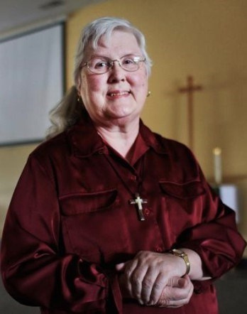
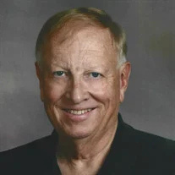
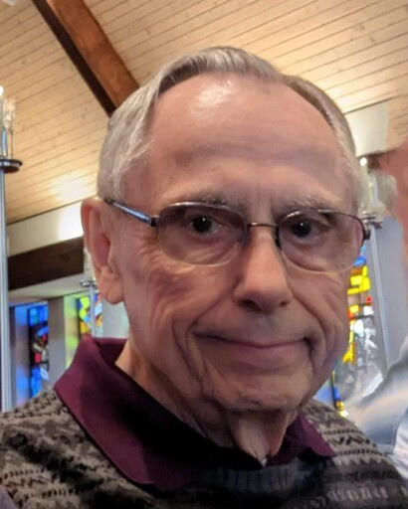
We Remember
Rev. Dr. Mary Jensen
PMA Rodney Hansen
Rev. Kent Morse

Slide 96
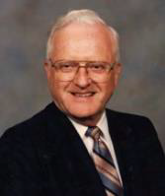
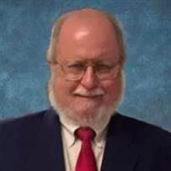
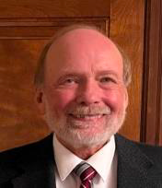
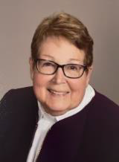
Rev. Alton Schwandt
Rev. Baron Cole
Rev. Dr. Olaf Roynesdal
Rev. Glenda Ferguson
God of grace,

Slide 97
Imagine...
IMAGINE!
Imagine?
Yarabba ssalami
amter alayna ssalam,
yarabba ssalami,
im la' biladina ssalam.

Slide 98
Imagine...
IMAGINE!
Imagine?
We commend these and all our prayers to you, O God, trusting that you are always with us; in the name of Jesus Christ, our risen Savior. Amen.
Prayers adapted from the following sources: Sundays and Seasons and Reconciling Works’ Deepening and Expanding Worship

Slide 99
Imagine...
IMAGINE!
Imagine?
Sharing of the Peace
Salaam! Fred! Pokoj! Rauha! The peace of Christ is with you always. And also with you.

Slide 100
Imagine...
IMAGINE!
Imagine?
Offering
Offerings given will be shared with our companion synods who are with us this weekend.

Slide 101
Imagine...
IMAGINE!
Imagine?
Musical Offering Come Sunday - Duke Ellington
“Come Sunday” was written by Duke Ellington in 1942 and premiered at Carnegie Hall on January 23, 1943 as part of a larger work entitled Black, Brown and Beige. Ellington introduced the suite as "a parallel to the history of the Negro in America." “Come Sunday” was included in a popular 1958 recording with Mahalia Jackson and again as part of Ellington’s Concert of Sacred Music in 1965.

Slide 102
Imagine...
IMAGINE!
Imagine?
OFFERING PRAYER
Let us pray. Gracious God, you bless us with gifts of guidance, new life, growth in grace, and fruitful labor. Accept the first fruits of time and toil, field and orchard we offer here. Bless and multiply these gifts to our nurture and the care of your creation; for the sake of your Son, our Savior Jesus Christ. Amen.

Slide 103
Imagine...
IMAGINE!
Imagine?
Thanksgiving for the Word
Holy God, our Maker, our Healer, our Teacher, your magnificent creation springs forth from your Word. All that has life and breath praises your name. For your Word that sustains the earth, we thank you, O God. We thank you, O God.

Slide 104
Imagine...
IMAGINE!
Imagine?
You sent us Jesus, your Word, to renew the world. He healed the sick, fed the hungry, preached your mercy, and called us to faith. For your Word in our Lord Christ, we praise you, O God.
We praise you, O God.

Slide 105
Imagine...
IMAGINE!
Imagine?
Nourish us with the Spirit of your Word, that we may grow in grace, bearing the fruits of redemption, and sharing your strength and beauty with all the world. For your Word in our lives, we entreat you, O God.
We entreat you, O God.

Slide 106
Imagine...
IMAGINE!
Imagine?
Accept our thanksgiving and receive our prayer, for the sake of your living Word, Jesus our Savior. Amen.

Slide 107
Imagine...
IMAGINE!
Imagine?
Blessing and Sending
As we are sent from this holy space and holy time, let us affirm our call to Christian vocation.

Slide 108
Imagine...
IMAGINE!
Imagine?
Beloved of God, both your work and your rest are in God. Will you endeavor to pattern your life on the Lord Jesus Christ, in gratitude to God and in service to others, at morning and evening, at work and at play, all the days of your life? I will, and I ask God to help me.

Slide 109
Imagine...
IMAGINE!
Imagine?
Almighty God, by the power of the Spirit you have knit these your servants into the one body of your Son, Jesus Christ. Look with favour upon them in their commitment to serve in Christ’s name. Give them courage, patience, and vision; and strengthen us all in our Christian vocation of witness to the world and of service to others.

Slide 110
Imagine...
IMAGINE!
Imagine?
Renew in us the commitment to use our gifts in the service of others, and especially of those in need. Let us be your hands to feed the hungry, shelter the homeless, clothe the naked, comfort the weary and outcast, welcome the stranger, care for creation, and be loving neighbors to all people.

Slide 111
Imagine...
IMAGINE!
Imagine?
Bless us as we go out from here to live and labor in our home congregations and communities. Prosper the work of our hands. May the gifts we use and share be signs of your love to all people, through Jesus Christ our Lord. Amen.

Slide 112
Imagine...
IMAGINE!
Imagine?
Siyahamba
(We Are Marching In The Light of God)
Zulu Folk Song
Notes:
Title slide during instrumental introduction – consider deleting

Slide 113
Imagine...
IMAGINE!
Imagine?
Si-ya-hamb’ e-ku-kha-neyn’kwen-khos’
Si-ya-hamb’ e-ku-kha-neyn’kwen-khos’

Slide 114
Imagine...
IMAGINE!
Imagine?
Si-ya-hamba, Si-ya-hamba oo
Si-ya-hamb’ e-ku-kha-neyn’kwen-khos’

Slide 115
Imagine...
IMAGINE!
Imagine?
We are dancing in the light of God
We are dancing in the light of God

Slide 116
Imagine...
IMAGINE!
Imagine?
We are dancing, dancing, we are dancing oo
We are dancing in the light of God

Slide 117
Imagine...
IMAGINE!
Imagine?
We are praying in the light of God
We are praying in the light of God

Slide 118
Imagine...
IMAGINE!
Imagine?
We are praying, praying, we are praying oo
We are praying in the light of God

Slide 119
Imagine...
IMAGINE!
Imagine?
We are singing in the light of God
We are singing in the light of God

Slide 120
Imagine...
IMAGINE!
Imagine?
We are singing, singing, we are singing oo
We are singing in the light of God

Slide 121
Notes:
Leave blank – short drum solo before final verse

Slide 122
Imagine...
IMAGINE!
Imagine?
Si-ya-hamb’ e-ku-kha-neyn’kwen-khos’
Si-ya-hamb’ e-ku-kha-neyn’kwen-khos’

Slide 123
Imagine...
IMAGINE!
Imagine?
Si-ya-hamba, Si-ya-hamba oo
Si-ya-hamb’ e-ku-kha-neyn’kwen-khos’

Slide 124
Imagine...
IMAGINE!
Imagine?
Dismissal
Go in peace to love and serve God, to live out your Christian vocation, and to imagine… Thanks be to God.

Slide 125
Imagine...
IMAGINE!
Imagine?
Music Credits
The Spirit is Moving: A Jazz Liturgy of Renewal and hymn arrangements by Jon Ailabouni. Used with permission. Published by Jon Ailabouni Music (ASCAP).
All music and liturgical texts reproduced in this service (unless otherwise noted) are used by permission under the following licenses: OneLicense: A-723746 Augsburg Fortress Liturgies Annual License: SAS027327 Sundays and Seasons Hymns and Songs License: A723746 CCLI: 1891425 From sundaysandseasons.com. Copyright © 2025 Augsburg Fortress. All rights reserved.

Slide 126
Imagine...
IMAGINE!
Imagine?
Thank you to our musicians!
Jon Ailabouni – trumpet
Mindi Hadan – vocals
Sean Lebita – piano
Jonah Bennet – bass
Kendal Wooden – drums
Go in peace to love and serve God, to live out your Christian vocation, and to imagine… Thanks be to God.

Slide 127

Imagine...
IMAGINE!
Imagine?
For more information about Jon Ailabouni and The Spirit is Moving: A Jazz Liturgy of Renewal

