Slide 1

Through Stewardship
With Rev. Chick Lane, Sarah Callahan and Dn. Timothy Siburg
A Pre-Assembly Event
For Nebraska Synod, ELCA in Assembly
Friday May 31, 2024

Slide 2
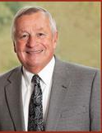
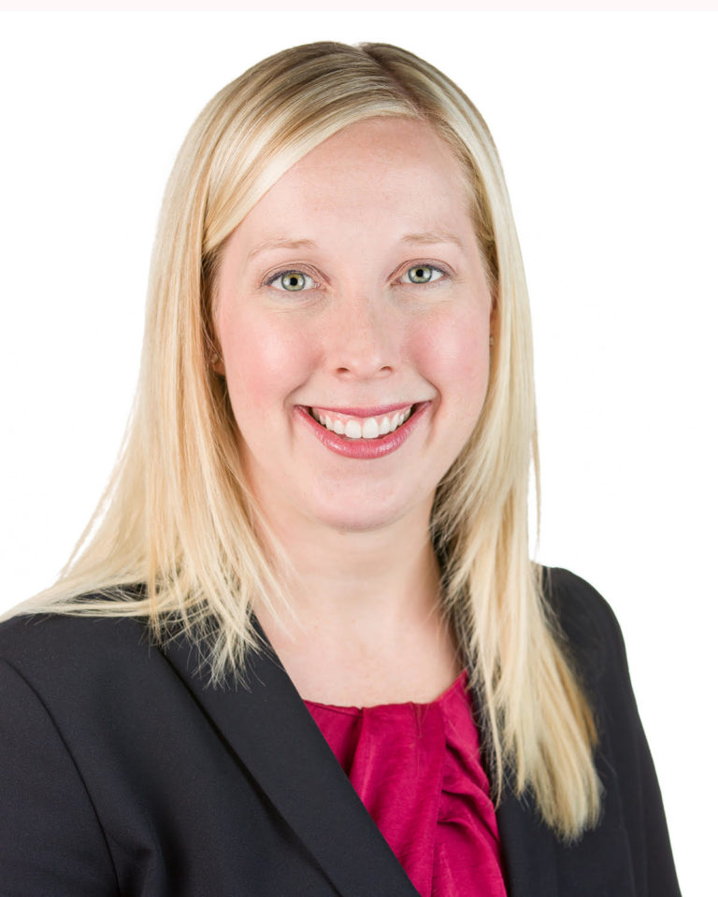
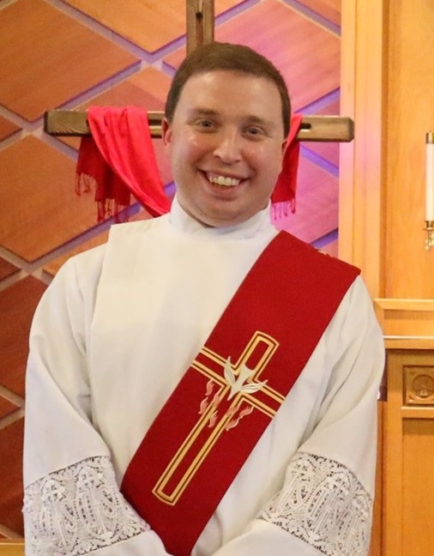

Welcome!
We’re glad you are here!
Introductions:
  Pastor Chick Lane
  Sarah Callahan, AEP & CAP
  Deacon Timothy Siburg
  And who are you?

Slide 3
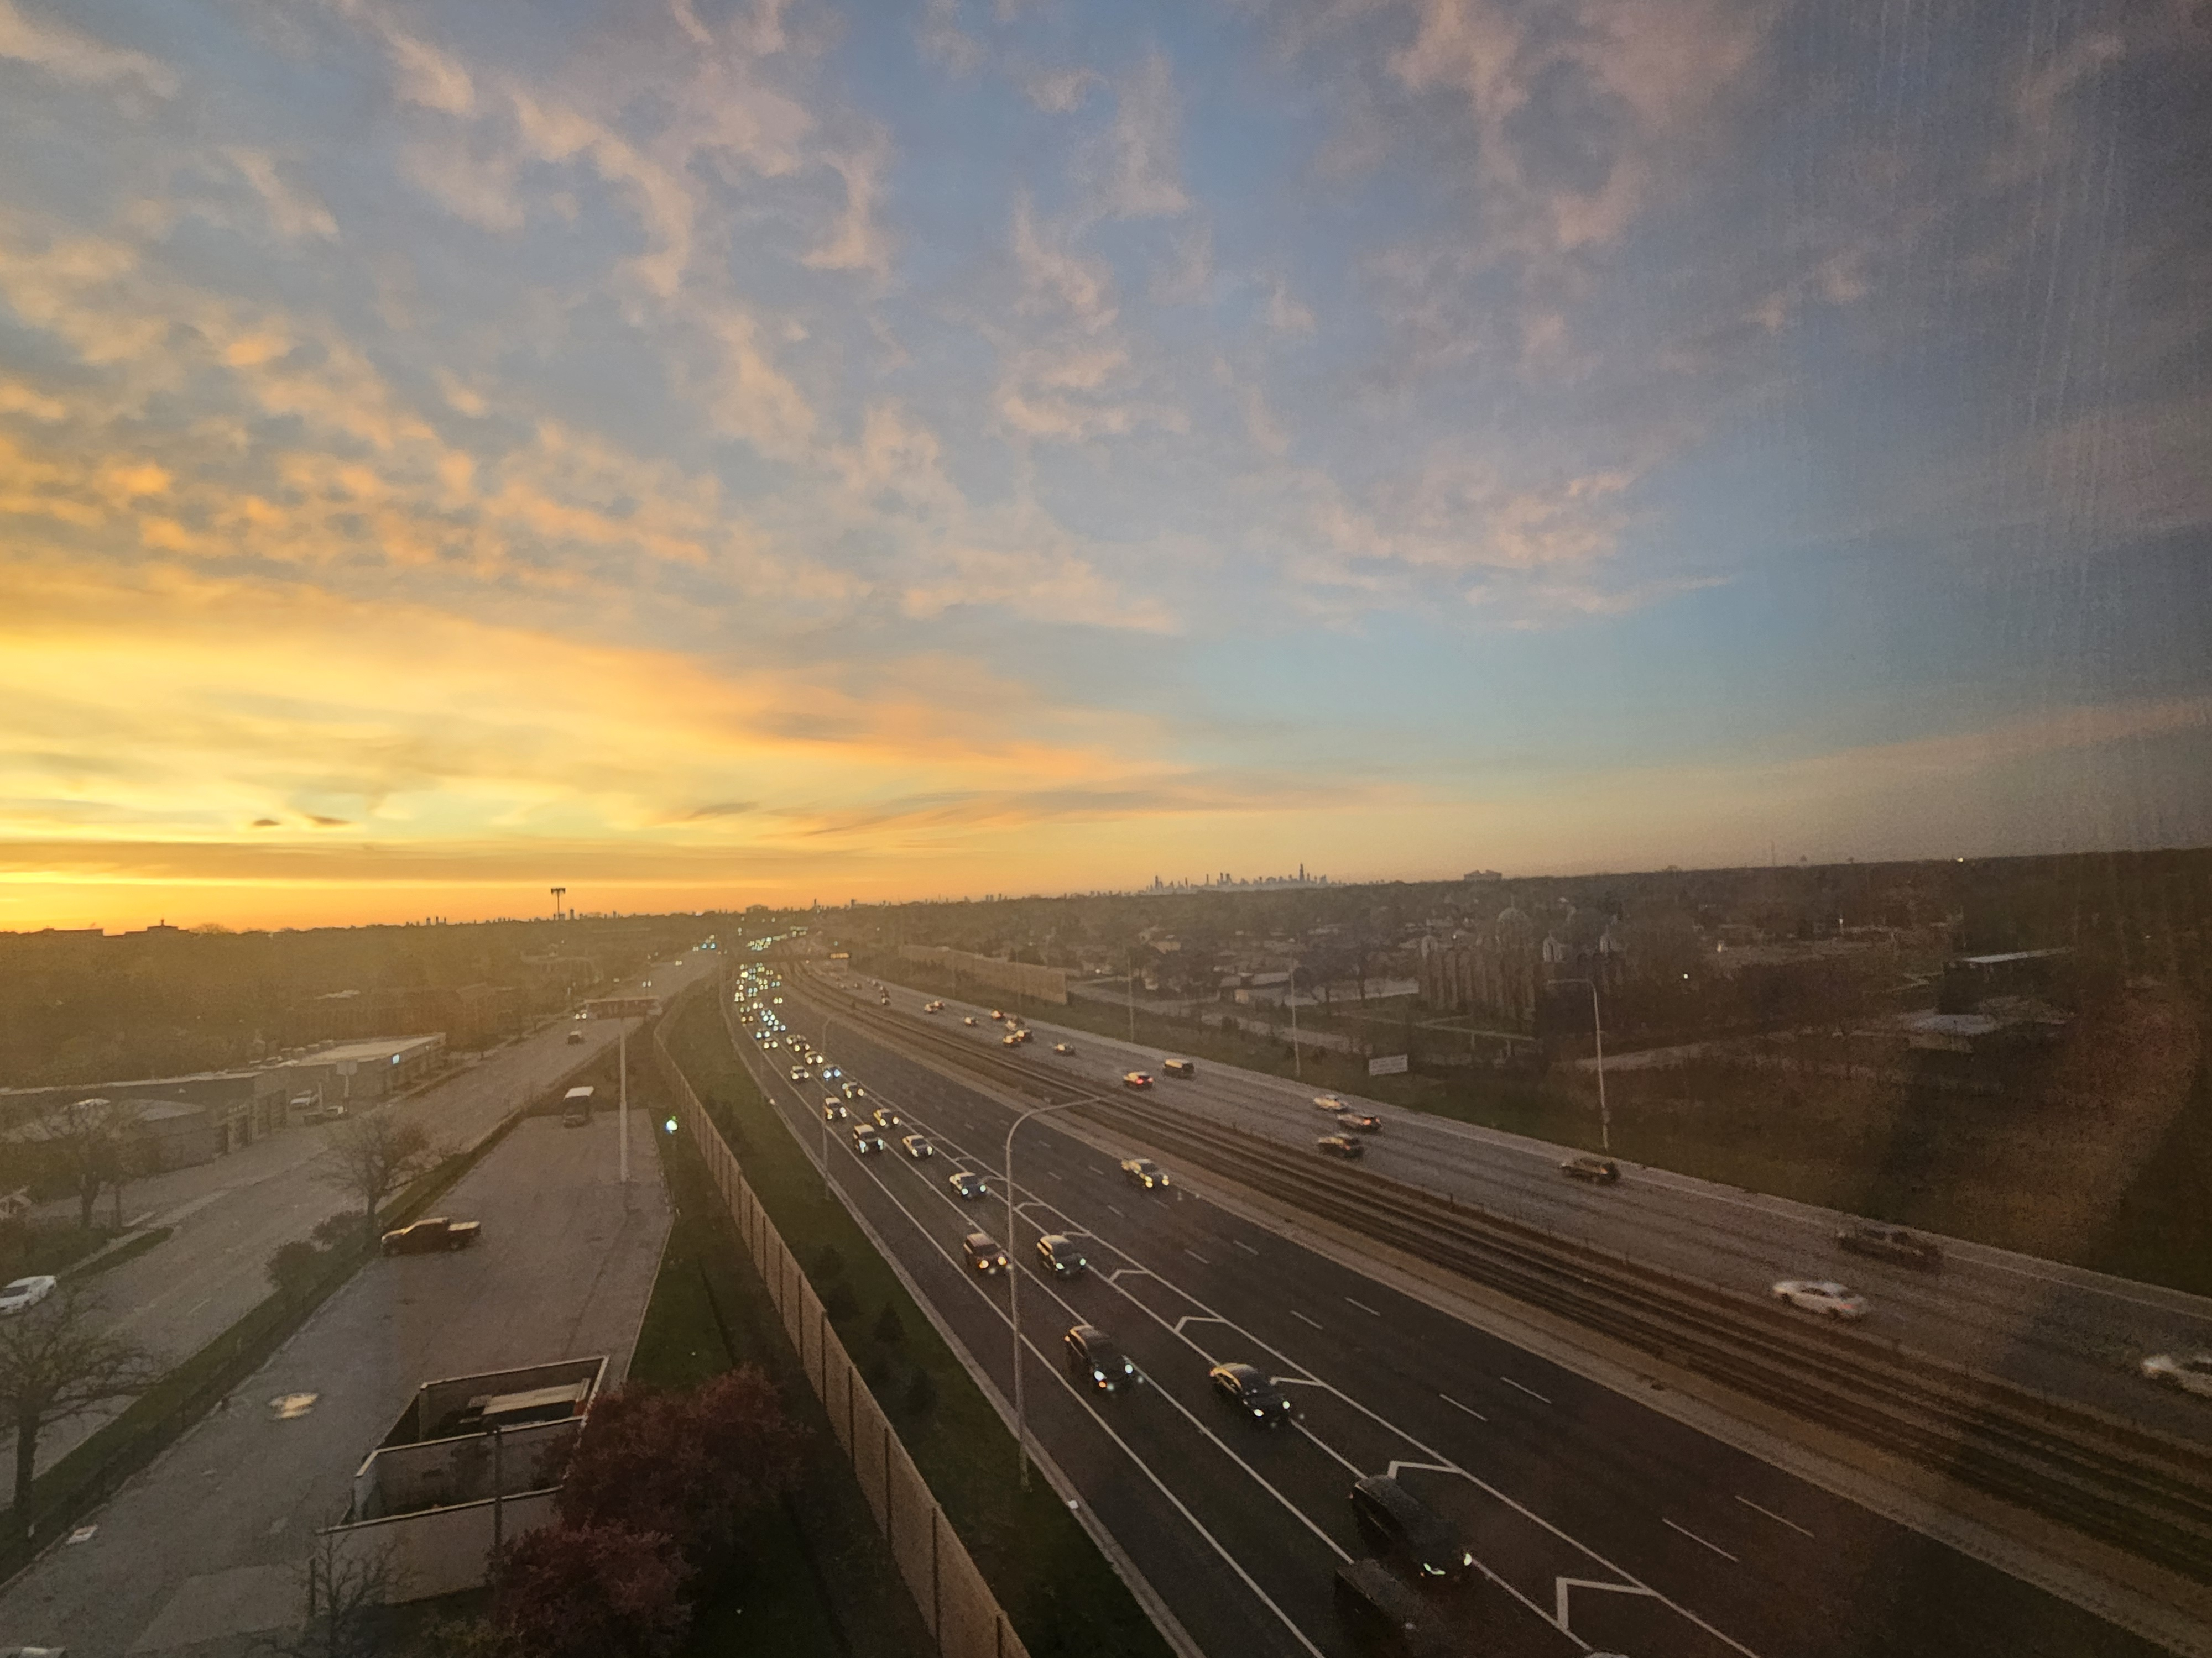
Overview of the Day and the Important Things
On your handout in front of you
The Basics
How has Covid changed your congregation’s stewardship ministry?
Ask- Encourage faithful stewards to grow in their giving & living
Thank- For gifts of the three T’s
Tell- Make sure people know
Leading stewardship in this new day
Next steps
Questions are good!
Break for lunch at noon
Restrooms are…
Resources available are...

Slide 4
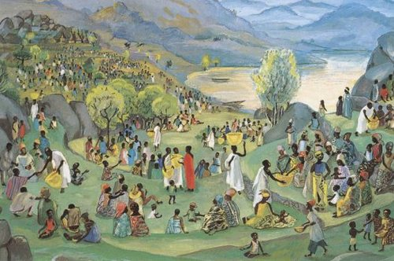
Beginning our Day in Scripture
Opening worship of assembly tomorrow will include the Gospel of John 6:1-14
Let’s dwell in this deep stewardship story for a bit
Listen to it
Then…
Painting: "Feeding of the Five Thousand" by Mafa in Cameroon. Photo of painting from Vanderbilt University Library. https://africanwaterlog.blogspot.com/2011/09/feeding-five-thousand.html

Slide 5
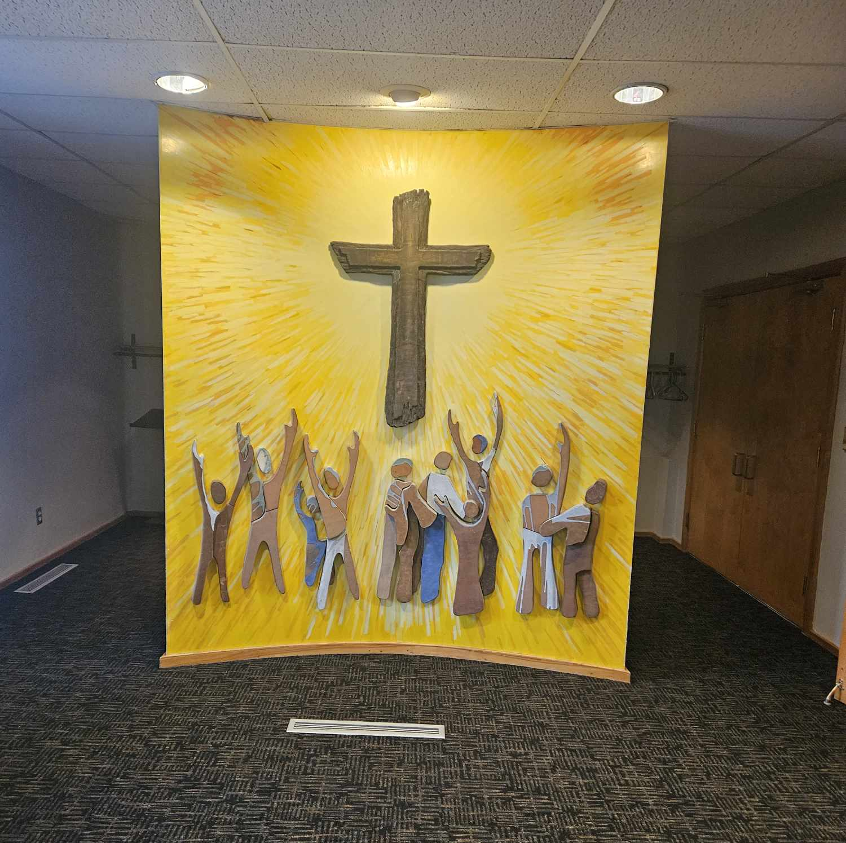
Imagine You are in the Story- Imagine if you are ______
Break into four groups as follows:
Group A: You brought some bread with you
Group B: You brought some fish with you
Group C: You brought nothing with you
Group D: You are the Disciples

Slide 6
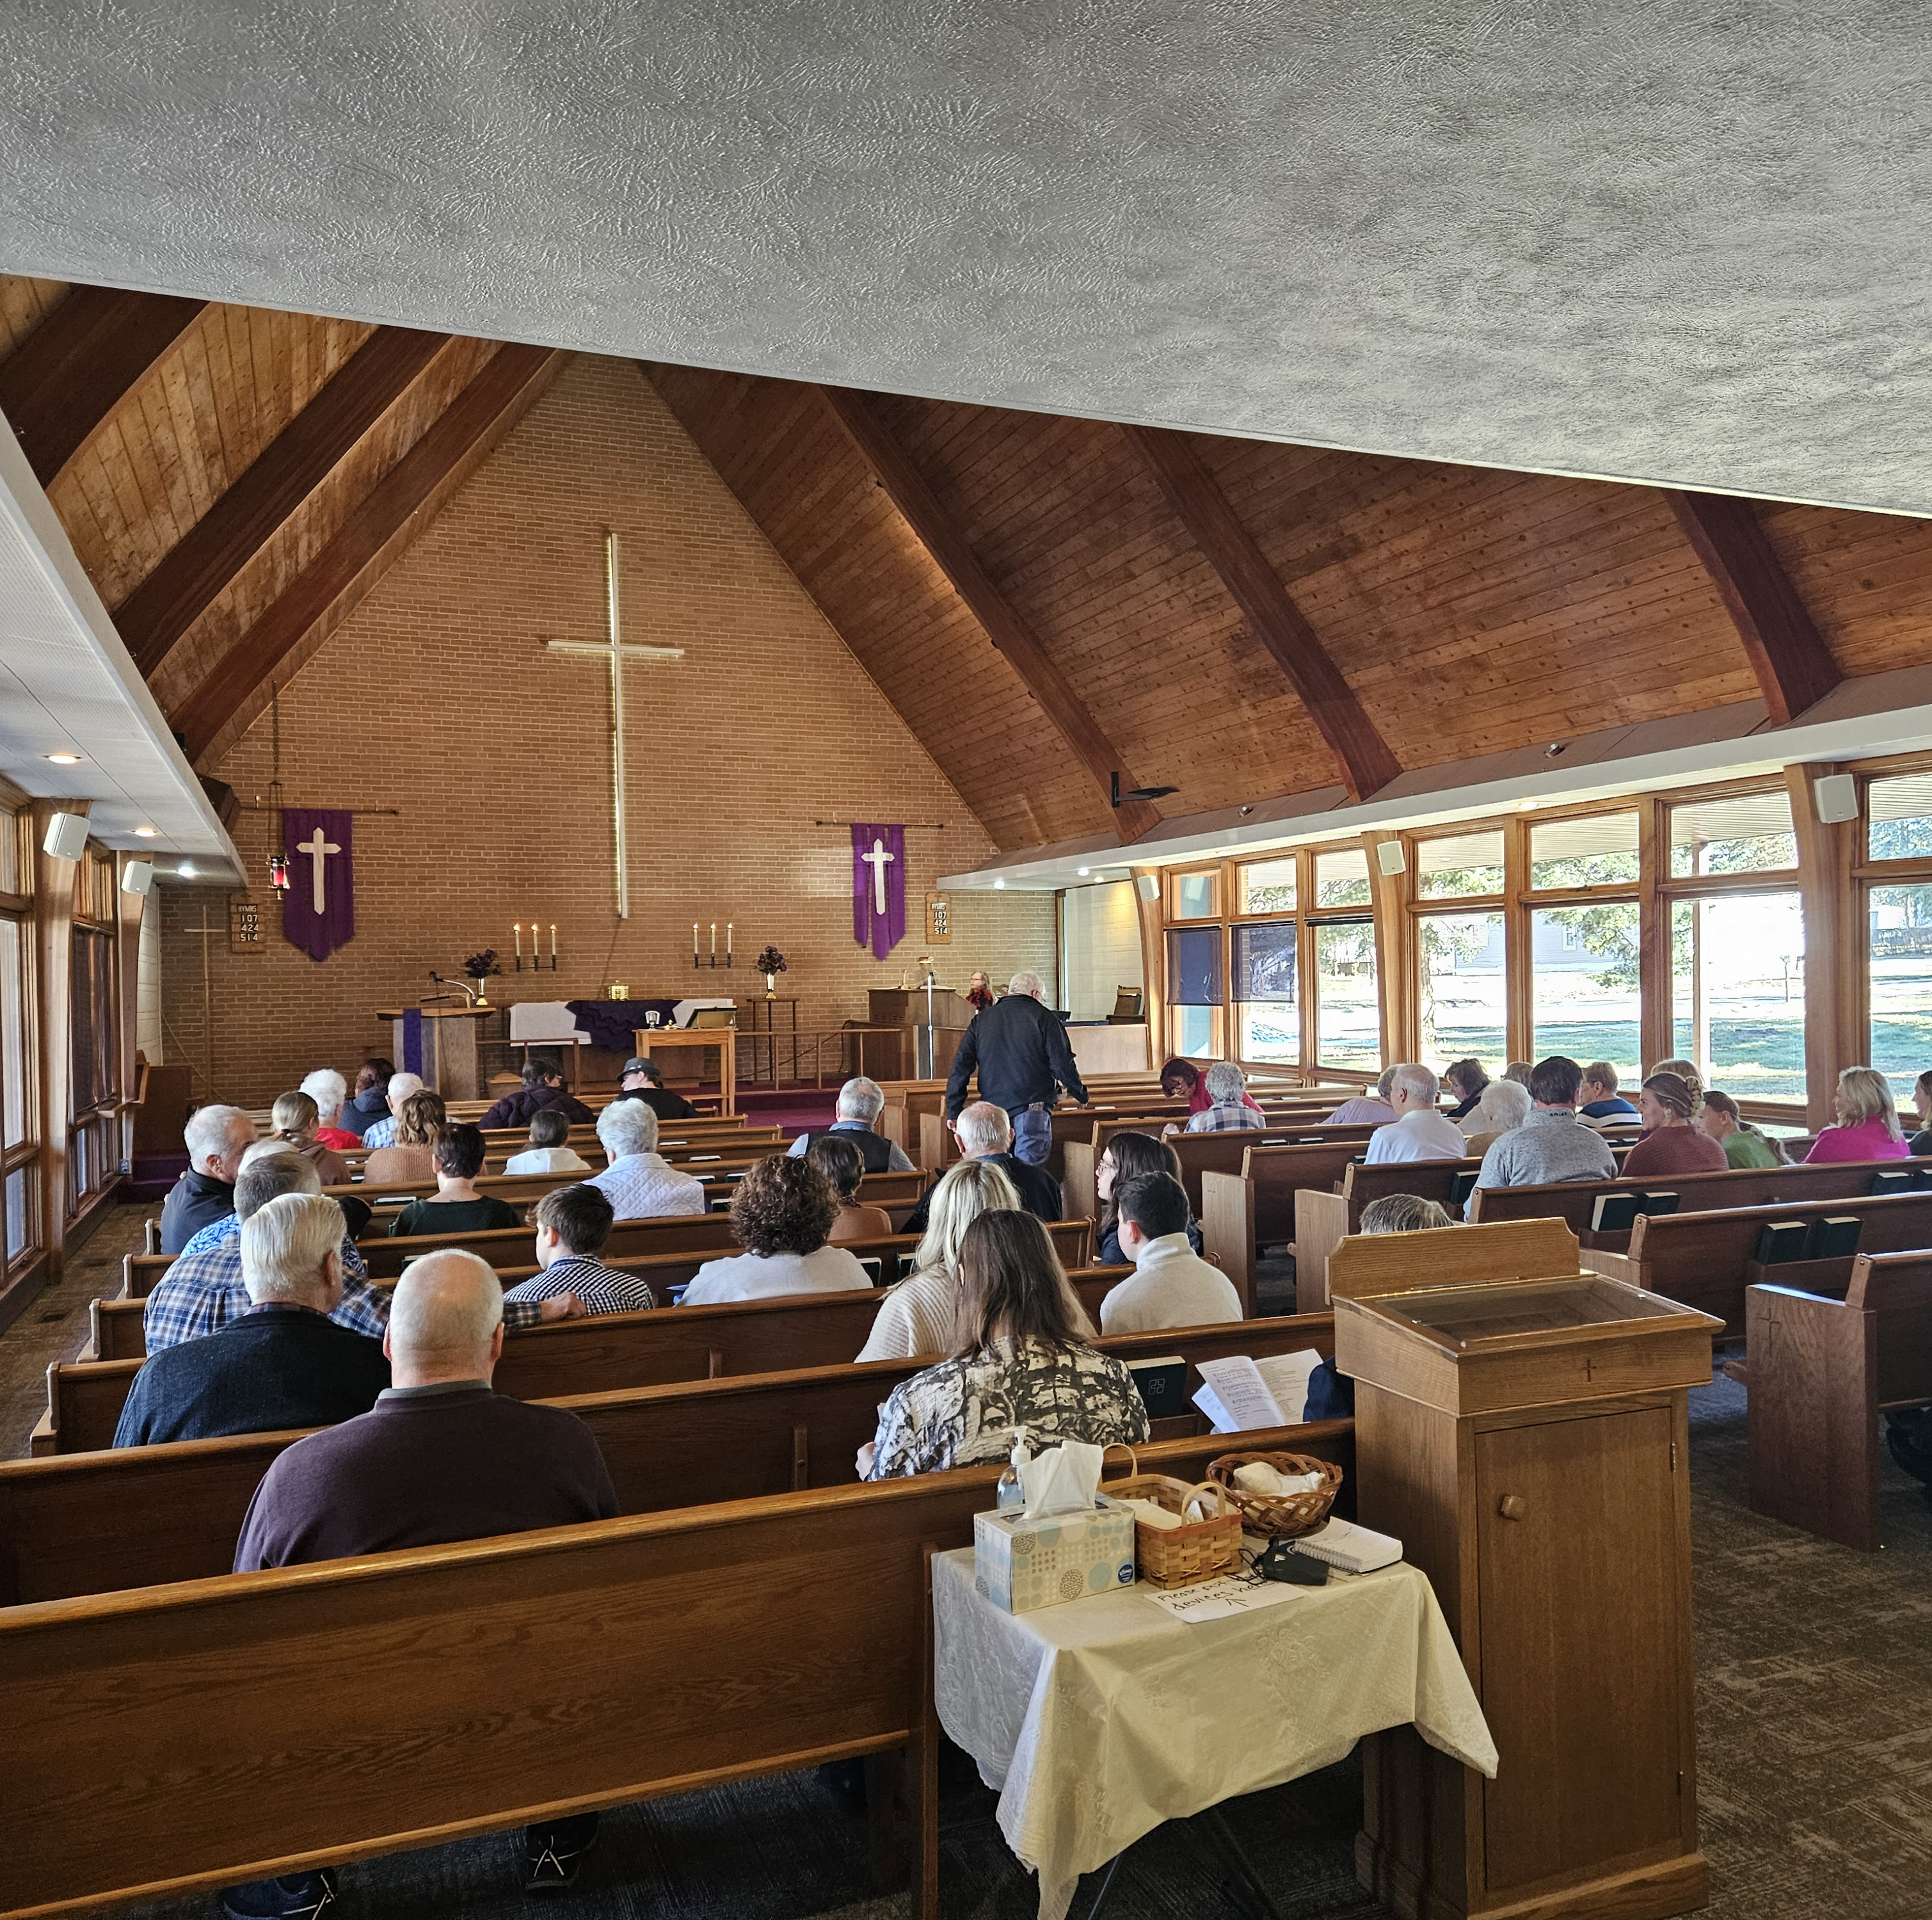
Being in the story…
Who are you, and why did you come?
What was your experience of the day?
What does this tell you about who Jesus is?
How might this help you live differently?

Slide 7
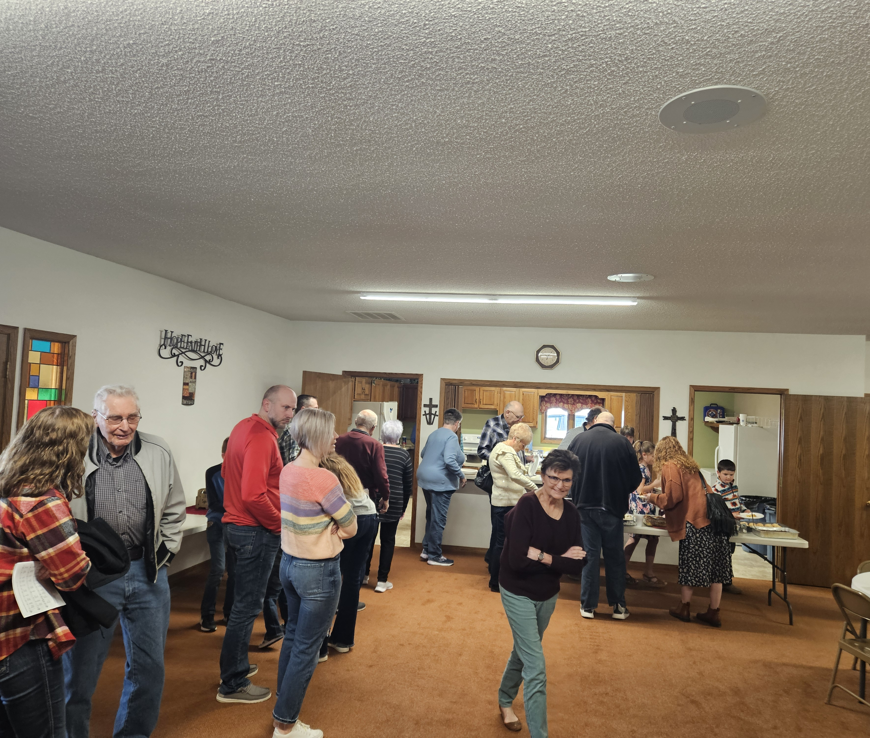
“Abundance is Real!”
This is God’s story, and it’s our story too…

Slide 8

Let us pray…
Gracious God, just as you fed thousands with a couple fish and a few loaves, open us up to the promise of your abundance now. Guide us in our time together. Help us to be ever mindful of what you entrust, and what you might be inviting. Give us good courage to wonder and ask the questions on our hearts and minds. Give us hope by reminding us that we are not alone, and we are in this together. Give us joy, by going and sharing your Good News of life-giving and life-saving love that you cultivate for all of your beloved. Lead us where you would have us go and be with us. Thank you, thank you, thank you. In your loving name we pray. Amen.

Slide 9
The Basics:
Cultivating Love through
Stewardship with Chick Lane

Slide 10

My favorite story of generosity
“Oh! but he was a tight-fisted hand at the grindstone, Scrooge! a squeezing, wrenching, grasping, scraping, clutching, covetous old sinner! Hard and sharp as flint, from which no steel had ever struck out generous fire, secret, self-contained, and solitary as an oyster. The cold within him froze his old features.”

Slide 11

My favorite story of generosity
“The chuckle with which he said this, and the chuckle with which he paid for the turkey, and the chuckle with which he paid for the cab, and the chuckle with which he recompensed the boy, were only to be exceeded by the chuckle with which he sat down breathless in his chair again, and chuckled until he cried.”

Slide 12
Grounding Your Stewardship Ministry
In God’s Word
  God is the creator and owner of all that is
  We are stewards
  What we do with money flows from and (more importantly) impacts our faith in Jesus
What might this mean for your congregation?
  Talking about money when you aren’t asking for any
  Talking about money when you are asking for some (this afternoon)

Slide 13

God is the creator and owner of all that is.
Psalm 24:1-2
The earth is the LORD’s and all that is in it,
the world, and those who live in it;
for he has founded it on the seas,
and established it on the rivers.

Slide 14
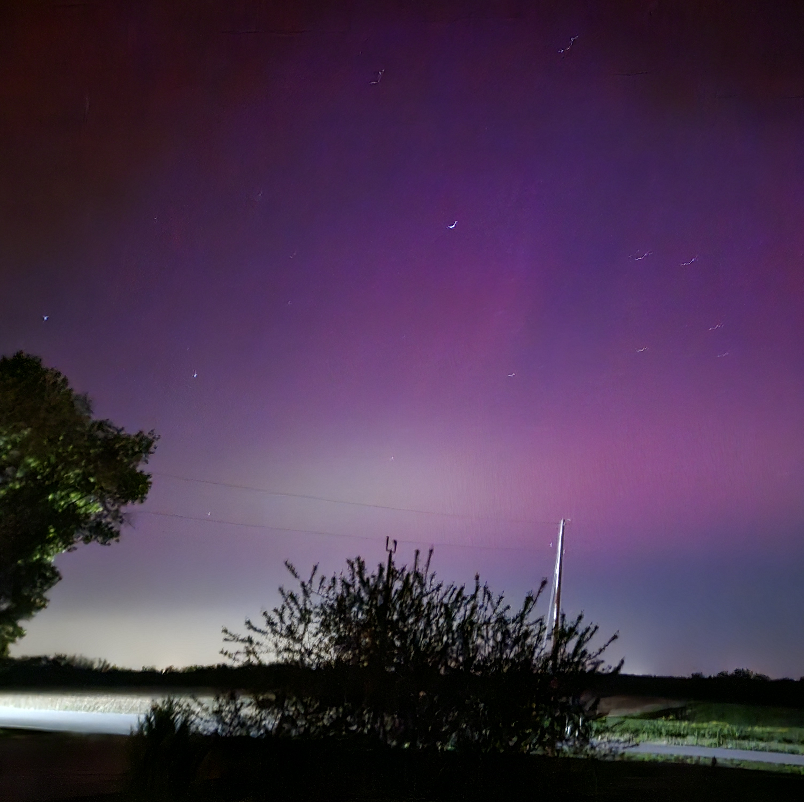
God is the creator and owner of all that is
Psalm 89:11
The heavens are yours, the earth also is yours;
the world and all that is in it--you have founded
them.

Slide 15
Deuteronomy 8:12-18
When you have eaten your fill and have built fine houses and live in them, and when your herds and flocks have multiplied, and your silver and gold is multiplied, and all that you have is multiplied, then do not exalt yourself, forgetting the LORD your God, who brought you out of the land of Egypt, out of the house of slavery, who led you through the great and terrible wilderness, an arid wasteland with poisonous snakes and scorpions. He made water flow for you from flint rock, and fed you in the wilderness with manna that your ancestors did not know, to humble you and to test you, and in the end to do you good. Do not say to yourself, “My power and the might of my own hand have gotten me this wealth.” But remember the LORD your God, for it is he who gives you power to get wealth, so that he may confirm his covenant that he swore to your ancestors, as he is doing today.

Slide 16
“The crisis reflected in the text and in Israel’s lived reality in the land, is that gifts given in abundance to the satiated do not finally eventuate in trusting gratitude, but in complacent self-congratulations. A gift kept long enough begins to seem like a possession. A gift kept long enough becomes separated in the memory from the giver, so that the giver is forgotten.”
- Walter Brueggemann. Deuteronomy. p. 109

Slide 17
It All Belongs to God – Cultural Challenges
Language of “ownership”
Ownership determines “How much am I worth?”
If it all belongs to God, why is it distributed so unequally? How can we talk about God’s abundance when some have so much more than they need and others have so much less than they need?

Slide 18
It
All
Belongs
to
God
We
Are
Stewards

Slide 19
We are stewards (not owners)
I Corinthians 4:1-2
Think of us in this way, as servants of Christ and stewards of God’s mysteries. Moreover, it is required of stewards that they be found trustworthy.

Slide 20
We are stewards (not owners)
I Peter 4:10
Like good stewards of the manifold grace of God, serve one another with whatever gift each of you has received.

Slide 21
We are stewards
Manager
Caretaker
Trustee
Power of Attorney
Executor of Estate

Slide 22
What we do with money flows from and (more importantly) impacts our faith in Jesus
  “As for those who in the present age are rich, command them not to be haughty, or to set their hopes on the uncertainty of riches, but rather on God who richly provides us with everything for our enjoyment. They are to do good, to be rich in good works, generous, and ready to share, thus storing up for themselves the treasure of a good foundation for the future, so that they may take hold of the life that really is life.”
  -- I Timothy 6:17-19
  “For where your treasure is, there your heart will be also.”
  -- Luke 12:34

Slide 23
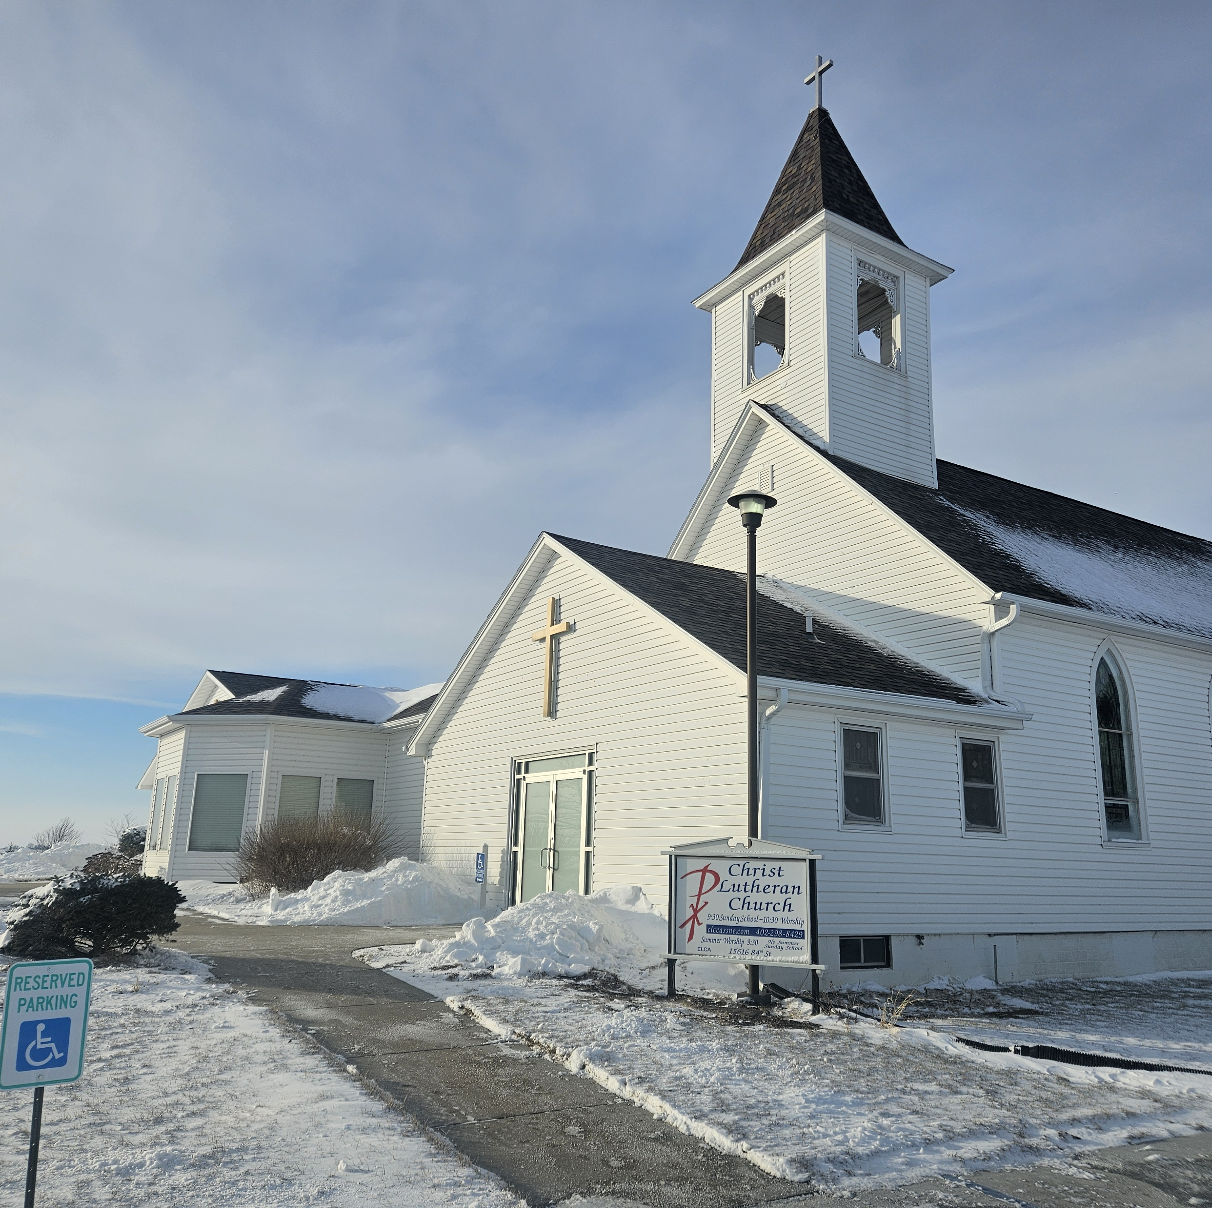
What might this mean for your congregation?

Slide 24
What does “stewardship” mean in your congregation?
For most people “stewardship” is a code word
For most congregation members, it is code for “What the congregation does to get some of my money out of my pocket and into the offering plate.” (and my job is to give just enough to not feel guilty)
For most congregation leaders, it is code for “Those things we have to do to get enough money to pay the congregation’s bills.” (and we will know how well we have done at year end when we know if we have enough money to pay all the bills)

Slide 25
The most important thing you can do in stewardship ministry is to move the money conversation…
From “Paying the Bills”
→
To helping people connect faith and finances in their lives.

Slide 26
How is money talked about in your congregation?
It isn’t
Only when we need some
As a part of the discipleship of each person

Slide 27
It is vital that churches talk about money
When you aren’t asking for any.
When you are inviting people to generous giving to support the congregation’s ministry.

Slide 28
Talking about money when you aren’t asking for any
  “Here is what we say through our stewardship practices: 10% belongs to God; the rest belongs to you. Give that 10% to the church, which will use it for God’s purposes. The other 90%? Do whatever you want with it.” - Rolf Jacobson

Slide 29
Talking about money when you aren’t asking for any

Slide 30
Talking about money when you aren’t asking for any

Slide 31
Talking about money when you aren’t asking for any

Slide 32
Talking about money when you aren’t asking for any
Emphasize “holistic” stewardship
Stewardship is not just about what you give away. All of life belongs to God, and how you use all of it is part of your relationship with your Lord
“Time, talent, treasure”
  All three, not pick one
  “Be most generous with the one I have the least of”
  “Volunteering” becomes “Ministry”

Slide 33
Talking about money when you aren’t asking for any
Name that this is what you are doing, then don’t dare ask for any
Sermons
  When the assigned text presents opportunities
  A sermon series on faith and finances
Adult education opportunities/Book discussion
  Enough by Adam Hamilton
  Reflections on Faith and Finances by Charles Lane
People are looking for help with finances and with faith – find appropriate resources

Slide 34
The Stewardship Triangle
God’s Provision
Time, Talents, Congregation’s
Treasure Ministry

Slide 35
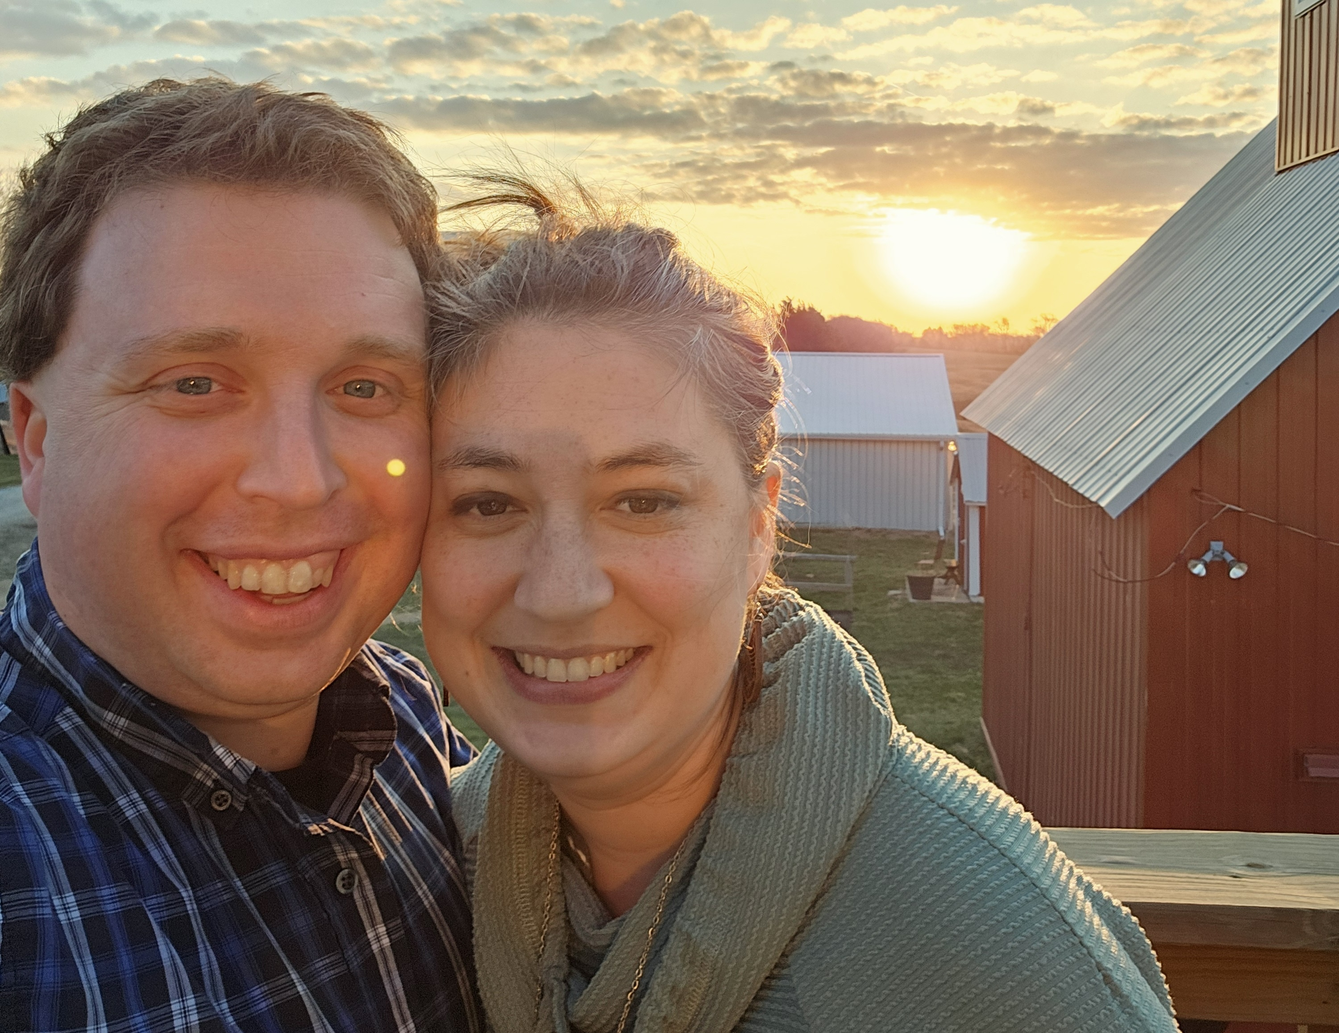
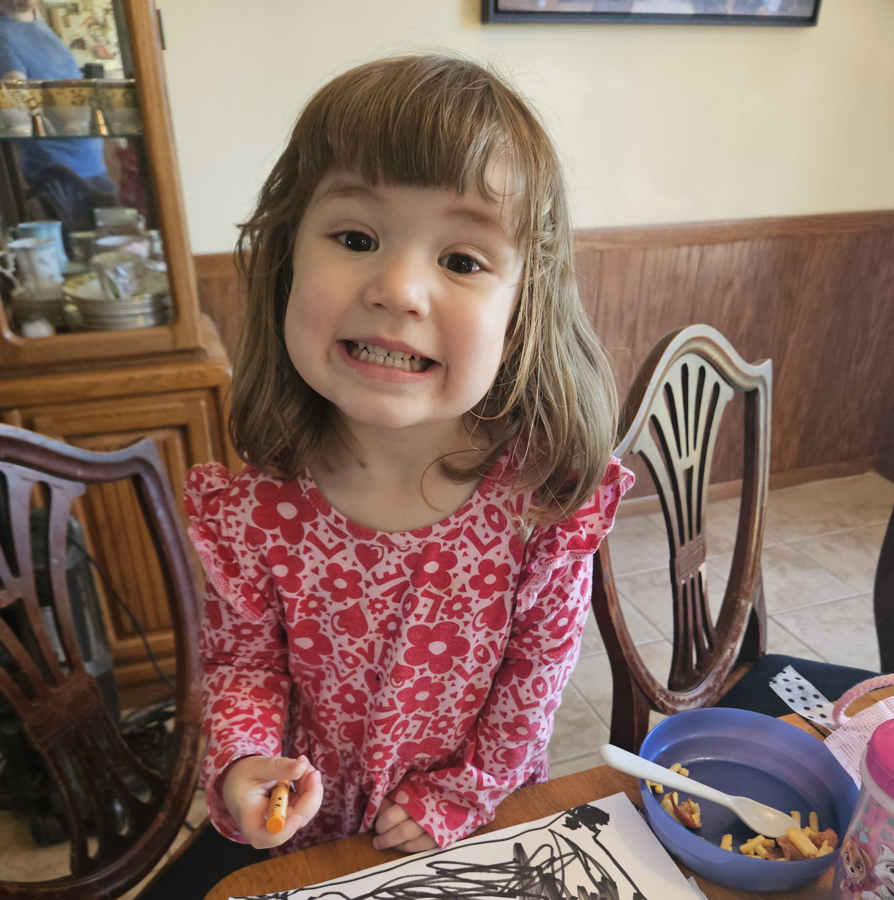
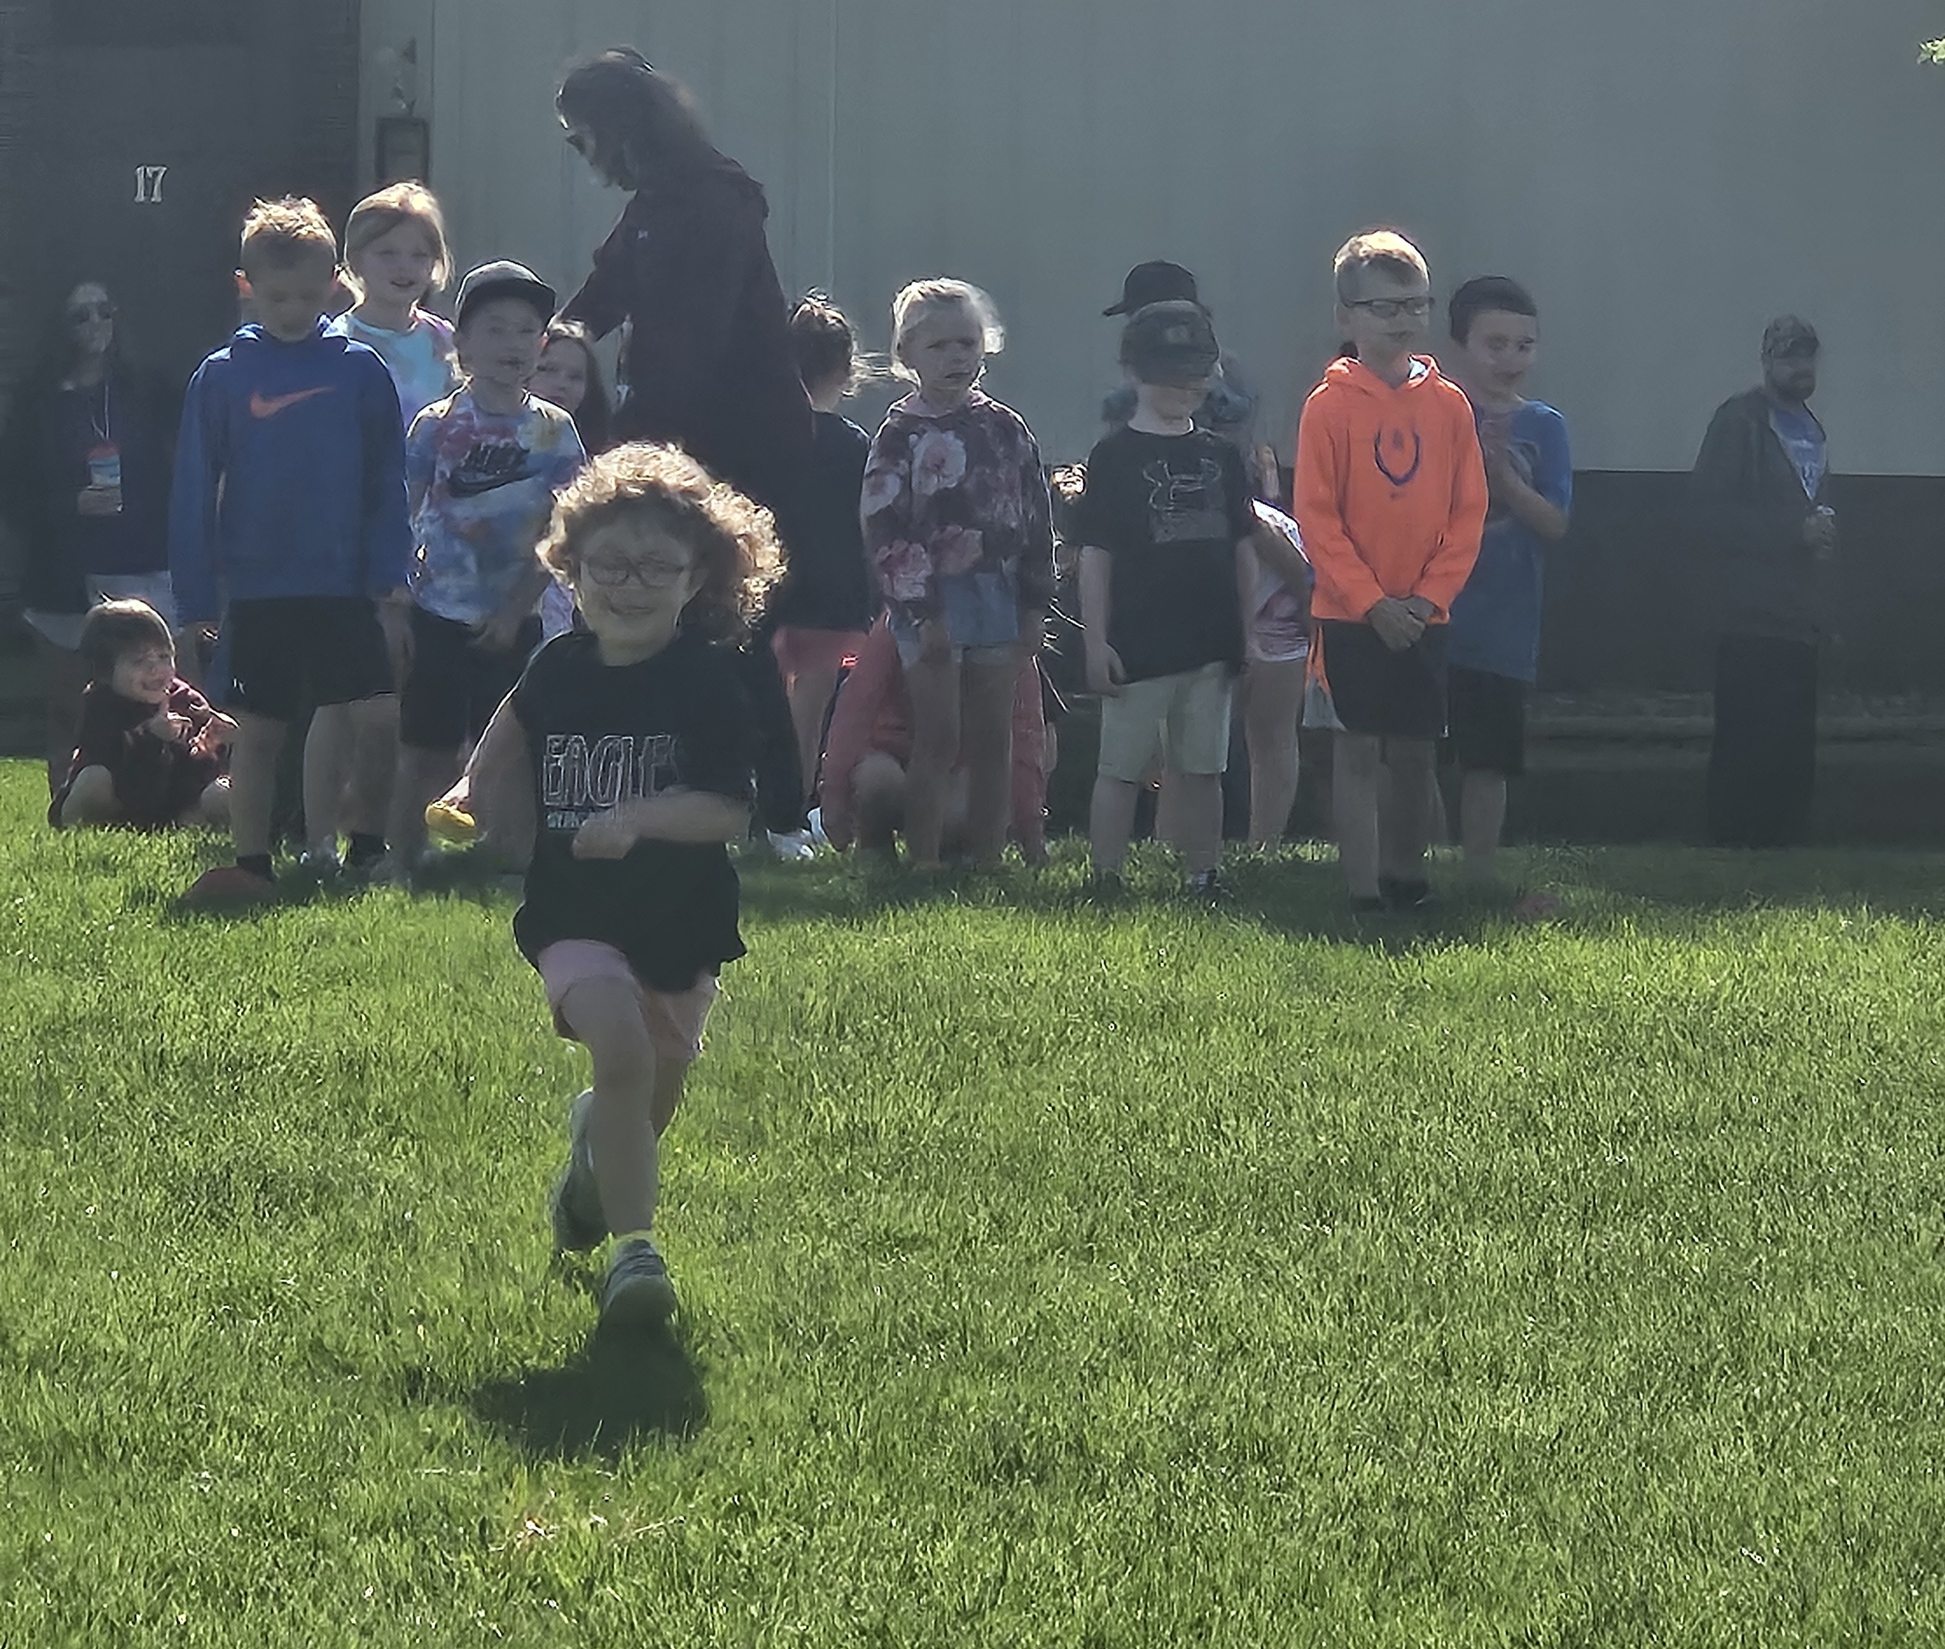
Stewardship is about all of life!
Holistic
Continuous conversation
Intersections of vocations
Time
Faith in daily life
Hope and the future- practicing what we preach
A story from a younger dad

Slide 36
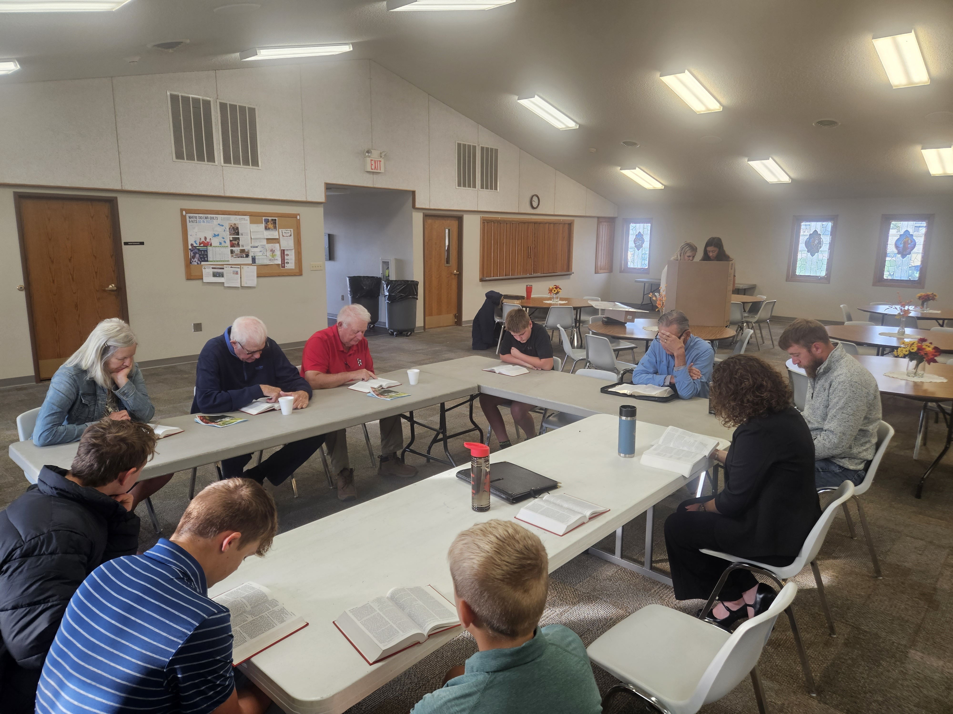
What does a stewardship leader look like…
Especially one who isn’t a pastor/pastoral leader
Showing up
Presence
Practicing what we preach
Invitation
Curiosity
Wonder
Distinctions about stewardship as holistic, and not just “fundraising”
Ideas year-round

Slide 37
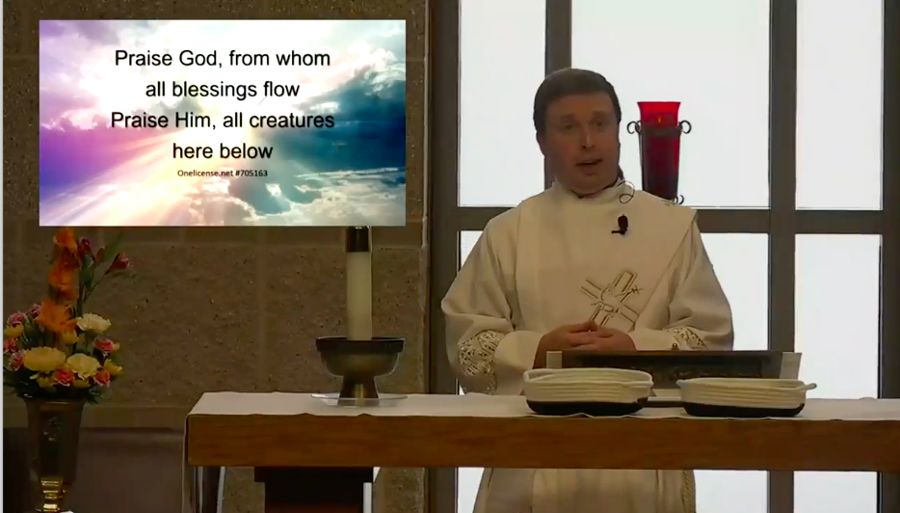
How has Covid changed your congregation’s stewardship ministry?
Some observations of what we have seen…
  Disaster response too
What have you experienced?
How have you adapted?

Slide 38

Lunch Prayer-
Let’s sing!
Be present at our table Lord,
Be here and everywhere adored,
These mercies bless and grant that we,
May strengthen for thy service be.
Amen.

Slide 39
Through Stewardship
With Rev. Chick Lane, Sarah Callahan and Dn. Timothy Siburg
A Pre-Assembly Event
For Nebraska Synod, ELCA in Assembly
Friday May 31, 2024

Slide 40
Ask
Cultivating Love through Stewardship
Nebraska Synod
Pastor Chick Lane

Slide 41
Ask – Unintended insights from an Easter sermon
We celebrate a “Past tense God”
We have full confidence in a “Future tense God”
We sometimes struggle to be fully aware of our “Present tense God”
  Asking people to support your congregation’s ministry is to invite them into the work of our “Present tense God”
  Make sure people know how your congregation is doing God’s work in the here and now, and invite them to support that work
    And don’t ever invite them to support your budget or pay your bills

Slide 42
Insights from Henri Nouwen
“When we seek to raise funds we are not saying, ‘Please, could you help us because lately it’s been hard.’ Rather, we are declaring, ‘We have a vision that is amazing and exciting. We are inviting you to invest yourself through the resources that God has given you- your energy, your prayers, and your money – in this work to which God has called us.’”
-The Spirituality of Fund-Raising, pp. 3-4

Slide 43
Insights from Henri Nouwen
“Asking people for money is giving them the opportunity to put their resources at the disposal of the Kingdom. To raise funds is to offer people the chance to invest what they have in the work of God. Whether they have much or little is not as important as the possibility of making their money available to God.”
-The Spirituality of Fund-Raising, p. 25

Slide 44
Insights from Clif Christopher –
Not Your Parents’ Offering Plate
Three Reasons People Give
A belief in the mission of the organization
  Does your congregation clearly articulate your mission?
  Is there wide knowledge/support among congregants for this mission?
Regard for staff leadership
  “If the people don’t know that I love them, how can I possibly ask them for money.”
Financial stability of the institution
  “People don’t give to sinking ships.” – Ken Callahan
  Don’t cry wolf. Bad news doesn’t motivate.

Slide 45
Things have changed a lot in the last five years
Impact of Covid 19 on stewardship response programs
Impact of Covid 19 on in-person worship attendance
Growth of electronic givers
  Good news
  Bad news

Slide 46
A well-run stewardship response program is still vital
For members
  A time to reflect on what it means to be a faithful follower of Jesus in the realm of finances
  A time to consider an invitation to generous support of the congregation’s ministry
For the congregation
  The best time to tell the congregation’s story
  The best time to invite the financial support that enables the congregation to do God’s work in the world

Slide 47
Important components of your annual stewardship emphasis
Tell the biblical story
  My preference is to have a theme passage/verse and treat this in several ways
Tell the congregation’s story
  All year long, tell what the congregation is already doing (More on this later)
  During the annual stewardship emphasis also tell what the congregation will be doing next year.
Ask for growth in giving

Slide 48
Tell the Biblical story
Every annual stewardship program should be a Bible study
Pick a passage that will speak to your congregation
  Preach on it
  Teach about it

Slide 49
Tell the congregation’s story
What’s Your Why?
Write your case statement
  Involve the congregation in the development
  Paragraph #1 - What are we already doing very well?
  Paragraph #2 - Look ahead
    What is God calling us to do next year?
    How are we going to make a difference in people’s lives next year?
    Why in the world should anyone give us money next year?

Slide 50
Ask for Growth in Giving
Ask people to grow their giving, but don’t expect them to do long division
Options
  Giving chart – 1%
  Grow one step
  Grow ½%
  Ask for a specific amount

Slide 51
Ask people to make a commitment for their giving for next year
Benefits for the giver
Benefits for the congregation

Slide 52
Ways to gather commitment cards
Commitment in worship
Fellowship meal after worship
Mail
Relay
Home visits

Slide 53
Stewardship Program Resources
Because of God’s Great Mercy
  www.elca.org/Resources/Stewardship#GodsGreatMercy
Walk with Jesus
  www.resources.elca.org (search for Walk with Jesus)
New Consecration Sunday
  www.amazon.com
Ecumenical Stewardship Center resources
  www.lakeinstitute.org/resource-library/ecumenical-stewardship-center-resources/

Slide 54
Three more topics
Additional giving opportunities
  “Mission of the month”
  Ask people how many opportunities they would like to have
Think generationally
Electronic giving
  Make it simple
  Ask regularly

Slide 55

The Place for Planned Giving in your Congregation’s Ministry

Slide 56







What do we mean by “planned gifts?”
Gift to your congregation
Grain
Bequests
CGAs
Home
Land
CRTs
Endowments
Notes:
Any gift that takes more planning than writing a check. This could be current gifts that are more complicated.
People should meet with me before they meet with their attorney to help organize their plans. Or it should happen if they want to revise what plans they currently have in place. Again, I’m not charging them, so what you are providing them by connecting them to me is a free service! This can save them time/money.

Slide 57




Legacy Planning is about Balanced Stewardship
Bequests
5+ YEARS
$$$
Current Gifts
Planned Gift
Offering Plate
WEEKLY
$
Major Gifts
Pledges
1-5 YEARS
$$
Notes:
We typically look to our checking accounts to make our smaller/regular gifts which may include our
weekly gifts to our congregations
monthly gifts to our favorite ministries
This may include annual gifts to the causes we support or even multiyear gifts or pledges.
And when we consider all the blessings we have received, and we think about the ministries that have been special to us throughout our lives, we turn to our estates to consider how we can make a difference even after we are called to our heavenly home.

Slide 58
Why should my congregation care about planned gifts? We need $ now.
92% of individuals maintain or increase annual giving after making a planned gift.*
Great Wealth Transfer – Over the next 30 years retirees will pass more than $36 trillion to families, friends, nonprofits, and additional beneficiaries. **
Nonprofits that focus on noncash gifts see exponential growth in their total fundraising. ***
Notes:
My organization needs $ now, why should I include planned giving with donors.
92% of planned giving donors maintained or increased their giving according to a 2019 GivingUSA Report. 45% said they increased gifts, likely because it had deepened their relationship to the organization. So focusing some efforts on planned giving can actually boost your current giving as well!
We are in the middle of a huge intergenerational transfer of wealth. Baby boomers are passing away and their wealth is transferring to their children and grandchildren more than $36 trillion on will be passed down over the 30 years. From giving usa 2019
Dr. James Russell published a paper in February of 2018 under the title, Cash Is Not King for Fundraising: Gifts of Noncash Assets Predict Contributions Growth. He analyzed over 1mil nonprofit’s 990s from 2010 to 2015. of the 8,927 nonprofits that raised over $1mil it showed that those only focusing on cash only grew at 11%. Those that accepted cash, real estate, paintings and other assets convertible as well as securities grew at a rate of 66%!

Slide 59
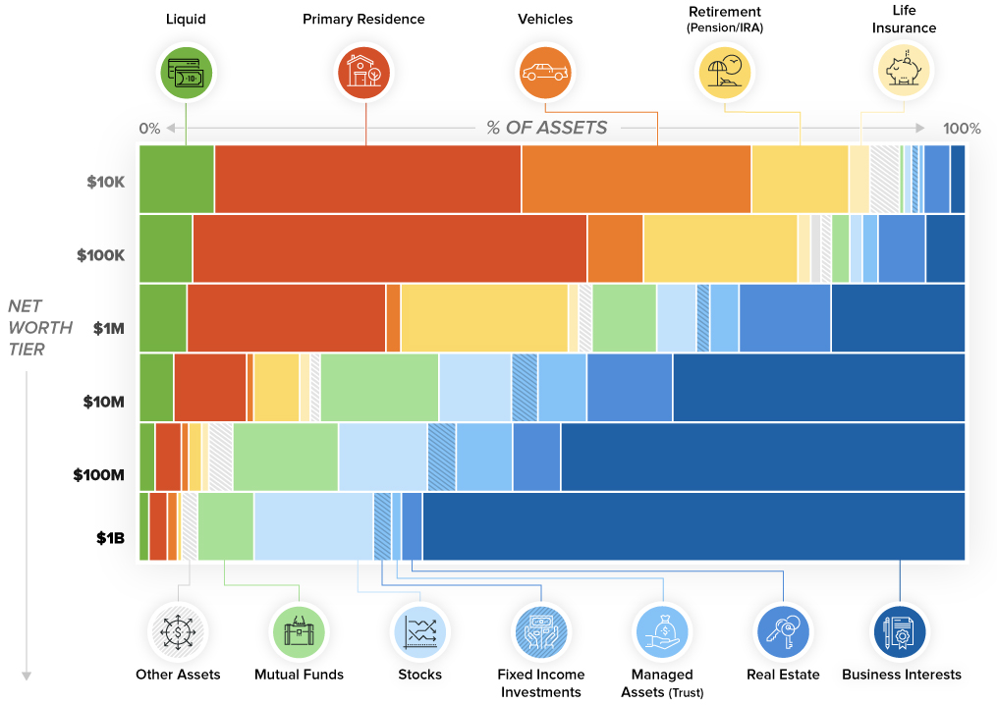

Slide 60
Opportunity!
68% of Americans lack a valid will!
Over 85% of people learn about bequests from their charities.
Only 25% of individuals change a gift once it is in their will.
Only 33% of people will tell you about a gift they have made.
Notes:
PlannedGiving.Com statistics from 2024:
1. 68% of Americans die without having a valid will in place. Of that very large group, most have never even created an estate plan or made
plans for their legacy. Others have old wills that have not been updated to account for family births or deaths; divorces;
stepchildren; ex-spouses; business partnerships; the sale of real estate; income changes, etc This means there is a huge opportunity here for estate gifts from your existing donors. Even more - many of your donors do not review their wills regularly even if they have one. (Should be reviewing every 5 years or when life situation changes.)
The biggest reason people cite as their reason for not doing this planning? Procrastination or don’t think they have enough assets to leave (everyone has ”stuff”)
2. 85.3% of people learn about bequests from their charities. If you aren’t talking to your donors about planned giving – it is likely that another organization is. (GivingUSA Special Report.)
3. Only 25% of individuals change a gift once it is in their wills. Once you are in – there is a high likelihood that you will stay in!
4. Only 33% of people tell you about a gift they made. Lutheran Giving is ”planting seeds” on your behalf many of which we won’t know about until they blossom, but we are also working to uncover more gifts so that you know about them!

Slide 61

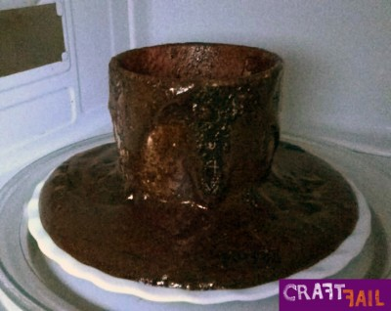
Why is Planning so Important?
Your Legacy
Expectation
Reality
Notes:
Why is this planning so important?
It is human nature that most of us just don't like to consider our own death. However, having your affairs in order can provide you with peace of mind. It has also been scientifically proven that there is a neural link between generosity and happiness!
Not having a plan is planning to fail.
So I think it is fair to say that we have established that we all need to have plan.

Slide 62

Listen, Listen, Listen for opportunities:
I wish I could do more for our congregation, but …
    My investments aren’t doing what they should.
    I can’t itemize my deductions, so I don’t get a charitable income tax deduction.
    I’m concerned about paying for my long-term care needs.
    I want to make sure my family is taken care of first.
    I need to sell my (business/family farm/vacation property.)
Notes:
It would be great if they would say I need to establish or update my will. Instead, it is more likely that they will say something along the lines of I wish I could do more for your organization, but….
These are all situations that can be addressed with gift planning if they are charitably inclined.

Slide 63

Offer Lutheran Giving’s Services:
We have an individual in our Synod who specializes in gift planning through Lutheran Giving. Her services are free and confidential and can help you maximize the value of a gift to your family as well as to our congregation. I would be happy to arrange for you to meet with her to discuss your goals.
Notes:
Lutheran Giving has worked with many donors from our organization who found working with her valuable, and ended up saving time/money with legal expenses.
You can even come to the first meeting to make the introduction! You may not want to stay for the financial data gather because your donor may want to keep this private.

Slide 64
Lutheran Giving does not raise money for its own mission.
Services are at no cost to congregations and to families interested in setting up charitable plans.
FREE Resources!!!
Notes:
Lutheran Giving provides confidential charitable estate planning consultation. If you have a heart for one of its ministry partners, Lutheran Giving wants to help you fulfill your wishes by leaving a meaningful legacy gift.

Slide 65


Expertise for Congregations
• Mission endowment fund guidance so congregations can be thoughtful stewards of bequests and planned gifts.
• Gift planning education through seminars on wills, estate plans and charitable gift planning.
• Investment options for endowments and institutional funds available
Notes:
So broken down further. I can help your congregation be an effective partner in planned and major giving, I offer assistance with:
Mission endowment fund guidance. This can be by helping to create a gift policy, endowment bylaws.
I can provide educational legacy presentations to Nebraska Synod congregations.
I even help by providing an investment option for your endowment through the ELCA’s Ministry Growth Fund (formerly Fund A).

Slide 66
Expertise for Your Members
• Charitable Gift Planning for anyone wishing to support Nebraska Synod congregations and its agencies and institutions as well as any Synodical or Churchwide ministry
Notes:
In addition to providing assistance with endowments and educational workshops, I can also work directly with your members on their charitable gift planning. People should meet with me if they have charitable intent for your congregation (or any of the partner ministries I represent). This should happen before they meet with their attorney to help organize their plans. Or it should happen if they want to revise what plans they currently have in place. Again, I don’t charge for my services so your members have nothing to lose!
There are strategies to giving that I can help people with and help them determine how to make the best gift using the best asset for the best beneficiary. Many people don’t realize that there are strategies and tools available to make giving more effective and efficient.
By working together, I can show your members ways that they can provide for their heirs, while also leaving meaningful gifts to ministry.

Slide 67
Creating a Culture of Thanksgiving in Your Congregation
Thank
Tell

Slide 68
Thank
I have heard of your faith in the Lord Jesus and your love towards all the saints, and for this reason I do not cease to give thanks for you as I remember you in my prayers.
–Ephesians 1:15-16
I thank my God every time I remember you, constantly praying with joy in every one of my prayers for all of you, because of your sharing in the gospel from the first day until now.
-Philippians 1:3-5

Slide 69
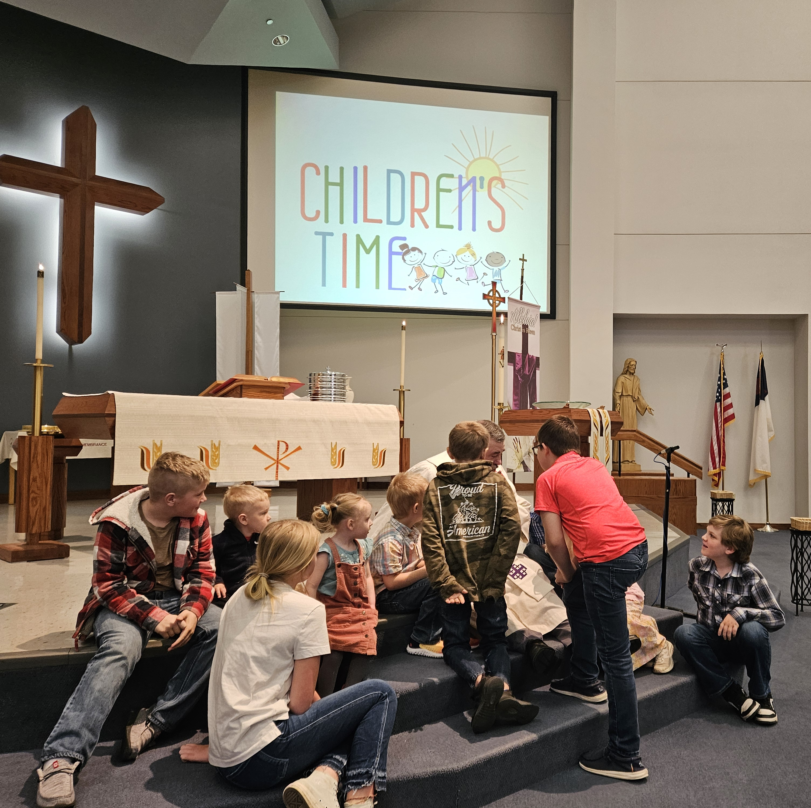
Thanking is a win-win-win
Thanking builds up the person who is thanked
Thanking builds up the person who is thanking
Thanking builds up the Body of Christ

Slide 70
Thank many people at one time
With reports of giving – a three paragraph letter from the pastor
  One great ministry event in the past quarter
  Thanks, your giving has made this and more possible
  One thing that is coming up in the next quarter that the pastor is especially anticipating

Slide 71
Thank many people at one time
In worship – Thanksgiving Moment
  At the time of the offering
  Very brief (less than one minute)
  Tell one story of a ministry of the congregation
  “Thank you. This has happened because of you. The offering will now be received”
In newsletter/e-news/website –
  Have ministry participants do this
  Tell story of ministry, tie to mission
  Tie to giving, say thank you

Slide 72
Thank one person at a time
Pastor/staff become intentional thankers
  Saying thanks before/after worship
  Pastor writes five thank you letters per week
  Find appropriate ways to express appreciation for significant acts of generosity
Congregational thanker(s)

Slide 73
A crucial question for thanking
Does the pastor know what people give?
  If not, why not?
  If so, how might this knowledge used?
    To thank
    To provide opportunities for giving
    To monitor sudden changes
    To provide the pastor with another important piece of information as she/he strives to provide spiritual guidance for each member

Slide 74
Develop a plan for thanking
embracingstewardship.com/products

Slide 75
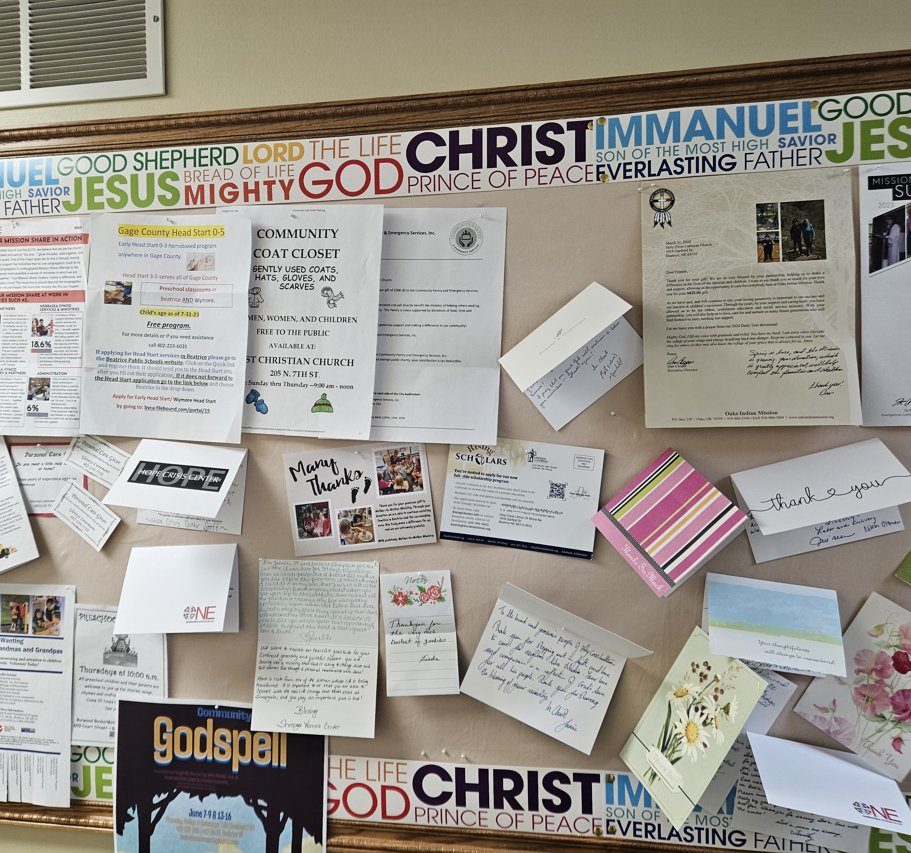
Tell- Make Sure People Know the Scope of the Congregation’s Ministry!
Regularly tell the story of what is happening in and through your congregation

Slide 76
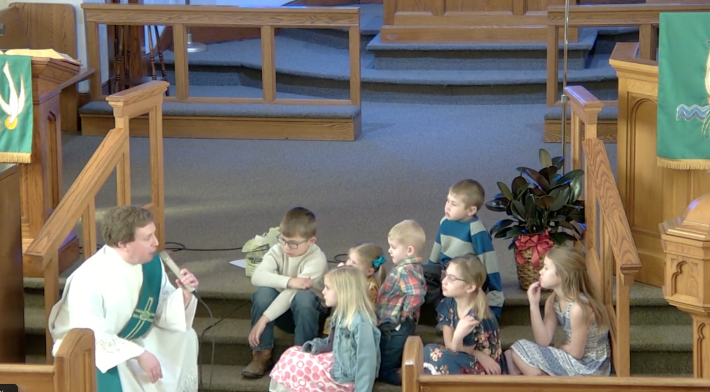
Make the budget more tangible
Imagine with me a scenario from a congregation’s annual meeting…
Does that sound familiar?
One idea- Narrative Budget
Connecting the numbers with the story (and vice-versa)

Slide 77
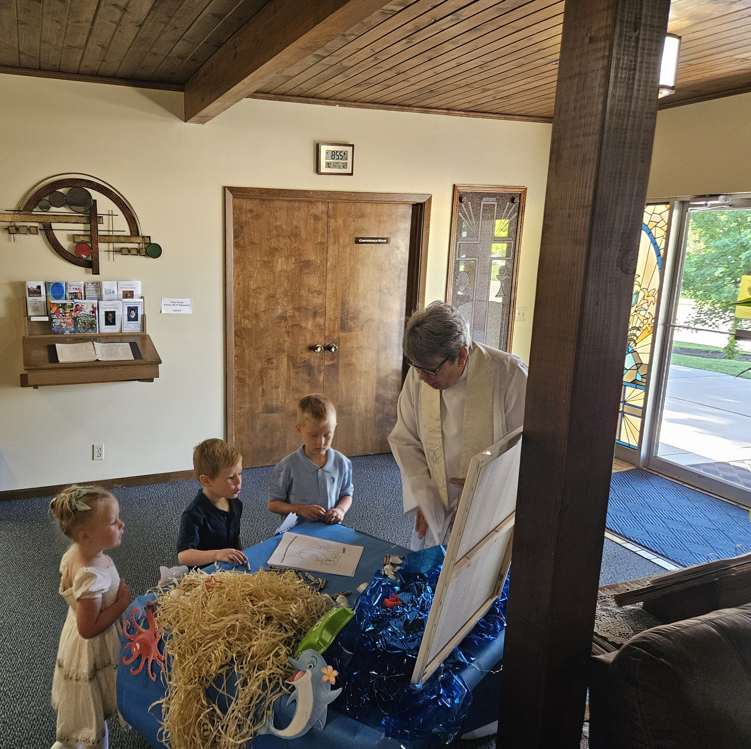
Impact of Story Telling
Story during worship
Story online
Videos, social media
Impact of seeing themselves in the story
Connecting the dots
Moving from head-space to heart-space
#1 Reason people give = belief in the mission

Slide 78
Stories are powerful…
Grace Duddy Pomroy in Embracing Stewardship (p. 116):
“Stories are powerful, but making the connection between God’s story and our own makes them even more powerful. A seminary friend of mine, Allison Siburg, put it this way, ‘There’s something at church that connects my story to a story bigger than me- a story my parents know, my spouse knows, a story my great-grandma knew, a story Paul, Sarah, Ruth, and Jesus knew: God’s story keeps interrupting our lives and saturates our lives (ALL of our lives) all at the same time.’ Our stories connect in deep and rich ways to biblical stories and God’s story throughout all of time.”

Slide 79
God’s story, our story, our neighbor’s story…
What is the story of God’s life-changing and life-saving love that you have to tell?
What is the story that your neighbor has to tell?
What are the stories your neighbor (and perhaps you) are longing to hear?
What is the story that God is inviting to be shared now?
Abundance is real…

Slide 80
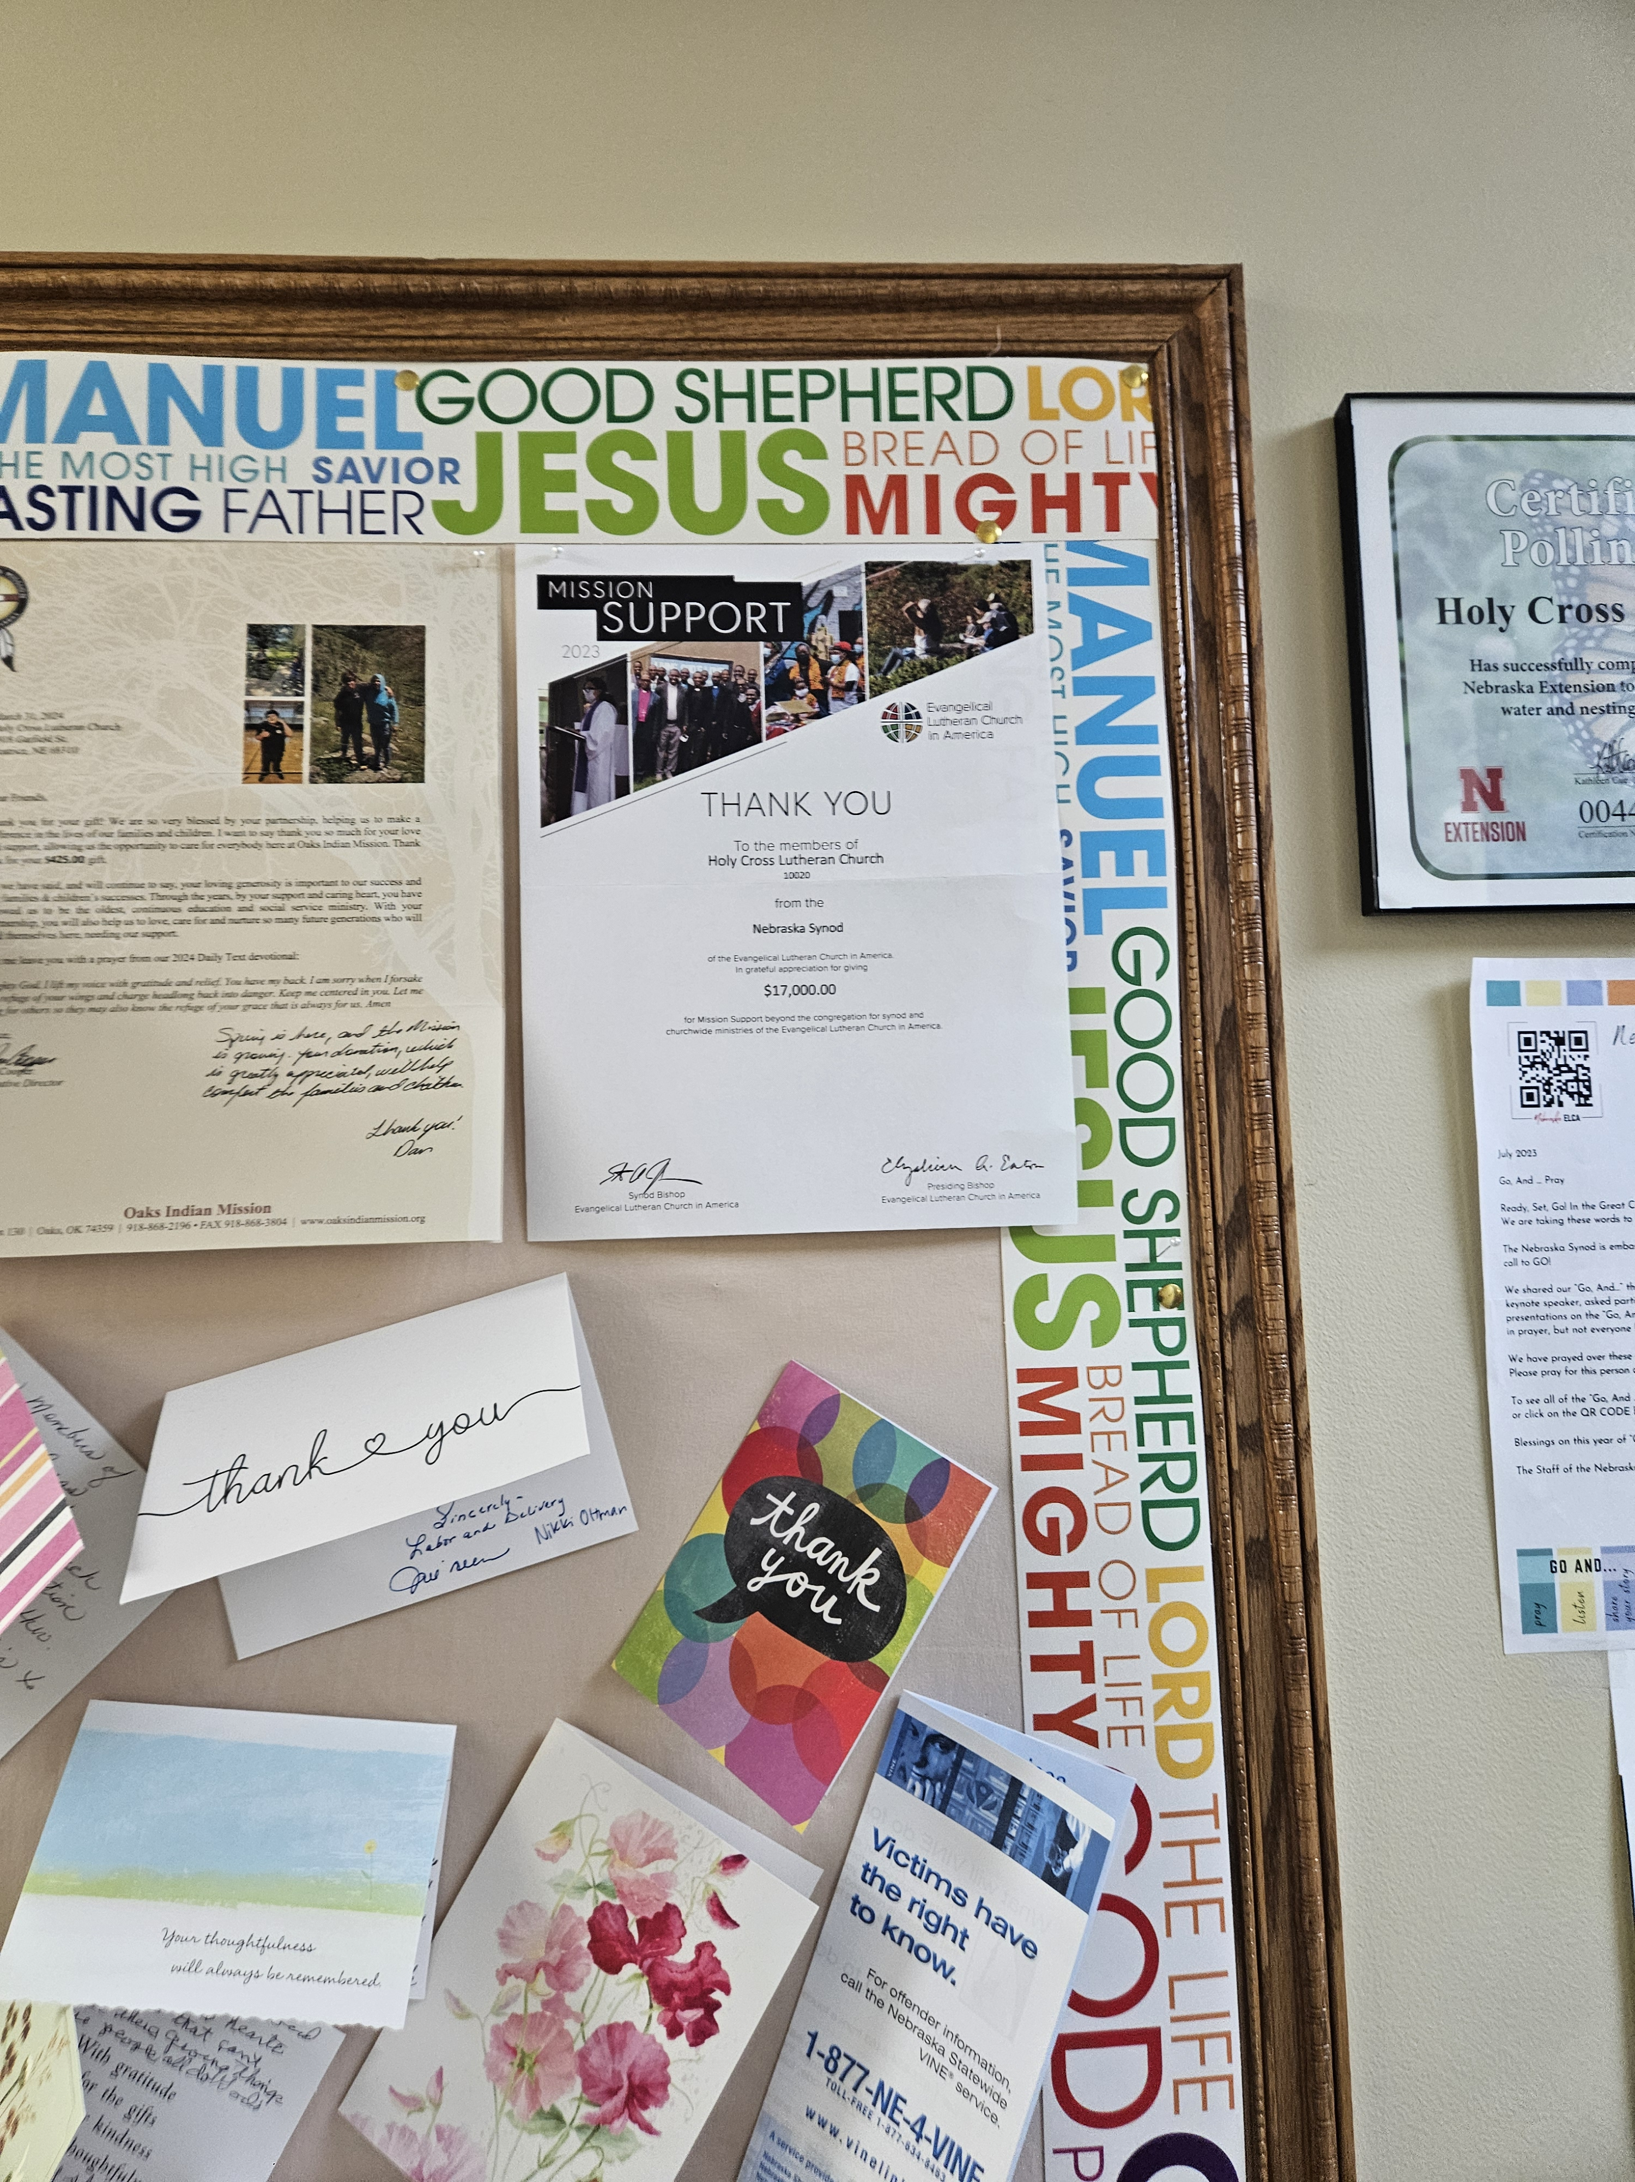
Mission Share
The story matters- because you matter!
Leaders
Youth and Young Adults
New and Renewing Ministries
Sharing the Good News
Meeting your Neighbors where they are at…
And so much more!

Slide 81
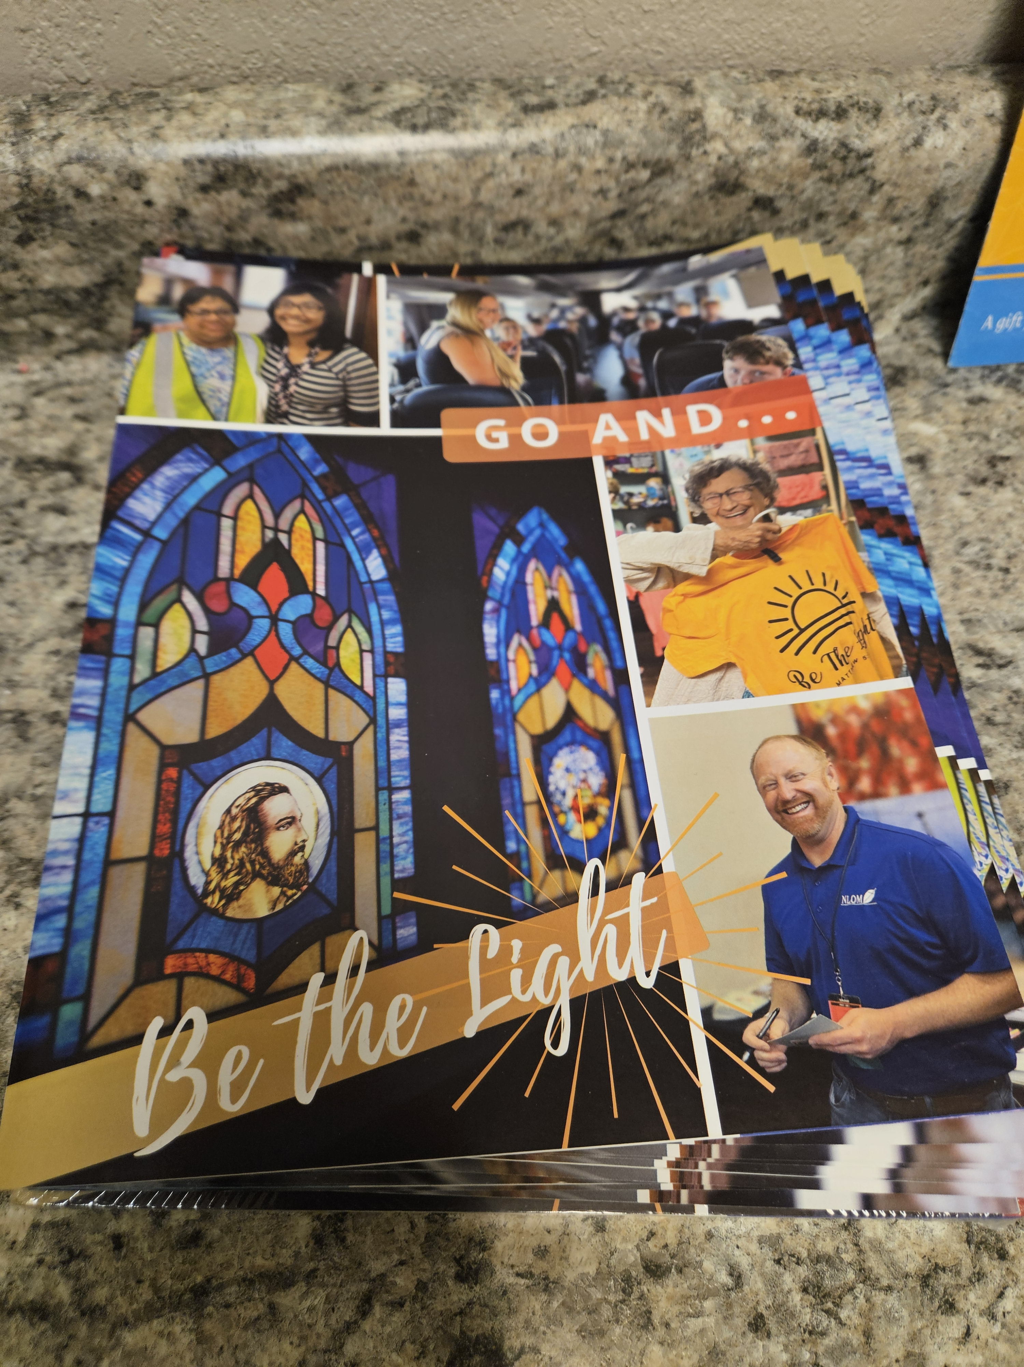
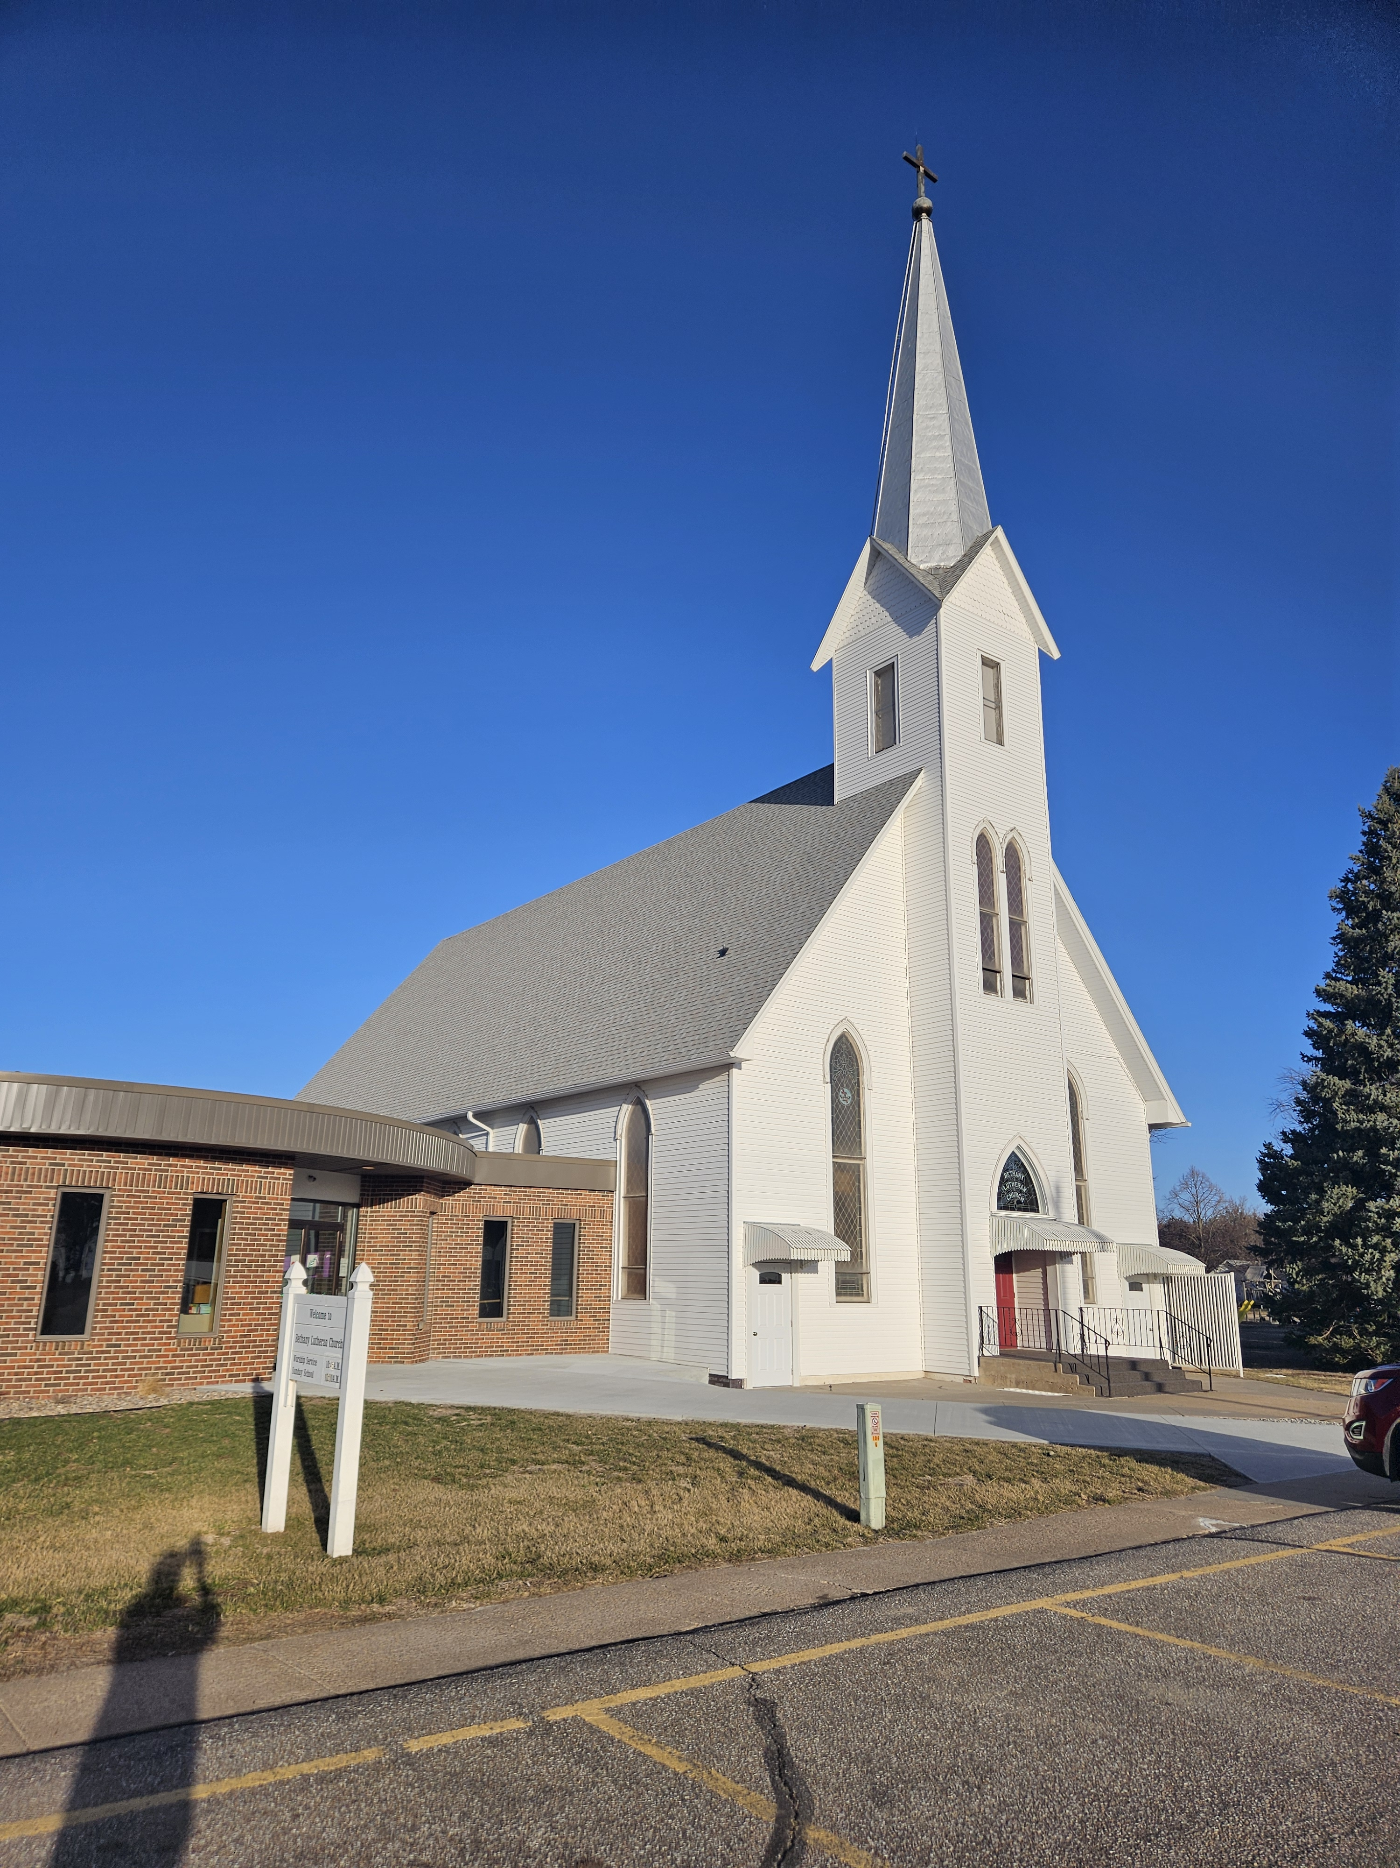
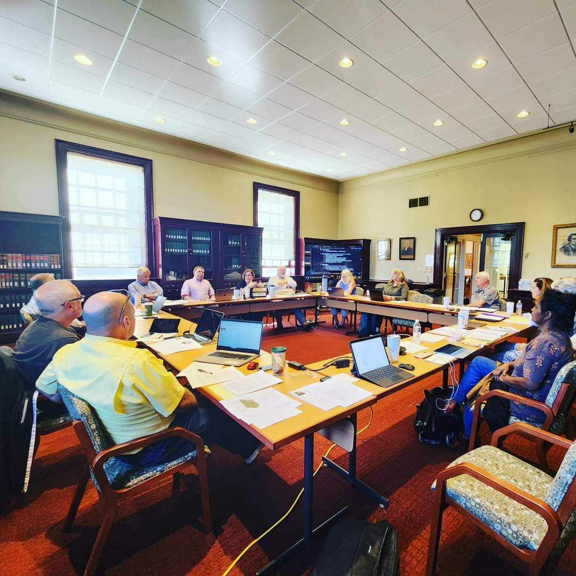
Story telling in terms of…
Inside the building
In the community
In the synod
In the country
In the world

Slide 82
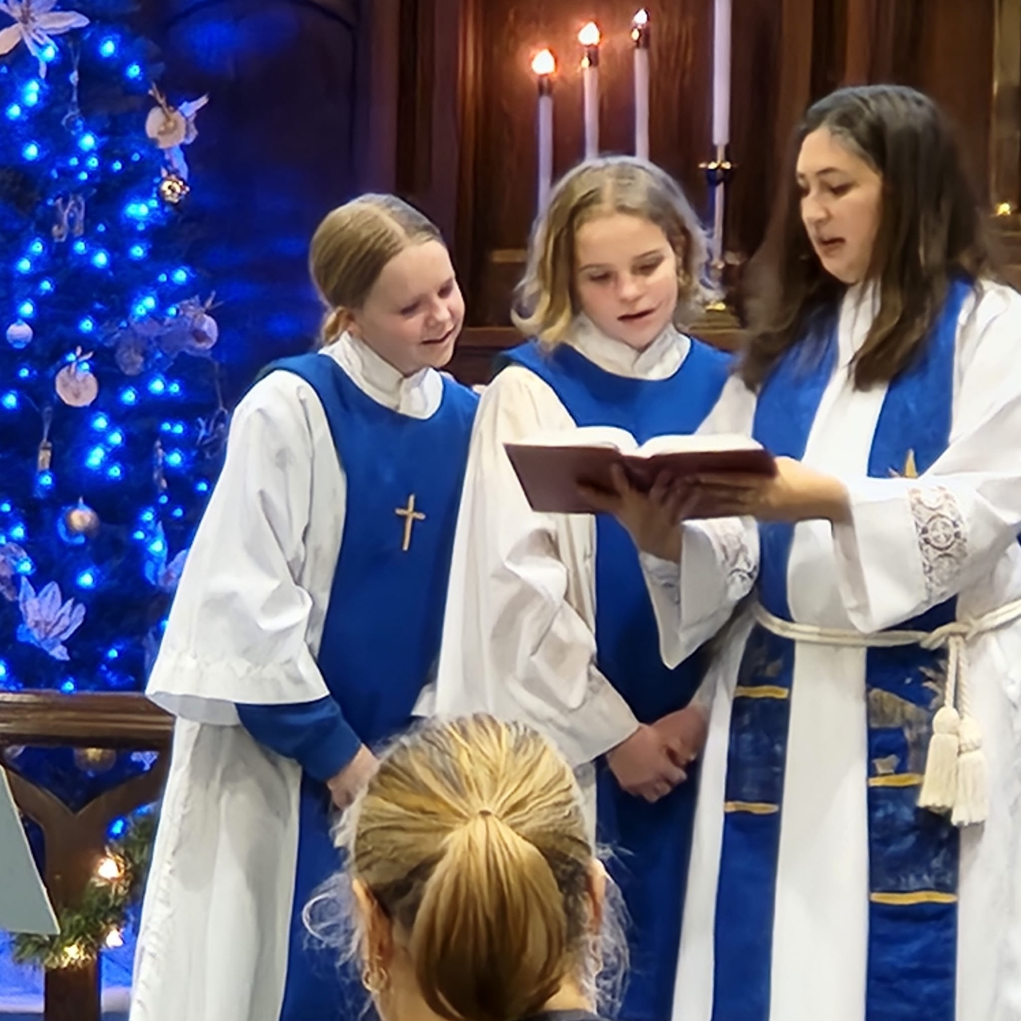
Leading Stewardship in this New Day
What’s new?
What has changed?
What are the emerging questions?
Experiments and ideas?

Slide 83
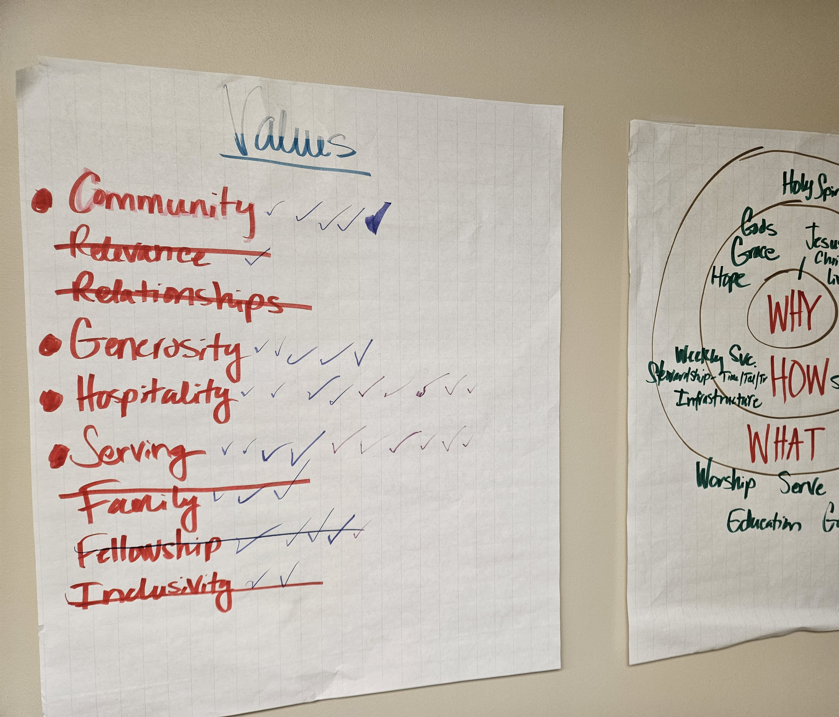
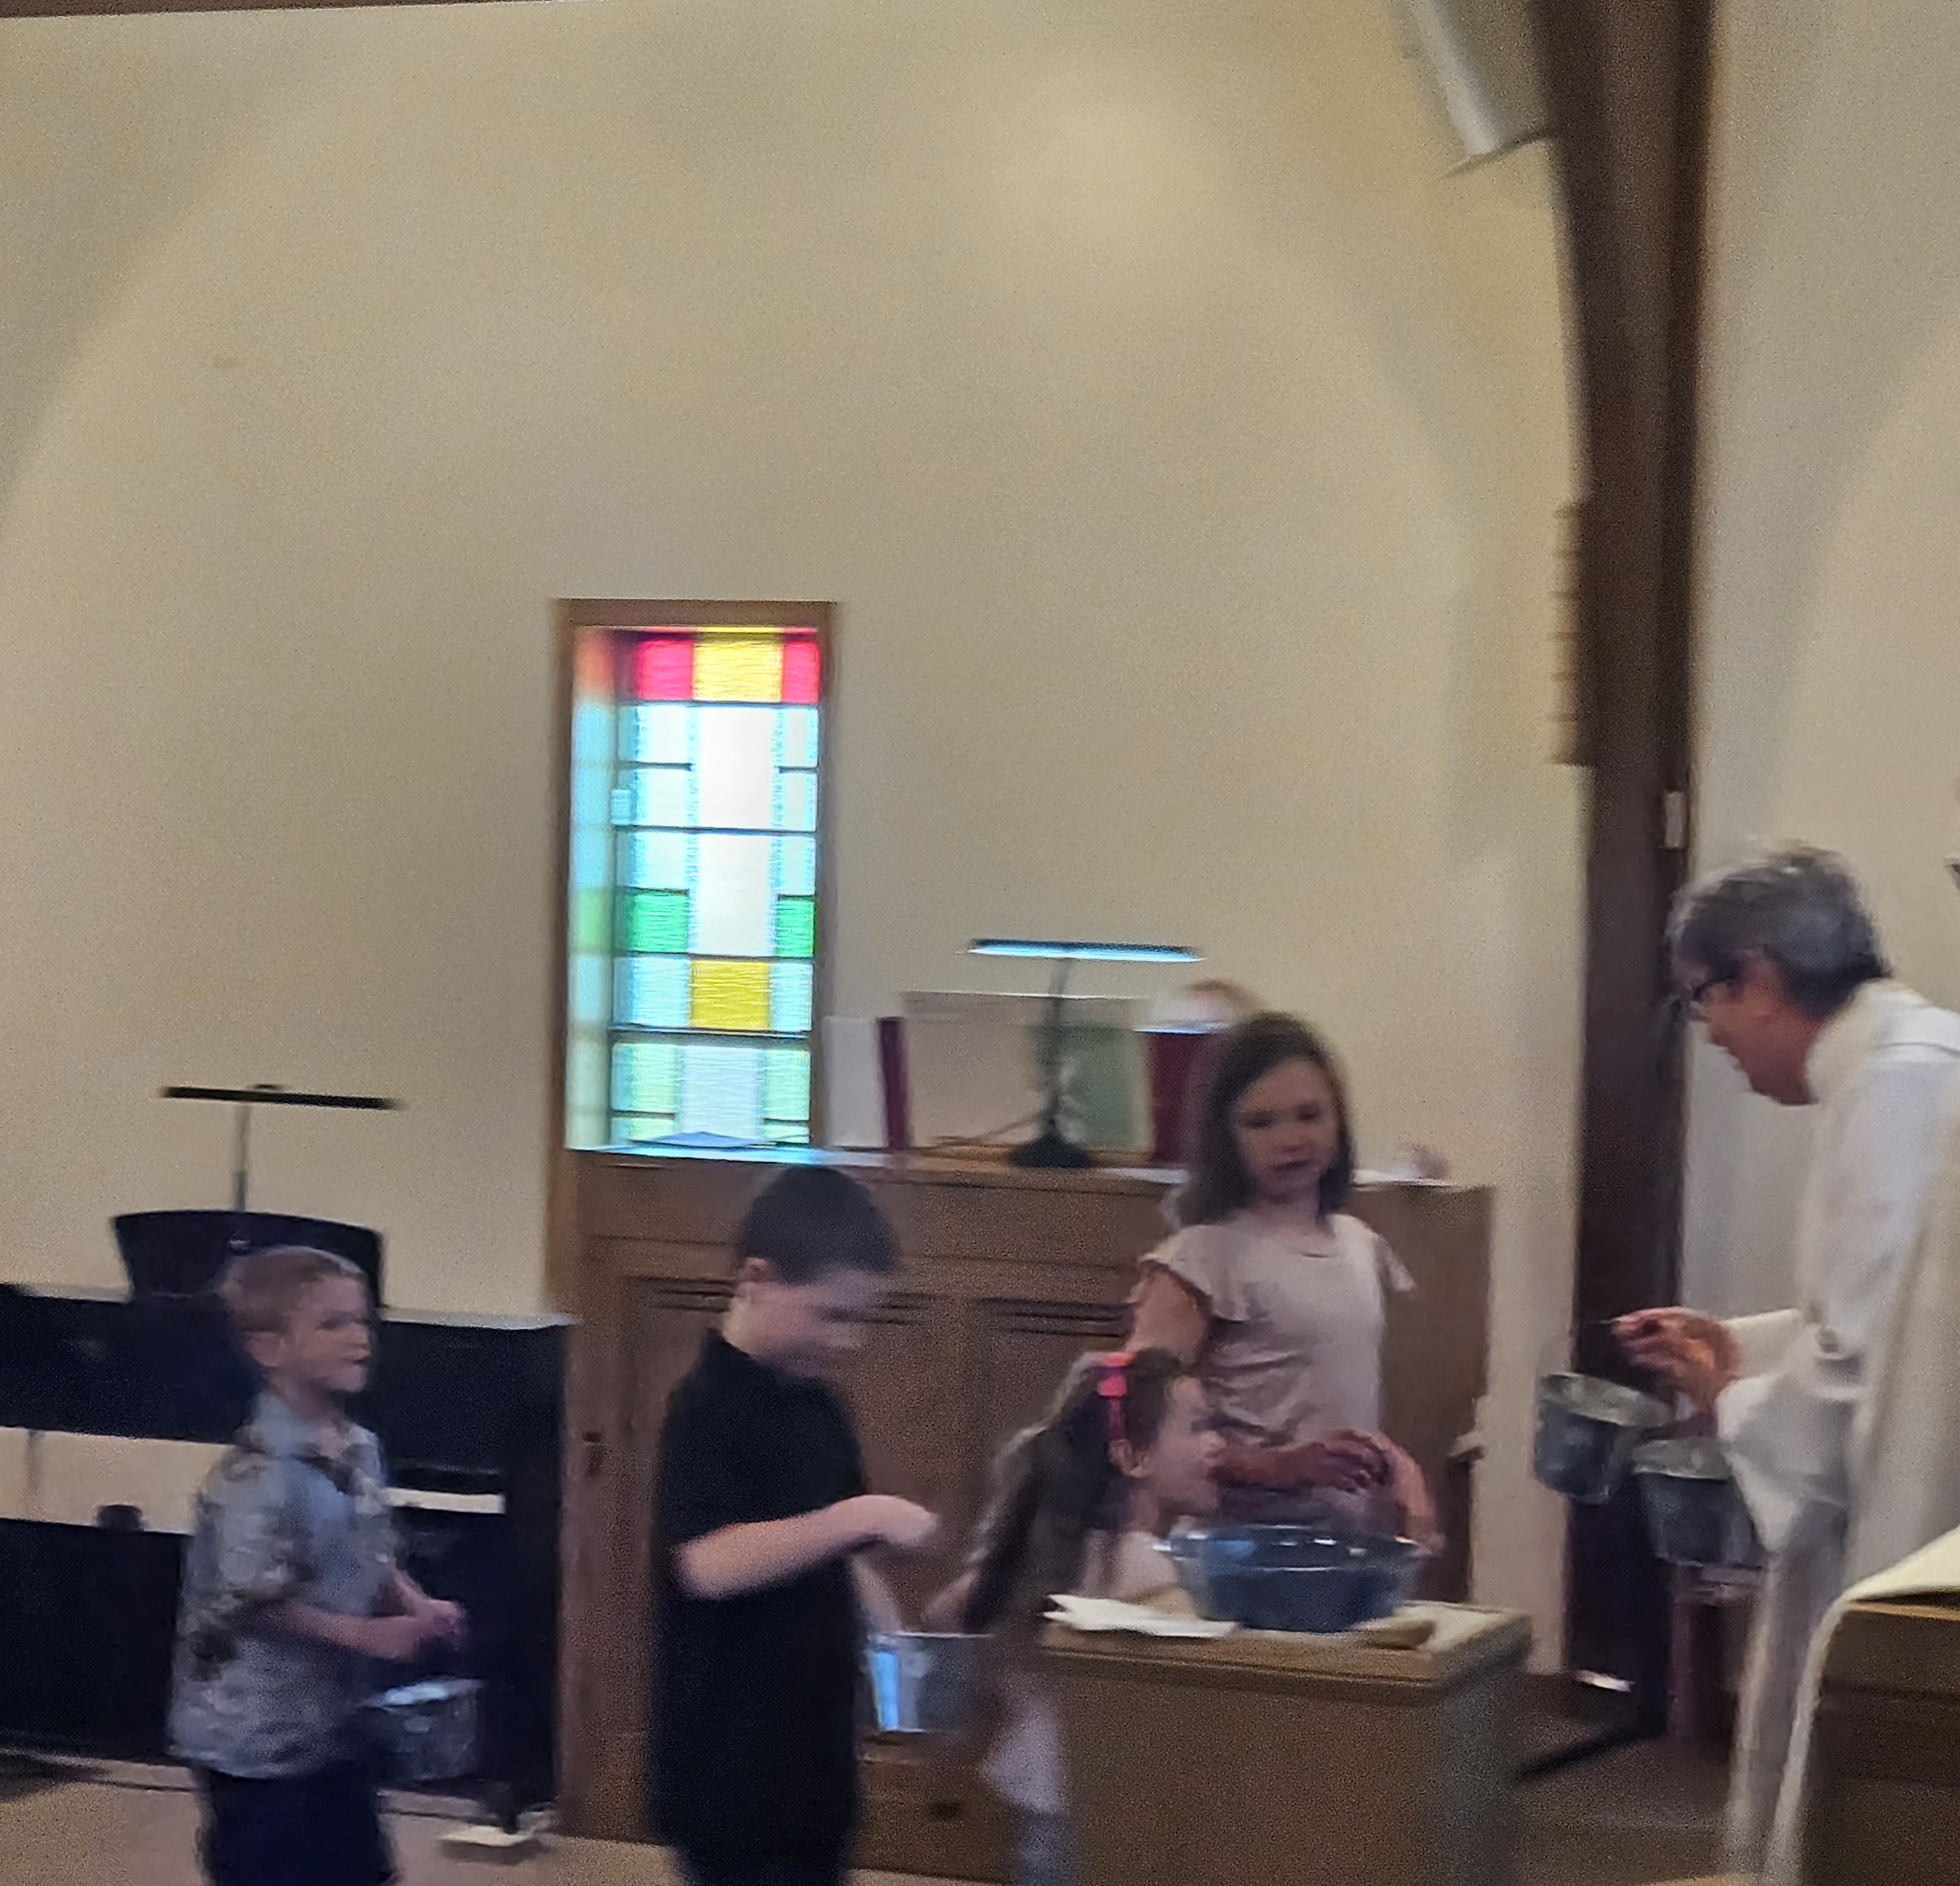
Make Responsible Decisions…
Based on realistic anticipated giving
How does your congregation go about this?
What does this look like in your context?

Slide 84
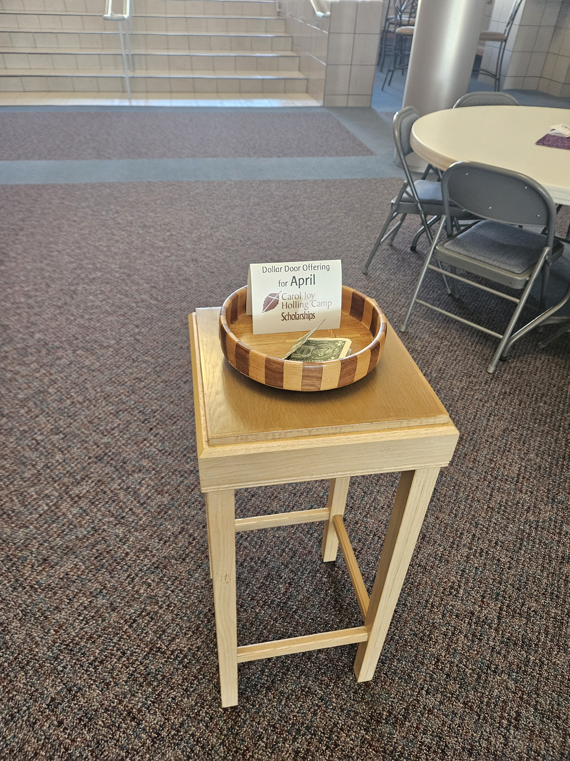
Thoughts about handling designated gifts
Things to keep mind
Observations
Questions to consider
What has your experience been?

Slide 85
Make It Easy for People to Give
as they want to give.

Slide 86


Slide 87
Make it easy for people to give
Ask the question, “Are there ways you would like to be able to give to First Lutheran Church that we are not providing?”
Observe your operations – are there places/times when cash and checks are the only options for giving?
Make changes to accommodate people’s preferences
Know that in three years you will need to make new changes

Slide 88
Two ways to give that can benefit the giver and the congregation.
Qualified Charitable Distribution
  From IRA
  Donor must be 70 ½
  Can go well with Required Minimum Distribution (73)
  Gift must go directly from financial institution to congregation
  Is not taxable income for giver
  Can be beneficial to givers who don’t itemize deductions
Gifts of appreciated stock
  Stock must be transferred to congregation’s brokerage account
  Tax deduction of appreciated value
  Giver doesn’t pay capital gains tax

Slide 89
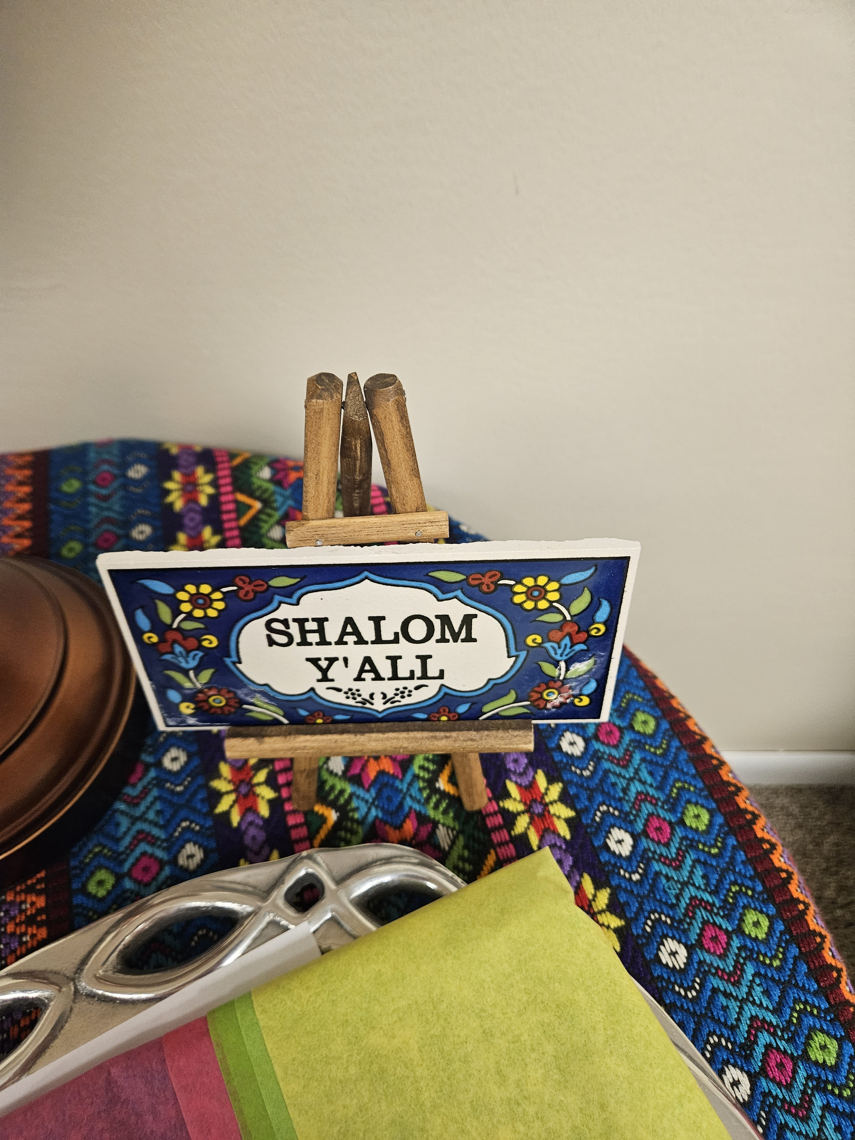
Faithfully and Creatively Invite Online Worshippers to Give…
Make it easy- QR code, link to giving page, etc.
Make it part of worship somehow and acknowledge participation and presence
Video stories
Find ways to connect in-person and online presence of the community

Slide 90
Make the Offering an
Act of Worship
even when the plate is almost empty

Slide 91
How many of you pass the plate during worship?
How is it going?
What has changed in the past 5 years?

Slide 92
The offering is an act of worship – my response to the goodness of God
My dilemma and response
What I have observed
  Awkwardness
  Unintended communication by ushers –
    “You really don’t want to have me pass this down the aisle, do you?”
    “You aren’t going to give anything, are you?”
  Problems
    If half of the worshippers aren’t in the room, how do we recognize their offering as an act of worship?
    If 90% of the worshippers who are in the room aren’t making an offering in worship, how do we recognize their offering?

Slide 93
One solution
Offering Prayer
Pastor: God of abundance, we offer these gifts to You.
All: May the gifts we give here, and the gifts we give online, further the good work of your Holy Spirit in the world.
Pastor: Bless these gifts, and guide us to use them faithfully.
All: Help us to live generous lives, trusting that in You, there is always enough. Amen.

Slide 94
What has worked for you?

Slide 95
A plea from an old guy on behalf of my peers everywhere
Count on us
and
Challenge us

Slide 96
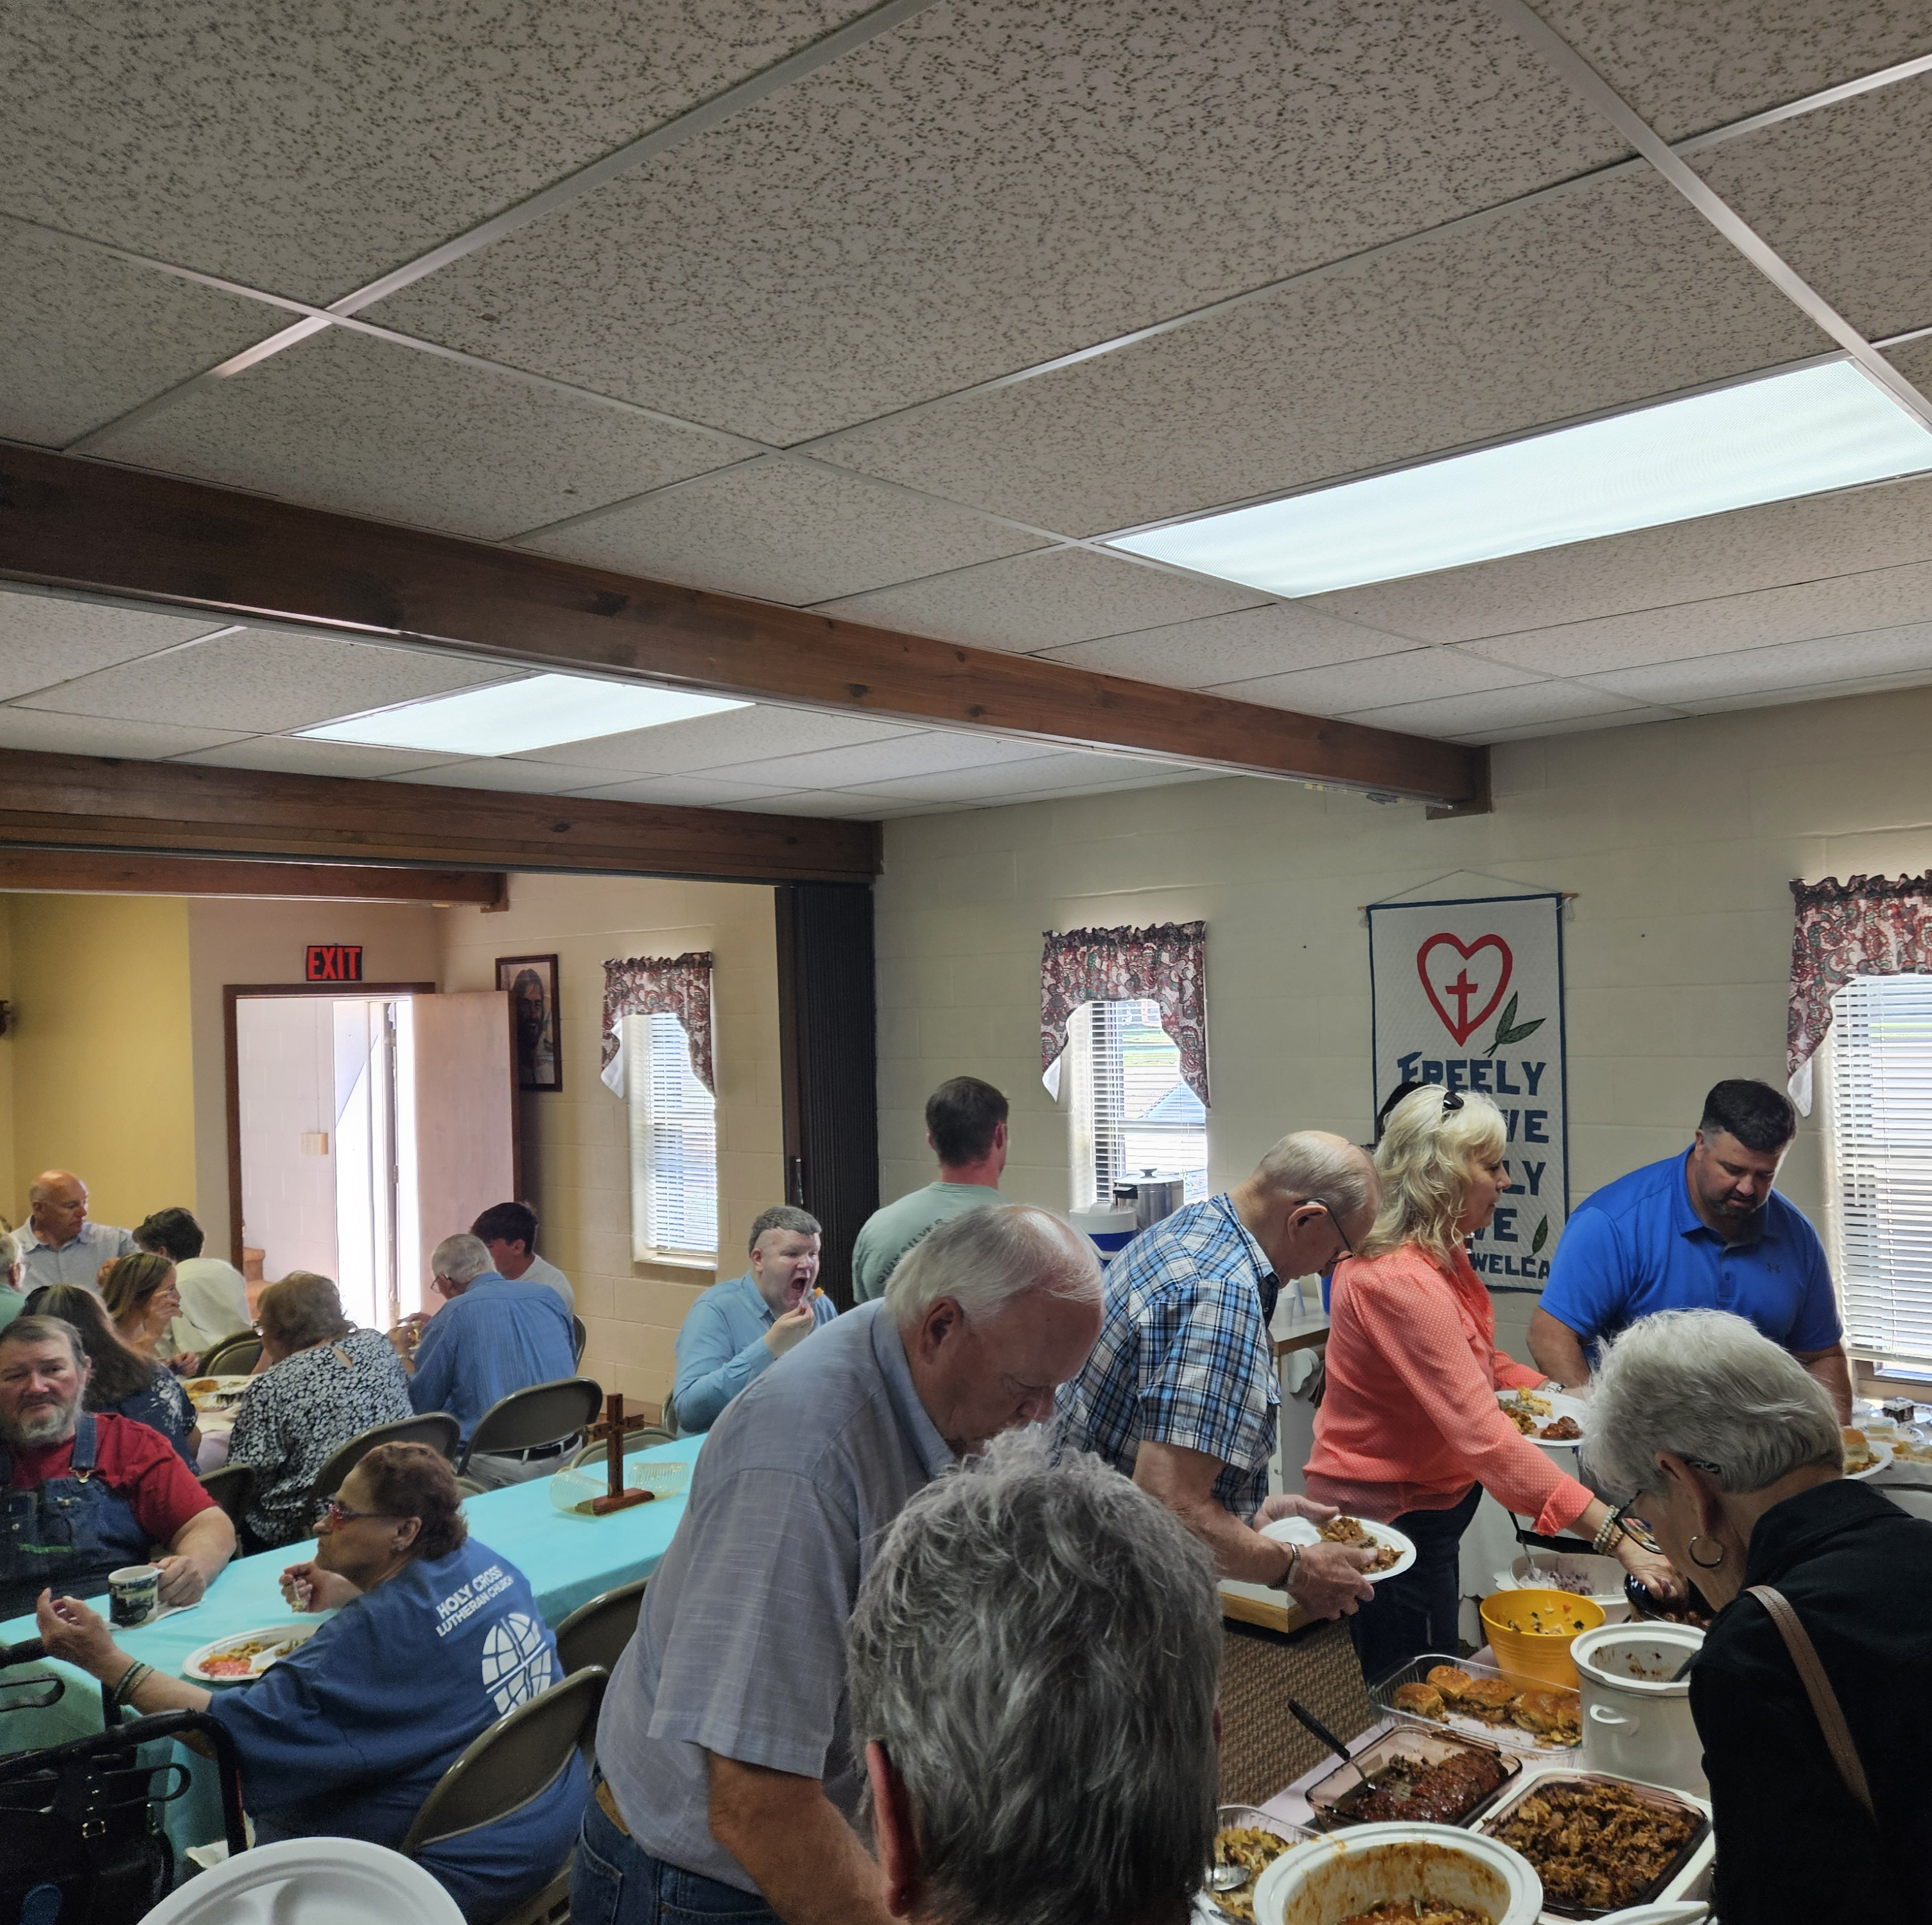
“I’ve done my part. Now it is time for someone else to take their turn.”
Is not a faithful response in the Kingdom of God!
But things have changed for me, so my participation can be different now than it was 30 years ago.

Slide 97
Time
I have more time to volunteer now than I have at any other time in my life.
I don’t need special attention. I can respond to the same invitations as everyone else.
However, if the church has something that needs doing that I might be very good at doing, ask me individually. Don’t forget, I and most of my peers have loved this church for decades. We’ll be flattered and will likely say yes.
Make good use of my time (and everyone’s time for that matter)
  Feed my Starving Children
  Sent to Serve Day

Slide 98
Talent
I think I still have talents, but I know they have changed.
When you ask me to do something, be clear what the physical requirements will be.

Slide 99
Treasure
My peers and I are all over the map regarding our financial situation (just like every other generation)
My wife and I are in a position now to be more generous in financial giving than we have been at any other time in our life
Ask me for gifts – you know me and you know my interests
“I’m living on a fixed income, you know” drives me crazy
  Isn’t most everyone?
  And really, I’m not. My pension and my social security income have increased almost every year since I retired.
  Besides, for many of my peers that income is fixed at a pretty high level

Slide 100
A plea from an old guy on behalf of my peers everywhere
Count on us
and
Challenge us

Slide 101

Other Questions on your hearts and minds?
What else are you wondering about?
What might the wisdom of the room hold?

Slide 102

Closing and Next Steps
Pick your 3-4 things or ideas from today to focus on
Name them to a partner
Write them down now
What will you focus on?
What will you try?
How will you take what you learned today and share it? Put it to use?

Slide 103
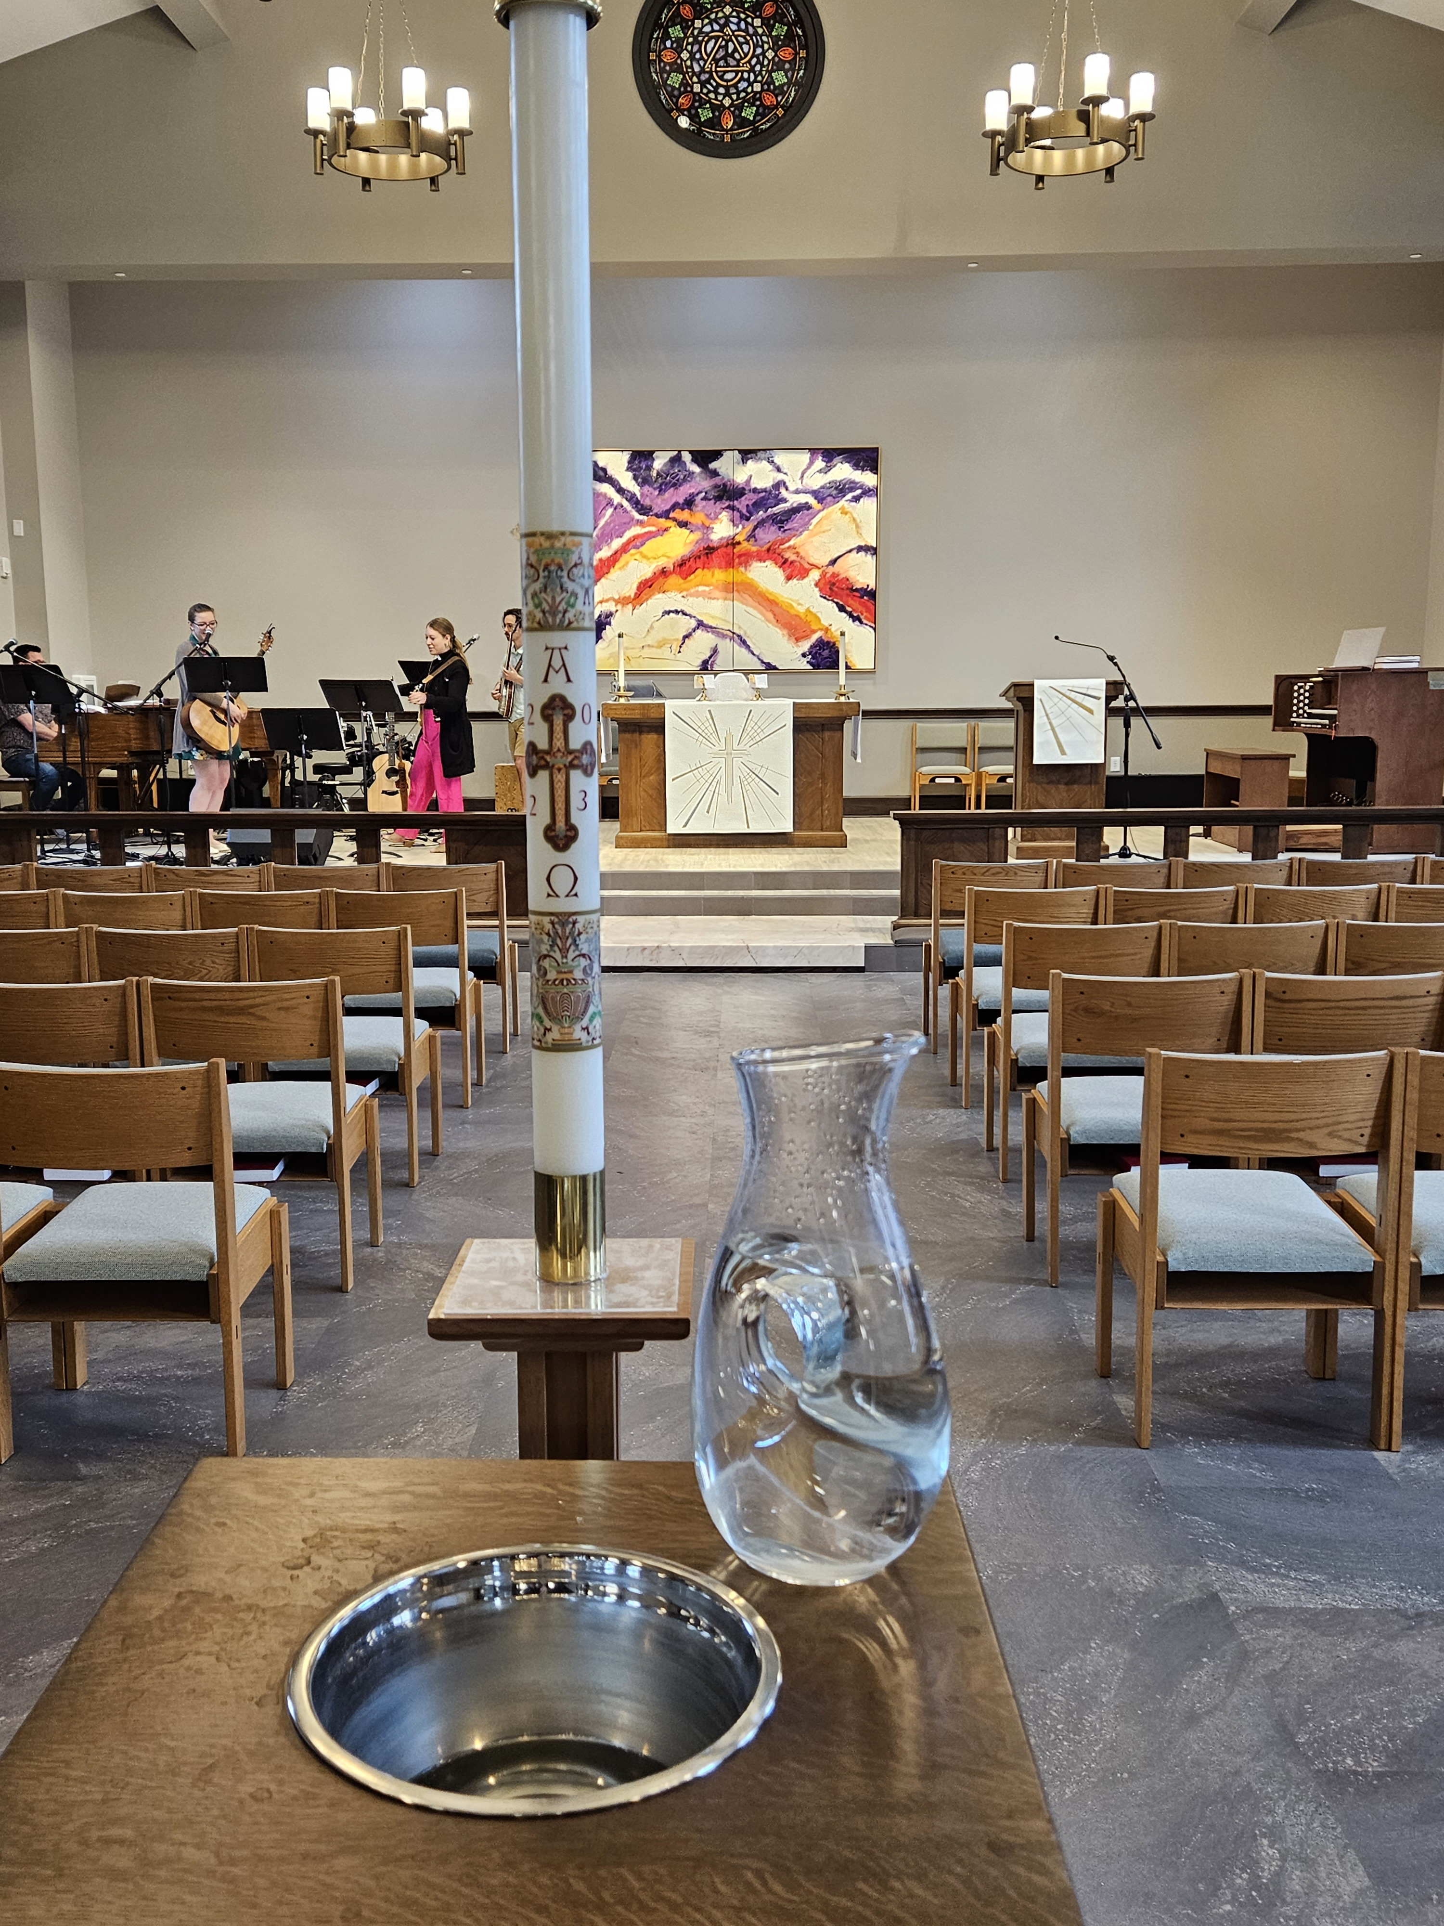
Other Resources That Might Be Helpful
Chick’s Books
Nebraska Synod Website
Stewardship Materials
Other links
This power point
Invite Sarah or Timothy to visit your congregation(s)

Slide 104
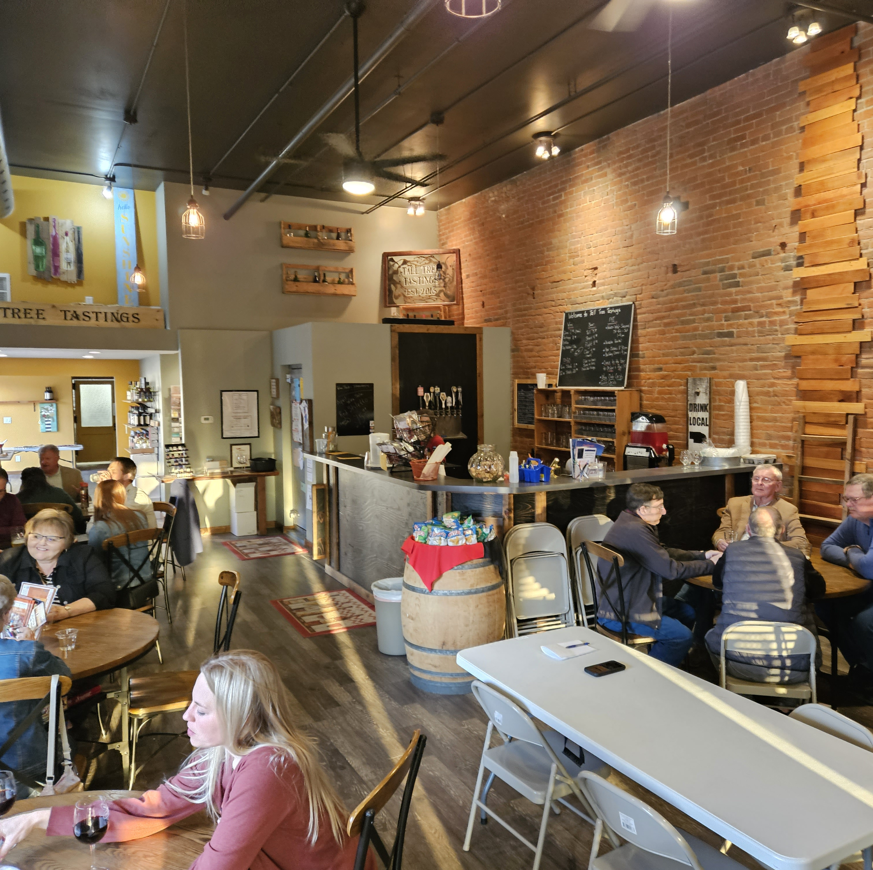
Keep the Conversation Going
Let’s keep sharing and asking the questions
For those interested, let’s Meet on Zoom this Fall!
  Check-in
  See how it’s going
  Preference for August, September, October?
  Put it on the calendar today

Slide 105
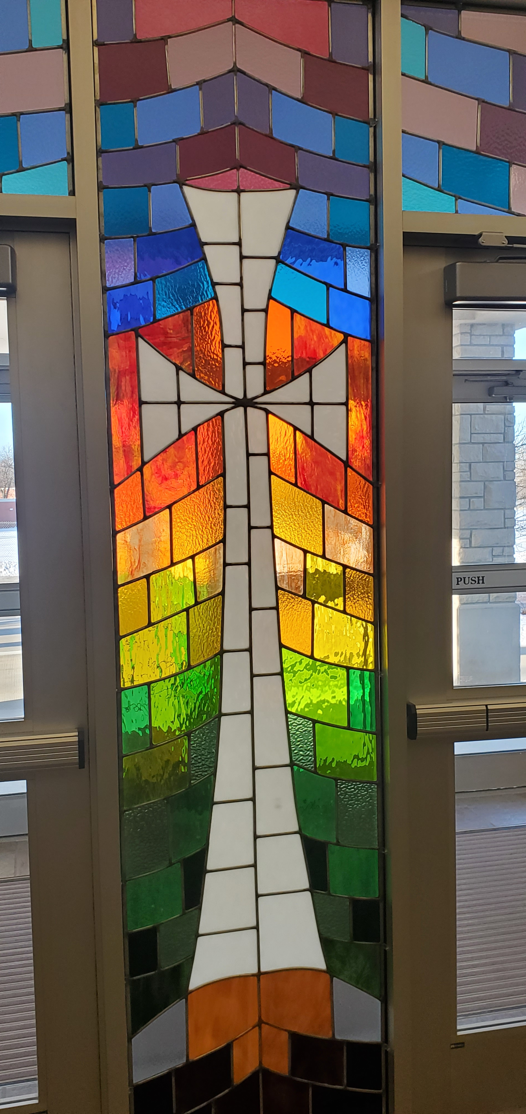
Closing Prayer
Let’s pray…

Slide 106
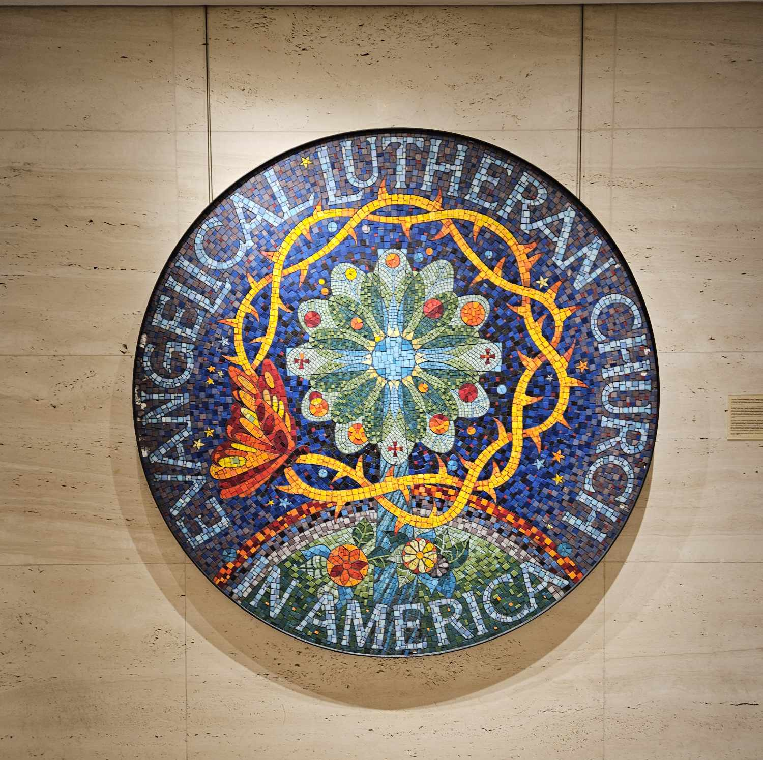
Thank You!
Thank you for being here!
Thank you for asking questions!
Thank you for being a leader in your faith community!
Thank you for all that you do as God’s people!
Thank you for being you!

Slide 107
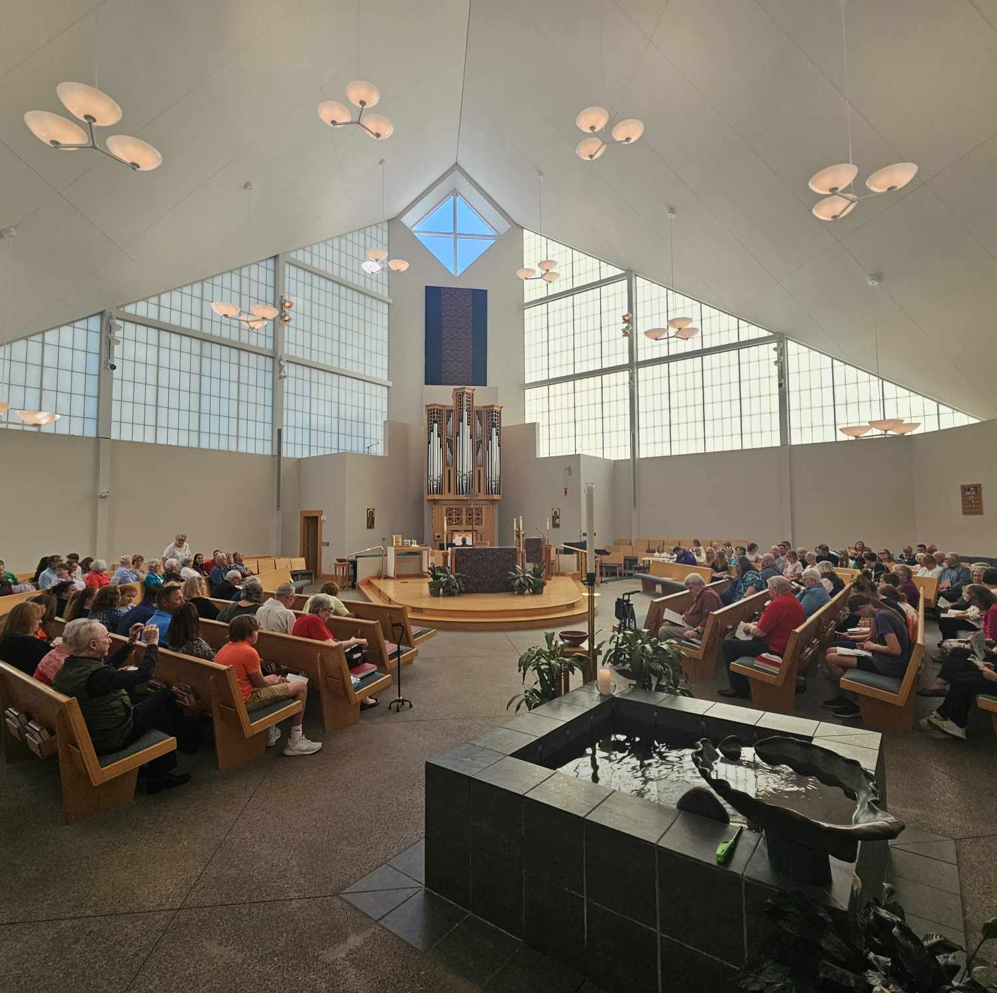
Go in peace…
Go in peace and serve the Lord!
Thanks be to God! OK! We will!

Slide 108
Through Stewardship
With Rev. Chick Lane, Sarah Callahan and Dn. Timothy Siburg
A Pre-Assembly Event
For Nebraska Synod, ELCA in Assembly
Friday May 31, 2024

